Slide 1
Cross-comparison tools for LIS, LMA, and VLF/LF Ground-based Network Data
Ken Cummins¹,
with help from:
Richard J. Blakeslee² , Lawrence D. Carey³,
Jeff C. Bailey³, Monte Bateman⁴, Steven J. Goodman⁵
¹ University of Arizona, Tucson, Arizona
² NASA Marshall Space Flight Center, Huntsville, Alabama
³ University of Alabama in Huntsville, Huntsville, Alabama
⁴ USRA, Huntsville, Alabama
⁵ NOAA NESDIS, Greenbelt, Maryland
GLM Stakeholders Workshop 2014

Slide 2
Context
Requirement
Ground-base lightning observations are needed to help create GLM proxy and ground-validation datasets over large continental and oceanic regions
Some Approaches
“bulk statistical analysis of datasets at the cell flash-rate level
Detailed stroke/pulse inter-comparisons to understand what is seen uniquely and in-common by various data sources (this work)
Issue
LLS performance for CG strokes and cloud pulses must be characterized before it can be intelligently applied
Location accuracy
Detection efficiency
Type classification (CLD/CG)
Sub-context: CHUVA LLS inter-comparisons

Slide 3
What sorts of tools?
Exploration Tools
Described in CHUVA Workshop abstract (Cummins et al.)
Similar to DLR tools
Detailed flash-level visual exploration
LIS groups
LMA sources
VLF/LF strokes and cloud pulses
Statistical LLS Inter-comparison Tools
Stroke/pulse level
Flash level
Available for community use (supported by NASA)
Fully documented

Slide 4
LLS Inter- comparison Tool
Coded in Matlab
Stand-alone executables can run on Unix, Linux, and Windows
Can specify datasets and related parameters in a “cfg” file using a text editor…

Slide 5
Tool “Outputs”
Analysis “Sheets”
Sheet 1:
Requires date, time, lat, lon, and (optionally) type (CG/CLD pulse)
Sheet 2:
Requires peak current estimates
Sheet 3:
Requires quality-related parameters
location error estimate
# sensors reporting the stroke/pulse
Spatial Detection Efficiency
Flash Analysis

Slide 6
Spatial Detection Efficiency
Observe spatial variation in DE
Combined for cloud pulses and CG strokes
Helpful for selecting LLS comparison regions
Automatic global country/coastline
Example: CHUVA TLS200cg (ref) and GLD360 (test)

Slide 7
Flash Analysis Overview
Definition of flash DE
This is complicated by the fact that LLS’s frequently disagree about the discharge type (cloud vs. CG)
Test_{CG}FmatchRef_{CLD}
Reference_{CLD}
Test_{CLD}FmatchRef_{CLD}
Test_{CG}
Test_{CG}FmatchRef_{CG}
Test_{CLD}
Test_{CLD}FmatchRef_{CG}
Reference_{CG}
Examples:
DE_TestCGF = 100.*(Test_{CG}FmatchRef_{CG} + Test_{CLD}FmatchRef_{CG}) /(Ref_{CG}F);
DE_TestAll = 100.*allMatchTest/(Ref_{CG}F+Ref_{CLD}F);
Details

Slide 8
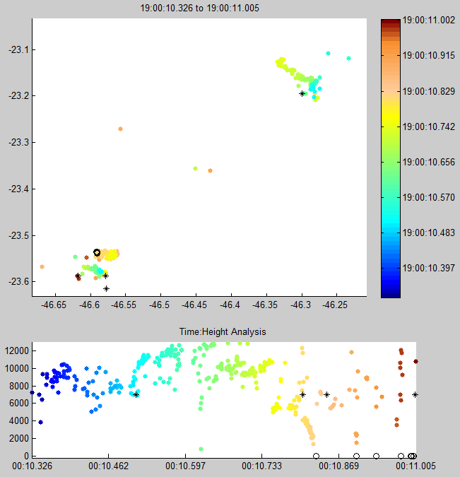
Additional Flash Analysis: where (in time) are the LLS cloud pulses detected?
The Flash Analysis includes a temporal analysis for each network
Are they part of a cloud flash?
Are they part of a CG flash?
What part of a CG flash?
Cloud flash
CG flash
“during”
“cld”
“pre”
Back

Slide 9
Flash – CHUVA LINET vs. GLD360

Slide 10
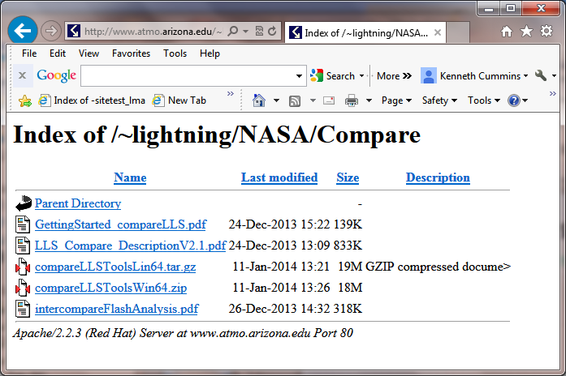
How to get the stuff…
http://Atmo.Arizona.edu/~lightning/NASA/Compare/

Slide 11
Example Use: LIS-referenced DE
Simple question: When LIS saw something, did others see it?
METHOD:
Selected a “common” (small) region and time period
Region determined by LINET
Time period limit defined by TLS200
January 1 through March 27, 2012
Note: LINET is compromised during these times
Total Groups/Flashes were ~2900/300 in 13 overpasses
Use tools to compute group-referenced and Flash-referenced DE
Produce flashes from LIS Groups and LLS “events”
Multiple IPI/Distance Criteria for flash grouping: (200 ms/20 km; 500 ms/30 km; 500 ms /50 km for some long-range networks)

Slide 12
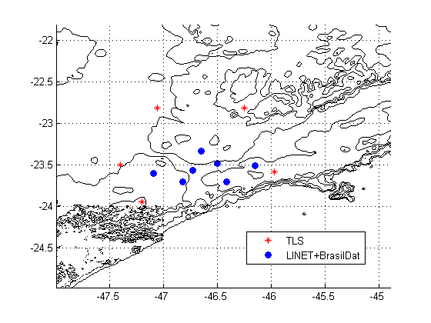
Selection of the Analysis Domain
Smaller domain would not have enough LIS flashes ( < 300)
The domain is quite large for LINET
confirmed that the LINET pulse/stroke DE, relative to TLS-LF-all, was not compromised over this domain

Slide 13
Sheet 1 – LIS Groups vs. GLD360

Slide 14
Flash Summary Statistics
Flash Grouping (IPI/Dist) | LLS Network | Relative Group DE | Relative Flash DE | Mean Groups/fl | Mean Mult. (G/C) | Nominal Sensor Baseline in test region
200/20 | LINET | 32.0 | 61 | 8.4 | 3.3/3.2 | 22-45 km
200/20 | TLS-LF “all” | 23 | 56 | 8.4 | 2.9/2.5 | 55-125 km
200/20 | BrasilDat | 15 | 45 | 8.4 | 1.8/3.3 | ~100 km
200/20 | GLD360 | 5 | 17 | 8.4 | 2.4/0.0 | >big
200/20 | TLS-LF CG | 6 | 13 | 8.4 | 3.3/0.0 | 55-125 km
200/20 | StarNet | 2 | 8 | 8.4 | 1.6/0.0 | >big
200/20 | WWLLN | 1 | 2 | 8.4 | 1.7/0.0 | >big
(estimated uncertainty of about +/-2%)
500/30 | LINET | 32 | 67 | 9.2 | 3.5/3.4 | 22-45 km
500/30 | TLS-LF “all” | 23 | 67 | 9.2 | 3.0/2.8 | 55-125 km
500/30 | BrasilDat | 15 | 53 | 9.2 | 1.8/3.6 | ~100 km
500/30 | GLD360 | 5 | 24 | 9.2 | 2.8/0.0 | >big
500/30 | TLS-LF CG | 6 | 19 | 9.2 | 3.5/0.0 | 55-125 km
500/50 | StarNet | 2 | 14 | 10.3 | 2.0/0.0 | >big
500/50 | WWLLN | 1 | 5 | 10.4 | 2.0/0.0 | >big

Slide 15
Comments from data contributors
WWLLN
The small domain and small number of flashes result in uncertainty in the WWLLN findings. Analysis over a larger domain should be done
LINET
During much of this time, only 5 of the 7 sensors were operational.
Leap-second issue with LIS data?
BrasilDat
Typically, only 1-2 of the 7 “special” sites were operational, and the network was just being calibrated. The network is now working much better than it was during the CHUVA campaign. ( the ~100 km baseline in the previous slide reflected the “functional” baseline during this study)

Slide 16
Summary / Comments
LLS Relative Performance vs. LIS Total Lightning
Wide variation in TL flash DE (few percent => ~70%)
Short-baseline VLF/LF networks CAN detect a majority of TL flashes (but do not represent the spatial extent of big flashes)
Note: Hartmut indicates that for days with all LINET sensors working, they would detect almost all LIS flashes that were within the network, as well as some flashes not reported by LIS
Some long-range LF networks MIGHT be sufficiently good to allow statistical up-scaling of the data for mid-oceanic LIS proxy and validation activities

Slide 17
End of talk…
Thanks!

Slide 18
Sheet 1 – two networks in Japan
Next

Slide 19
Sheet 1 – GLD360 vs. NALDN
Back

Slide 20
Sheet 2 – two networks in Japan
Next

Slide 21
Sheet 2 – GLD360 vs. NALDN
Back

Slide 22
Sheet 3 – two networks in Japan
Next

Slide 23
Sheet 3 – GLD360 vs. NALDN
Back

Slide 24
Flash Analysis Overview
Flash Grouping (within an individual LLS dataset)
New flash is initiated if there are no “active” flashes within the max inter-pulse interval (IPI) and within the max separation distance (typically 200 mS and10 km for “accurate” LLS’s)
If there is a match with more than one active flash, then the new pulse is added to the flash with the spatially-closest pulse
A flash is “closed” if the time between the most-recent pulse and the first pulse in the flash is greater then the max flash duration (typically 1 second)
Next

Slide 25
Flash Analysis Overview
Flash / Pulse “Typing”
Pulses within a CG flash are categorized as one of three types:
“pre” cloud: likely preliminary breakdown or leader pulse
“during” cloud: k-changes etc.
“CG” stroke: we think we knew what this is…
Any flash containing a CG stroke is a CG flash
A flash is detected in-common by two LLS’s if:
Any pulse in the flash is matched using the tight requirements employed by the Inter-comparison Tool
Any “unmatched” pulses in the flash meet the max IPI/Distance requirements when compared to any pulse from the other LLS
Next

Slide 26
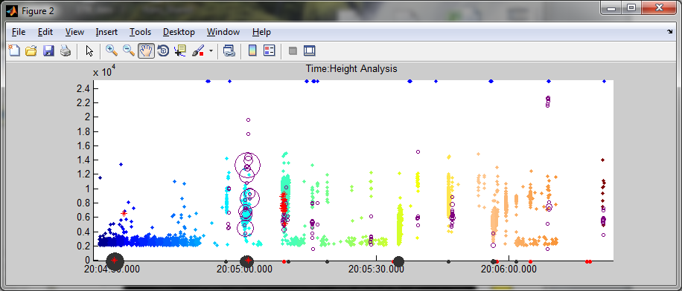
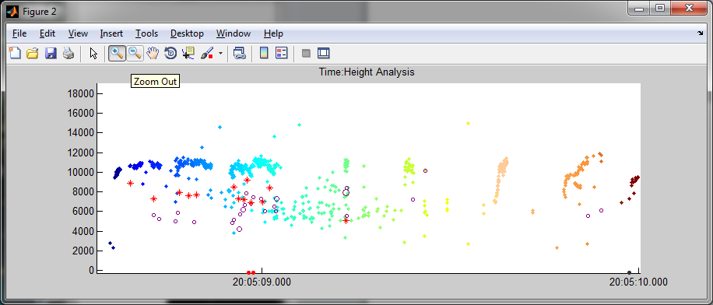
Time-height Analysis of LIS, LMA, and LINET
Back

