Slide 1
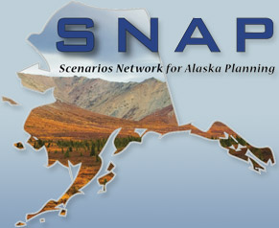
Hydrology, Hydropower, and Remote Sensing in Alaska
Jessica Cherry, Katrina Bennett, and Molly Tedesche
High Latitude Proving Ground

Slide 2
Outline
Motivation: Communities and Physical Infrastructure
High Latitude Proving Ground Snow Hydrology related activities
Other Tools in our Toolbox/Ongoing activities related to imagery-based hydrology

Slide 3
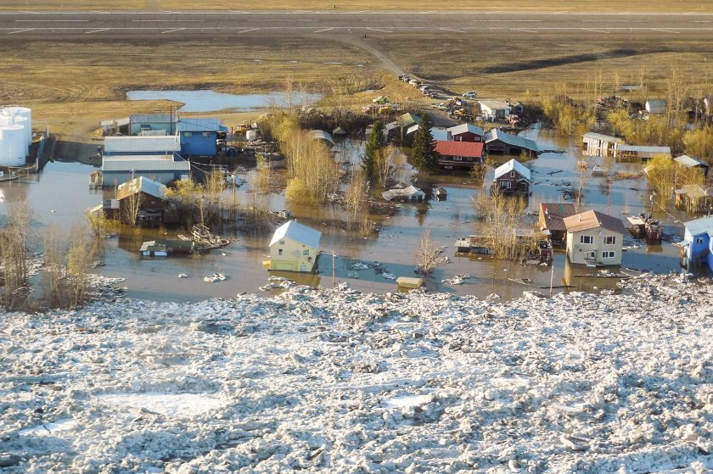
Another Flood Season in AK
NWS photo

Slide 4
Susitna Proposal
2.6 million megawatt hours/year
39 mile long reservoir
$5 billion

Slide 5
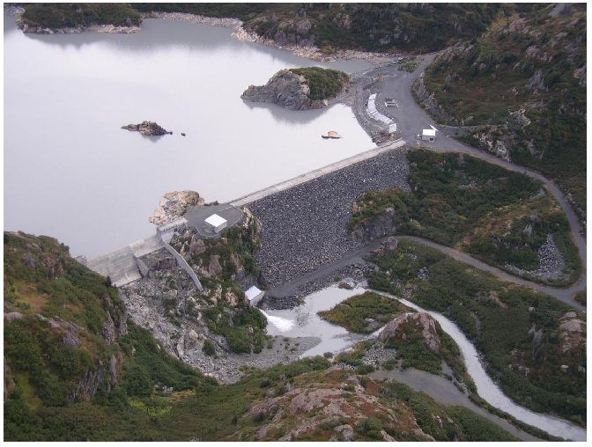
Bradley Lake: Railbelt Power

Slide 6
Bradley Lake
Two unit 45 MW plant
Notes:
Transmission goes all the way to the interior, Fairbanks gets 17% of it’s power from this hydro facility.

Slide 7
Notes:
Intertie was completed in November entirely using medium and heavy lift helicopters.

Slide 8
Snotel Network in AK

Slide 9
High Latitude Proving Ground Snow Products: collaboration with AK River Forecast Center

Slide 10
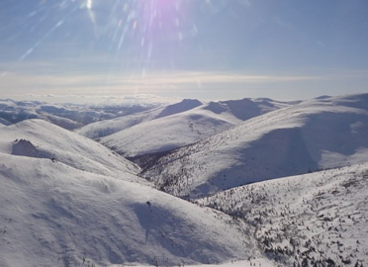
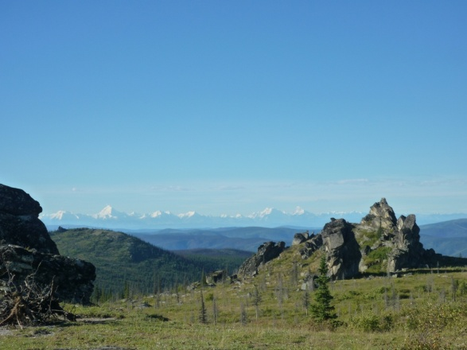

Slide 11
SNOW-17/ SAC-SMA
SNOW-17, snow air temperature index model
SACramento Soil Moisture Accounting model, conceptual water balance model and a frozen ground iteration (Dec 2010), run in lumped mode
Anderson, 2006
MODIS
Burnash et al. 1973

Slide 13
Field Work Spring Snowmelt 2013
MODIS needs to be verified at the broad scale for quantification of error in snow cover extent through the melt season
For example, an important question is how does the MODIS data perform in boreal forested regions in comparison to open vegetated sites?
These questions can not be addressed without a detailed field campaign

Slide 14
Field Work Spring Snowmelt 2013
Capture melt using different types of remote sensors
Fish eye approach
Time-lapse photos
Airborne low level RGB photography (Navion L17, 4 person fixed-wing, 1500 feet AGL)
Manual sampling through sites in the basin
Aim to capture a range of forested, tundra and shrub sites for validation of MODIS snow cover extent and melt
MODIS pixel
SNOTEL site

Slide 15
CPCRW Snow Surveys

Slide 16
New Collaboration: NOHRSC
Goals: making more snow and other hydrology products available in Alaska on operational time scales
Short term: frequent telecons
Experimental model evaluation by UAF grad students
Get MODSCAG (GOES-R SCA) product flowing to Alaska
Long term: expand airborne observation program
Test and evaluate physically based hydrology models
Utilize and improve data assimilation
Using NASA LIS and SNODAS in Alaska

Slide 17
Other tools in our Toolbox

Slide 18
In Situ Station Networks

Slide 19
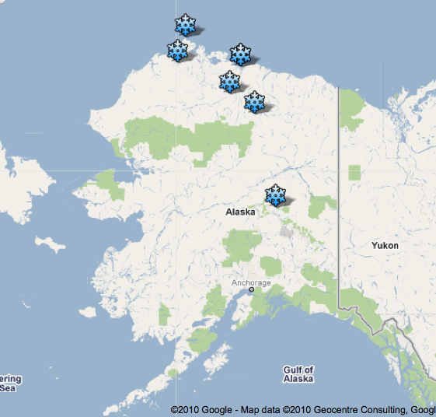
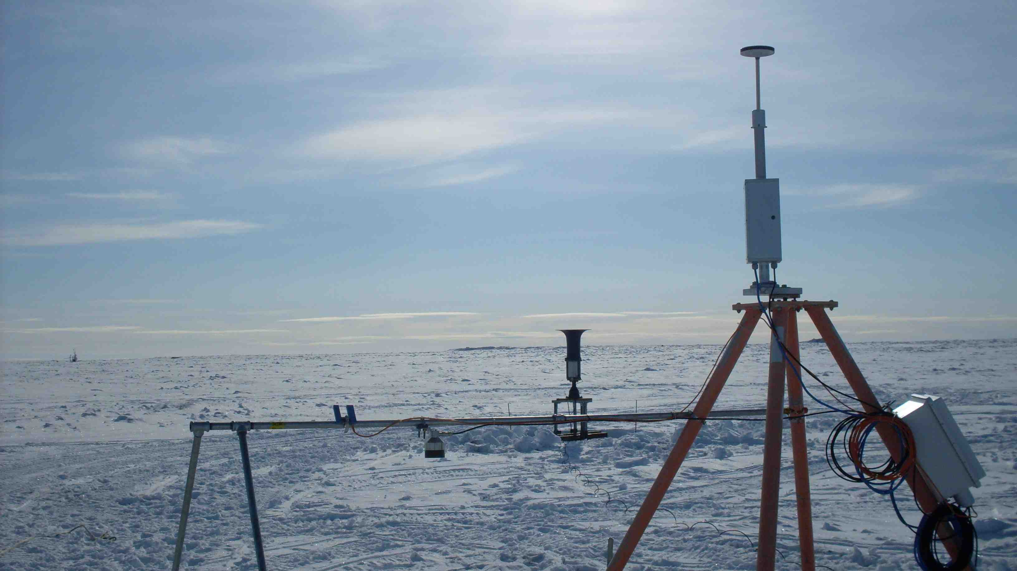
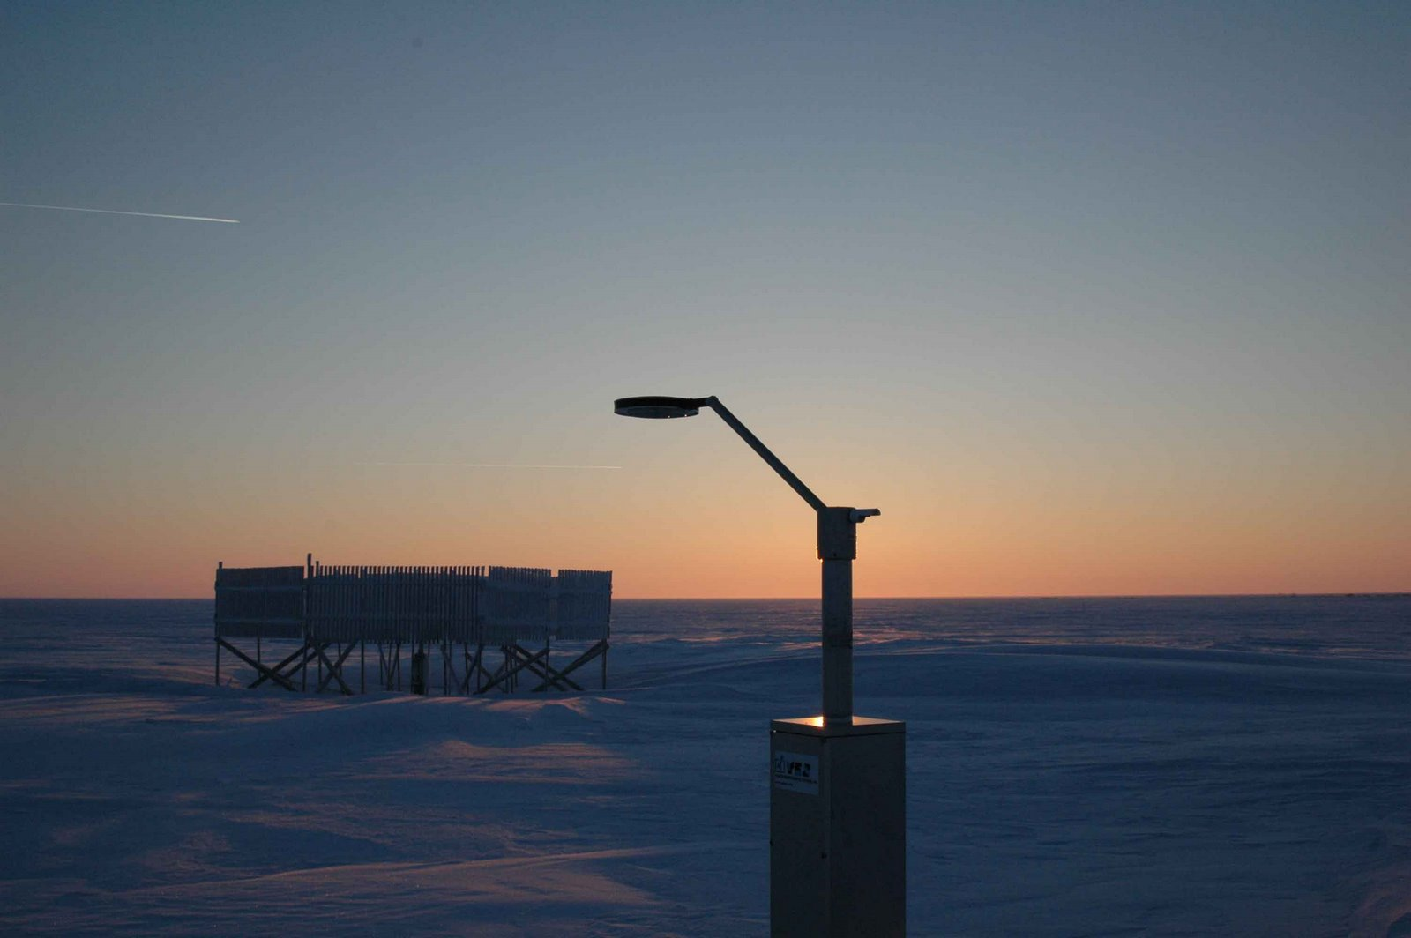
Arctic Transportation Networks: improved monitoring and prediction of blowing snow
Bar
ATQASUK
Atq
Olik
Umt
Tlk
Fox
= deploying in summer 2013
BARROW
Used for in situ studies and validation of models
WRF model
J. Cherry

Slide 20
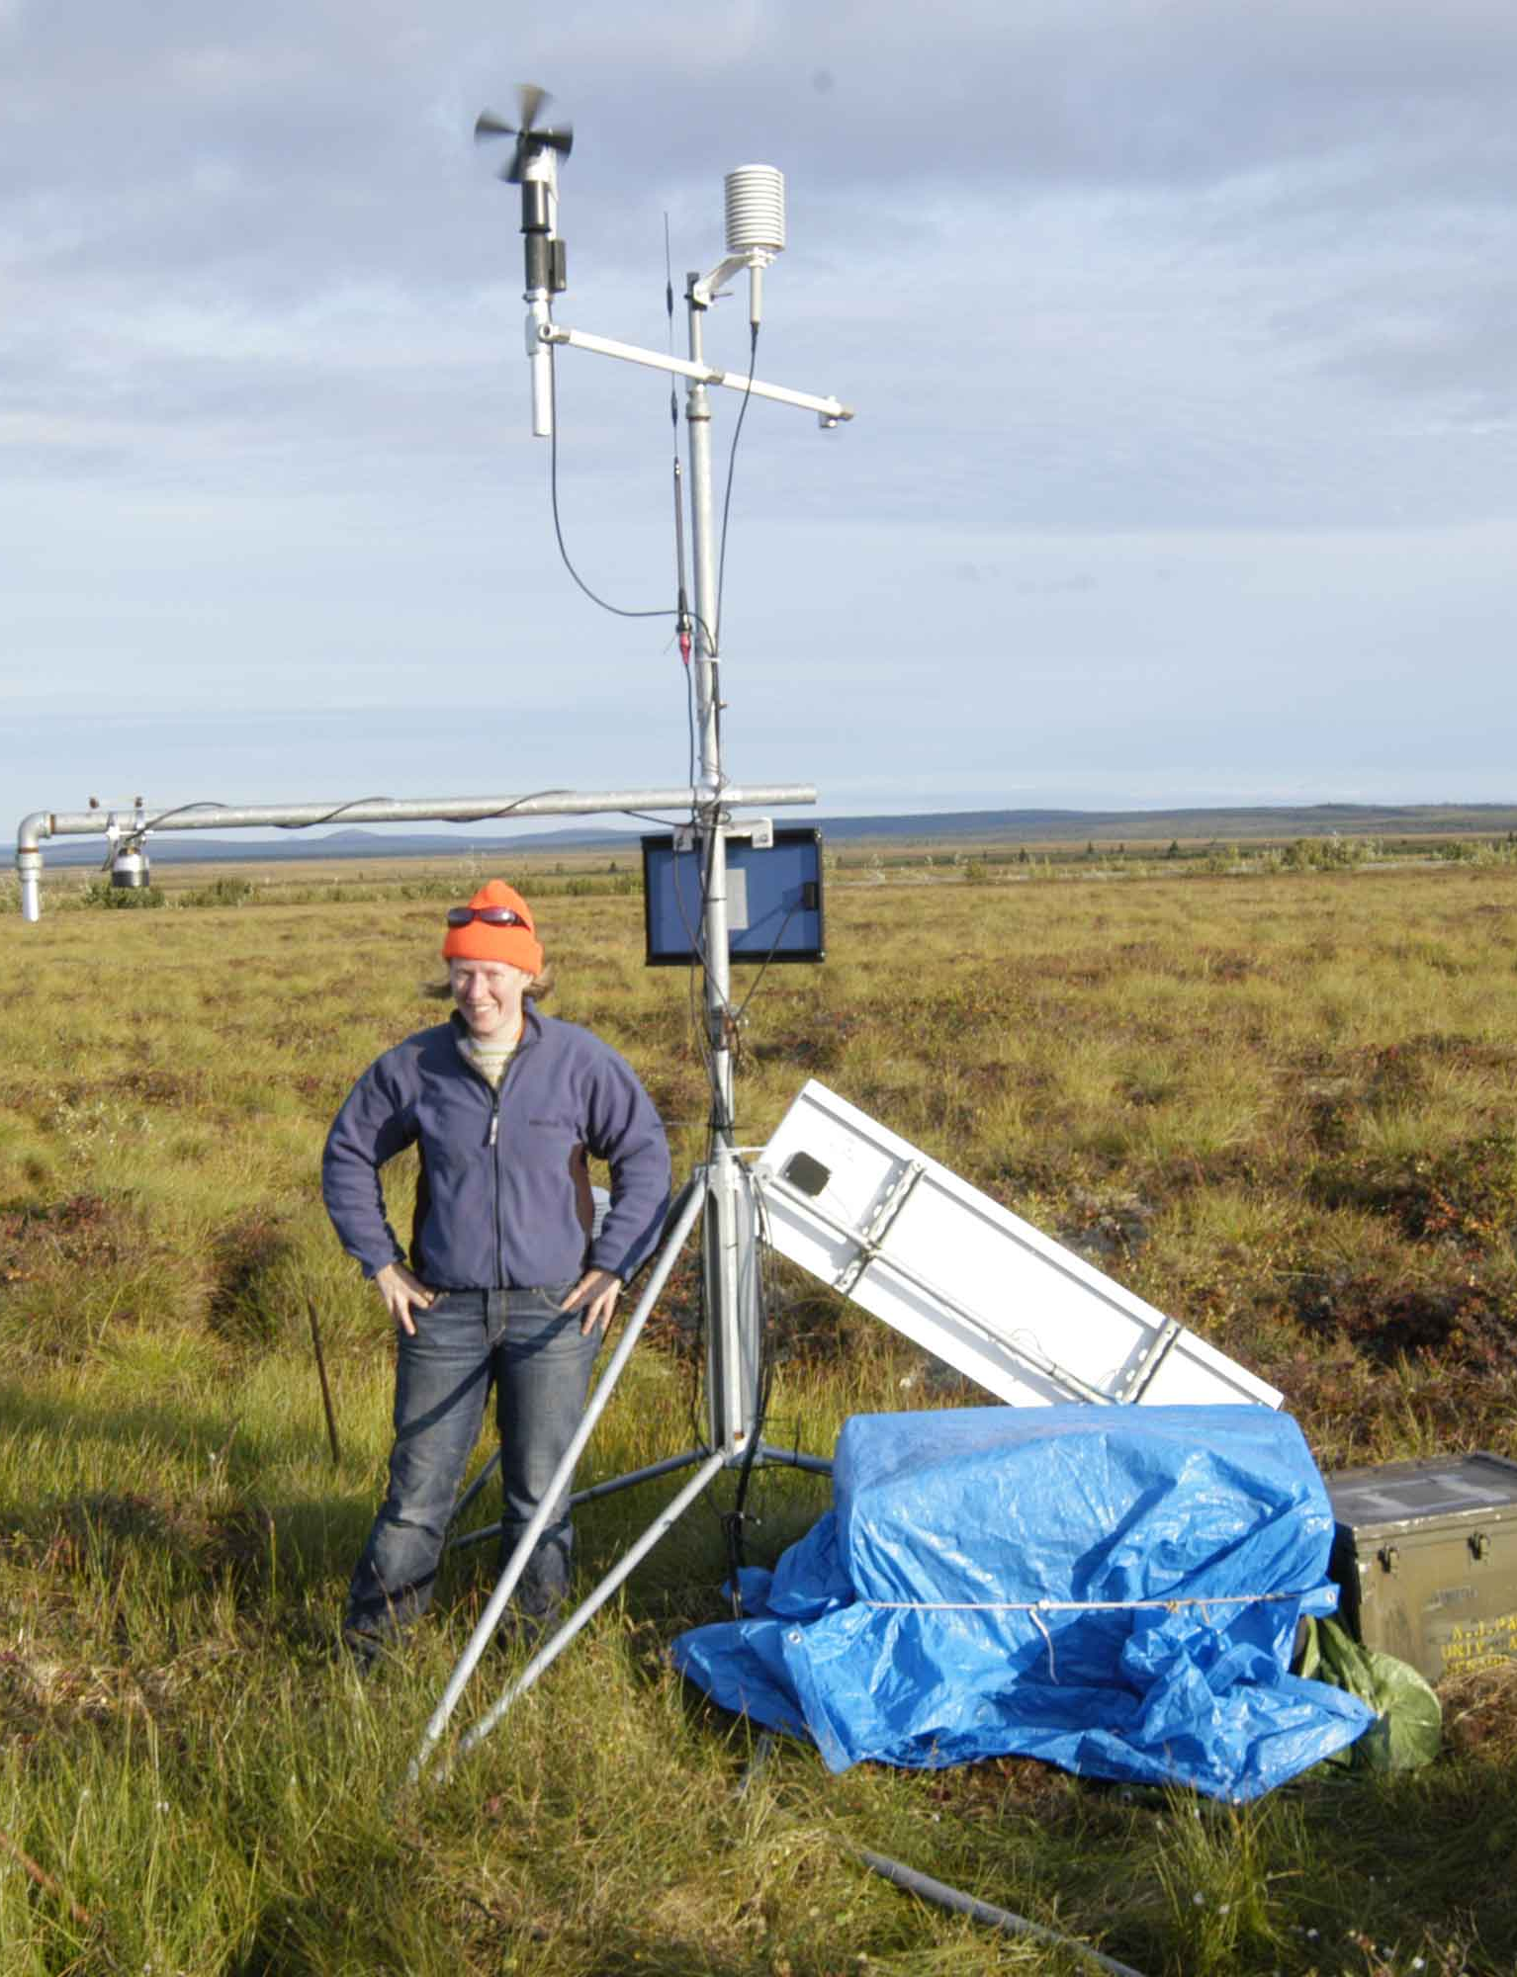
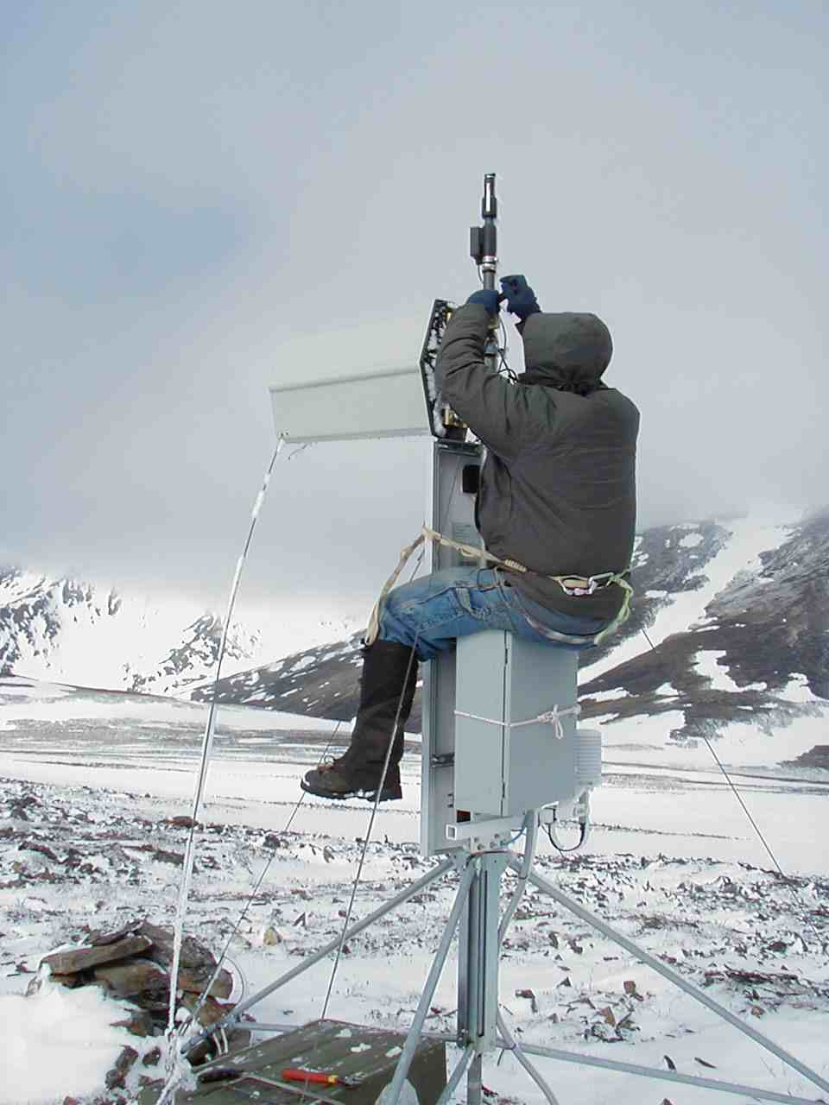
Example: Seward Peninsula http://ine.uaf.edu/werc/projects/seward/
Real Time Data pulled over a network of radios and repeaters
Uploaded to Internet at Nome; web services
Archived at UAF
Photo: R. Busey
Photo: J. Cherry
Partnerships: Northwest Campus of UAF in Nome, Anvil City Science Academy (Jr. High), Kawerak Native Corp, National Park Service

Slide 21
Data Management

Slide 22
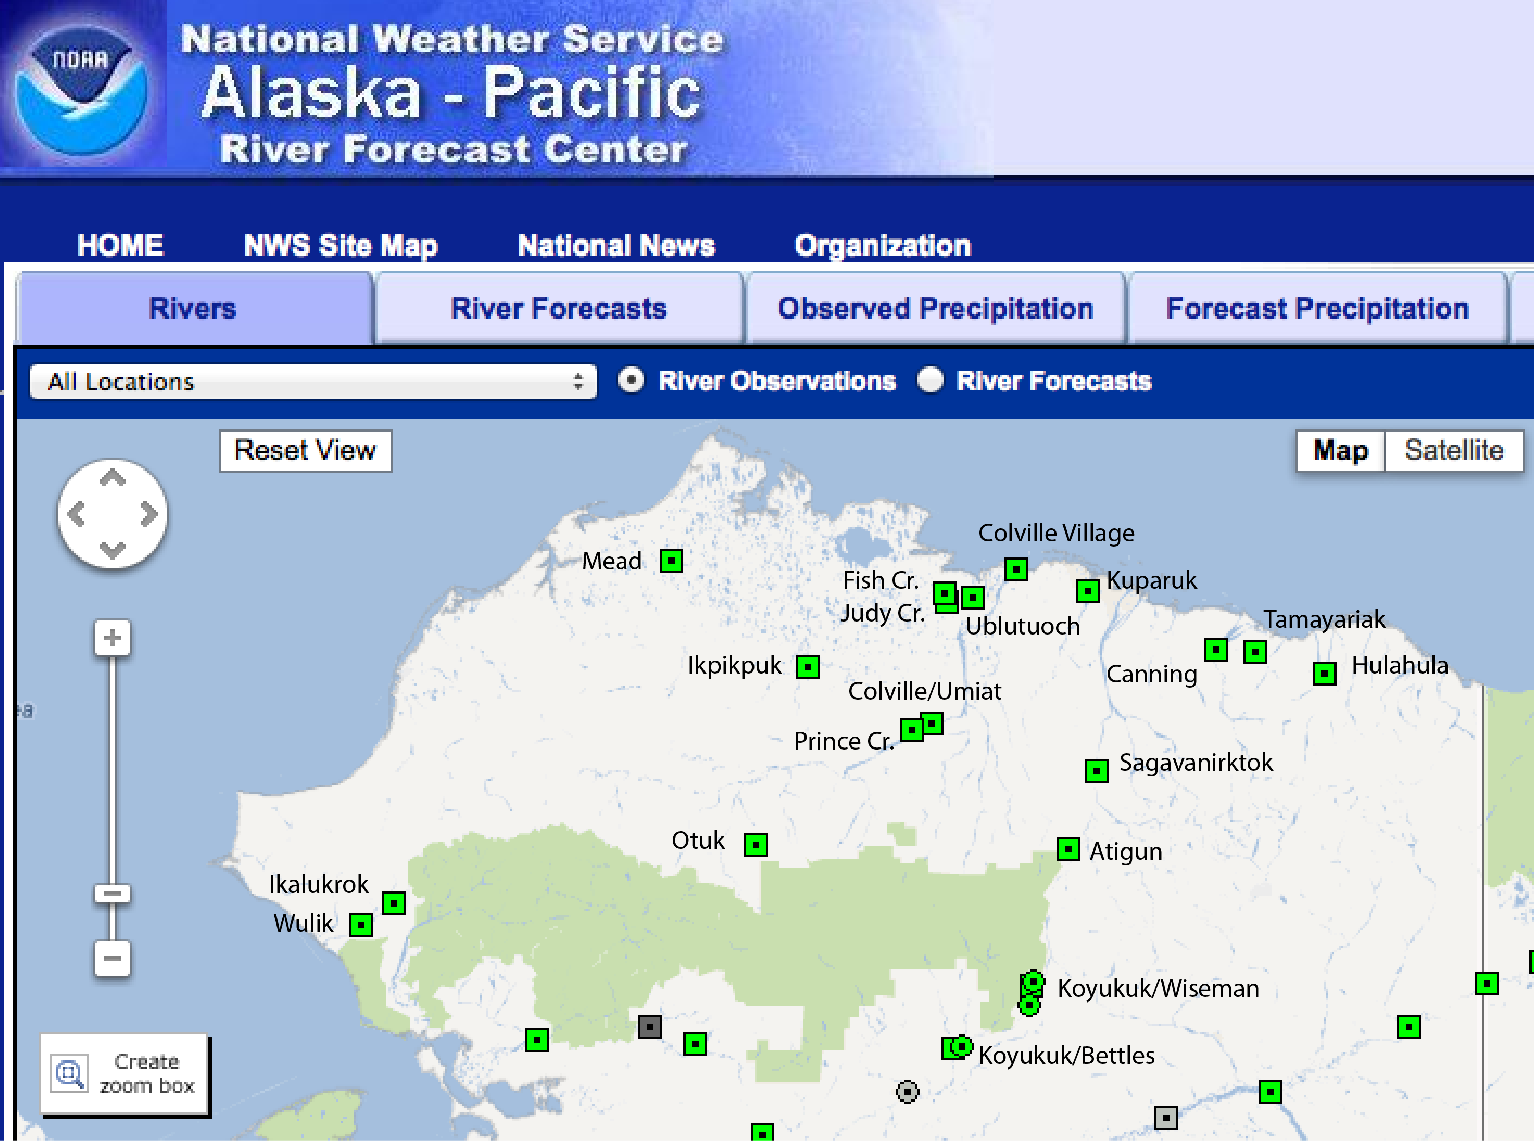

Slide 23
Airborne Observation and Cal/Val

Slide 24
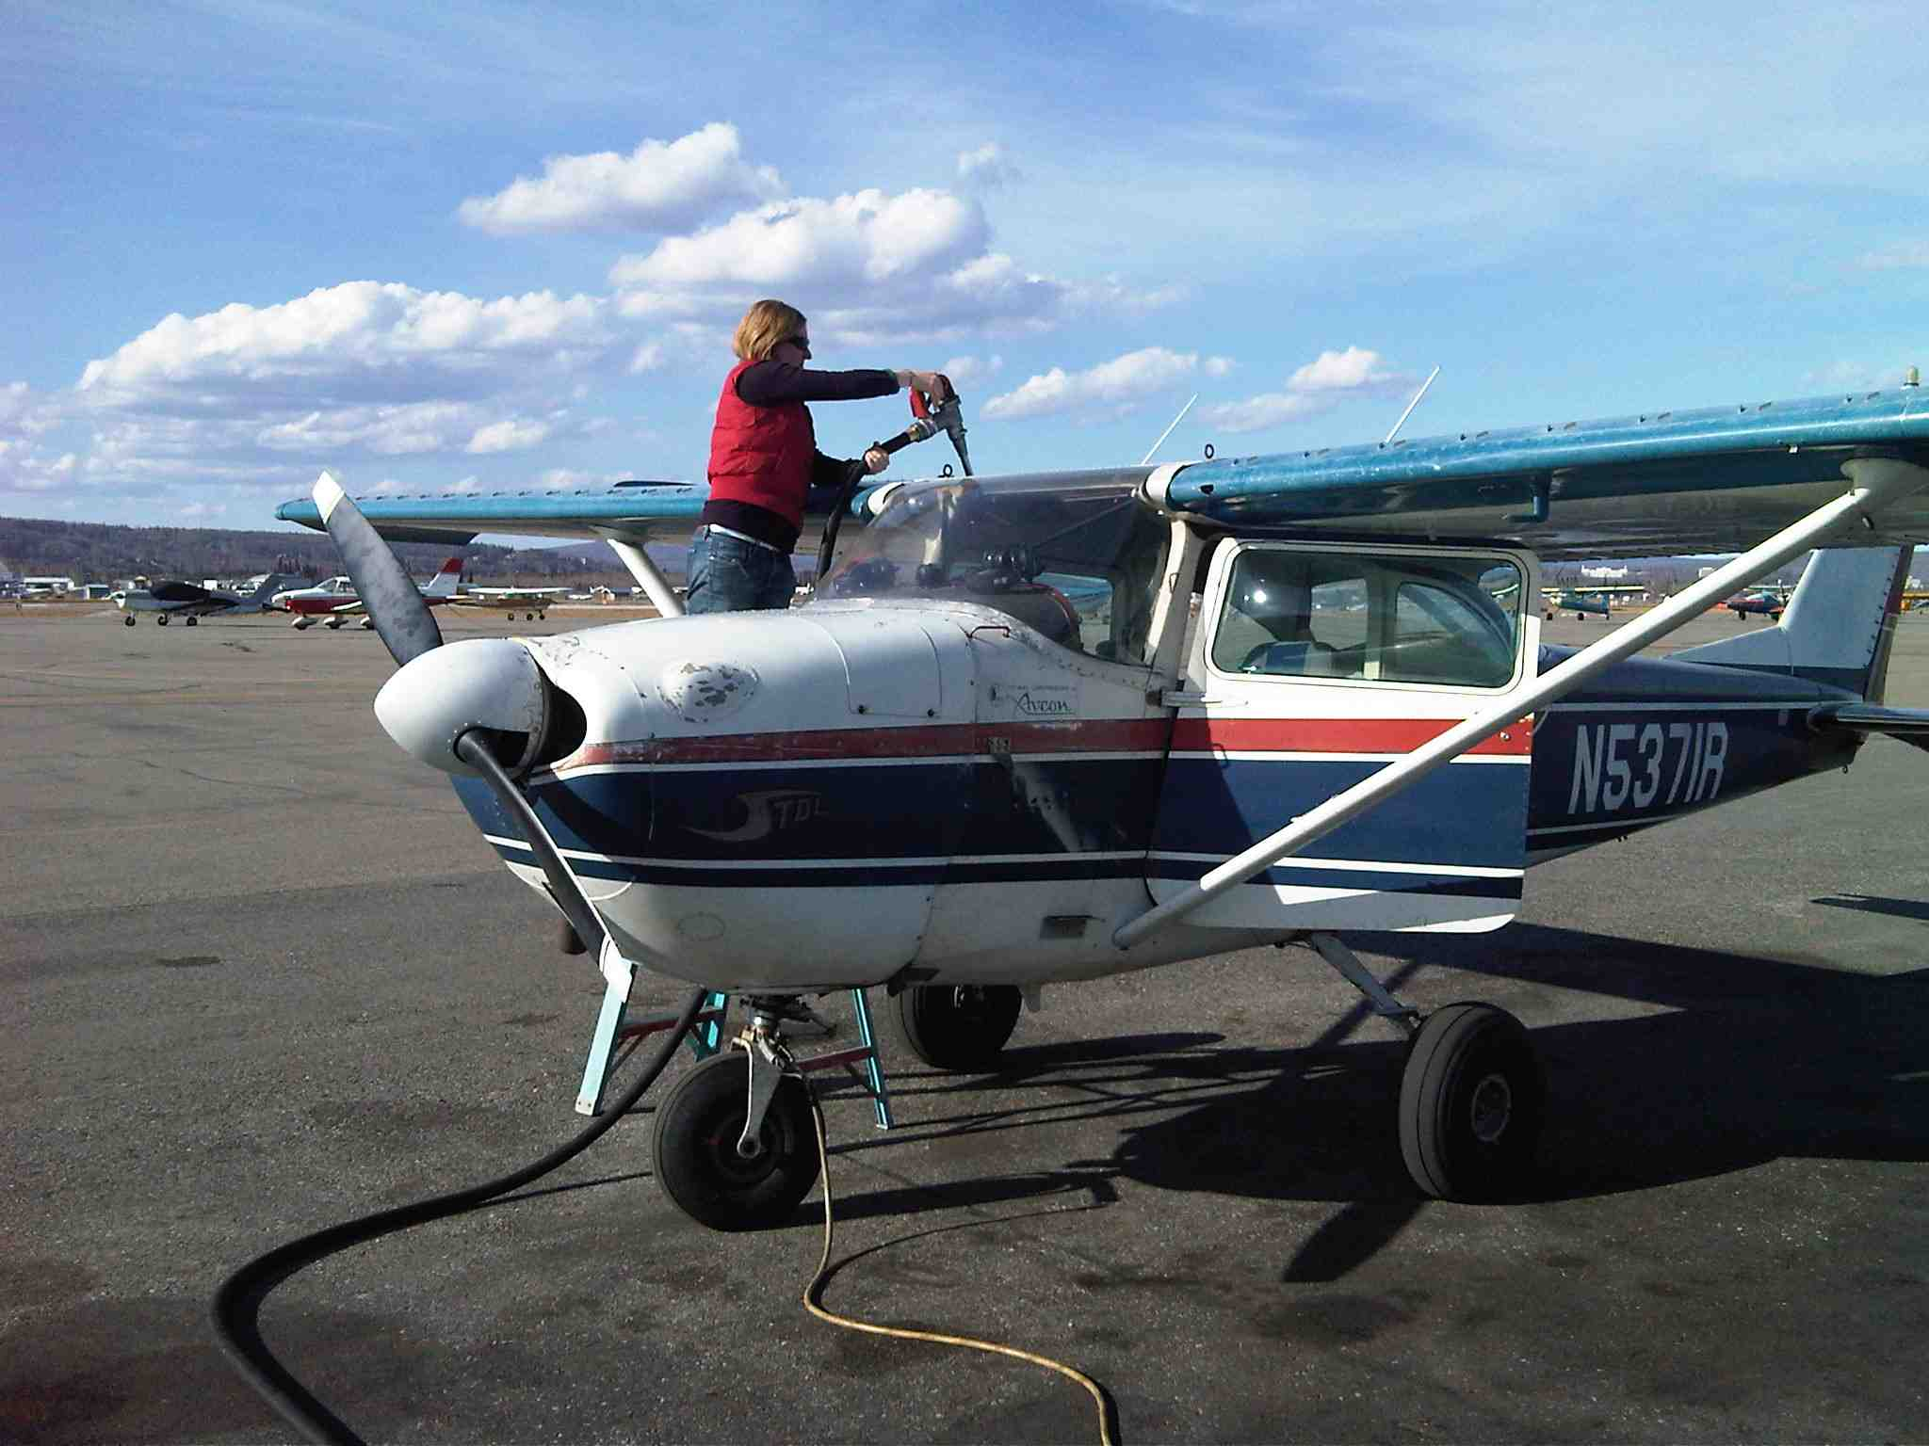
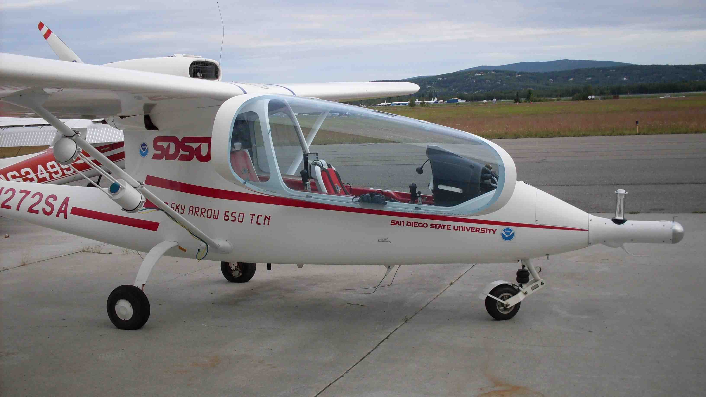
Platforms: Conventional
Photo: Chas Jones
Photo: Pat Harman
Photo: Bob Busey
Photo: Jessica Cherry

Slide 25
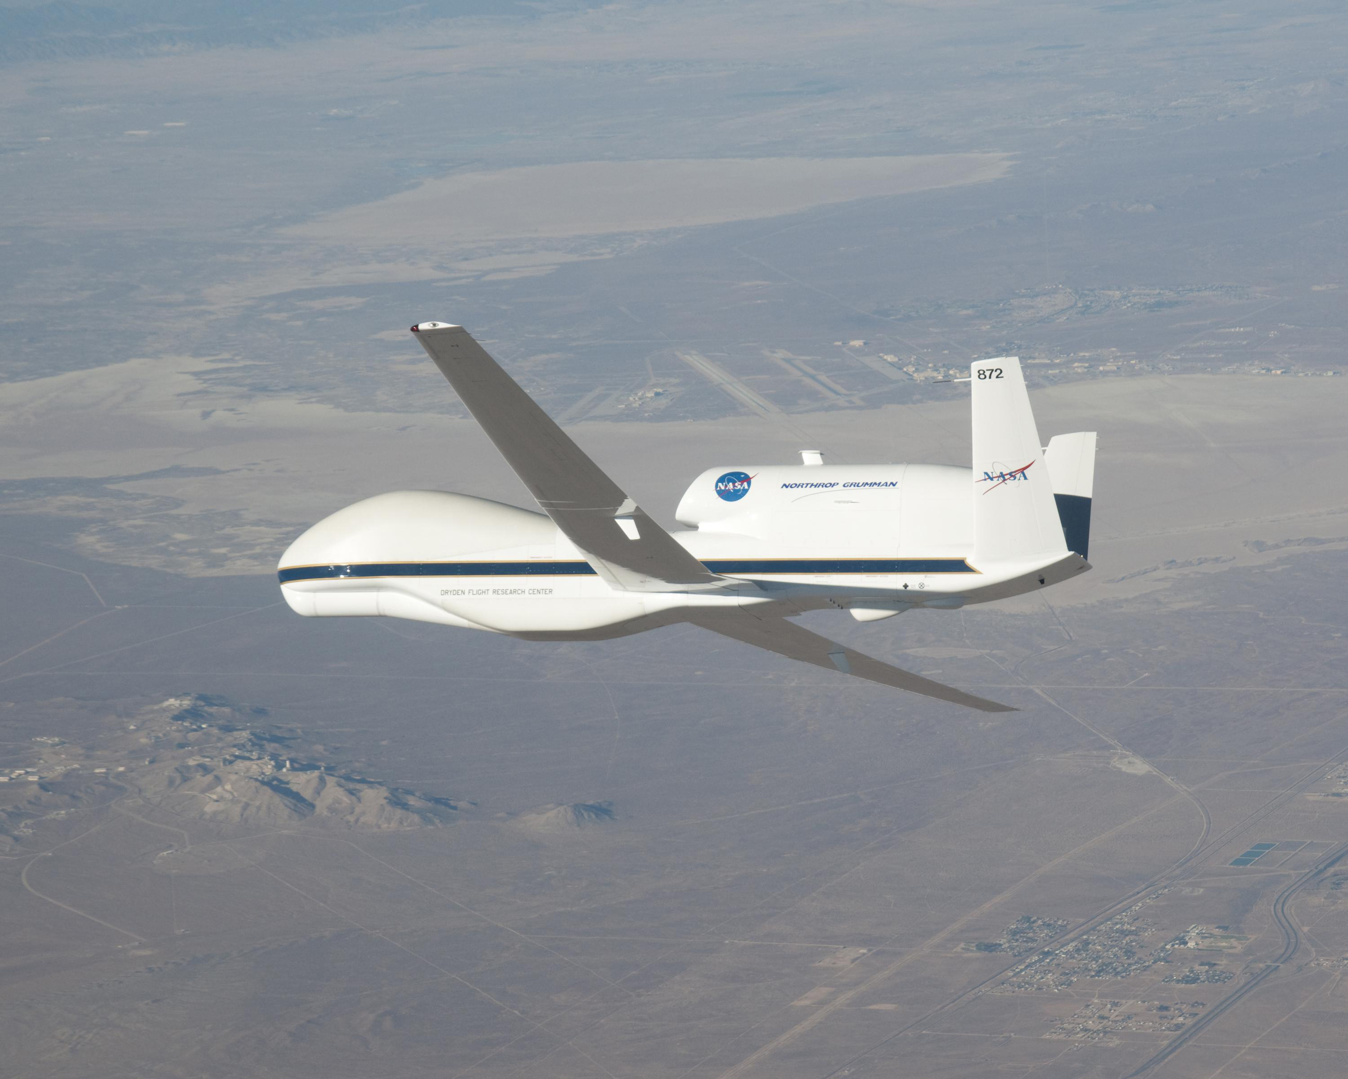
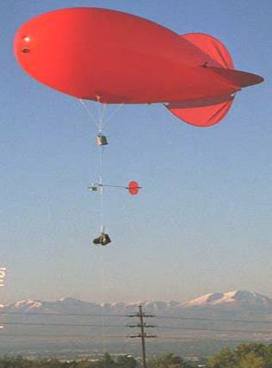
Platforms: UAS & Balloons
Photo: Jessica Cherry
Photo: NASA
Photo: Pat Harman
Photo: Vaisala

Slide 26
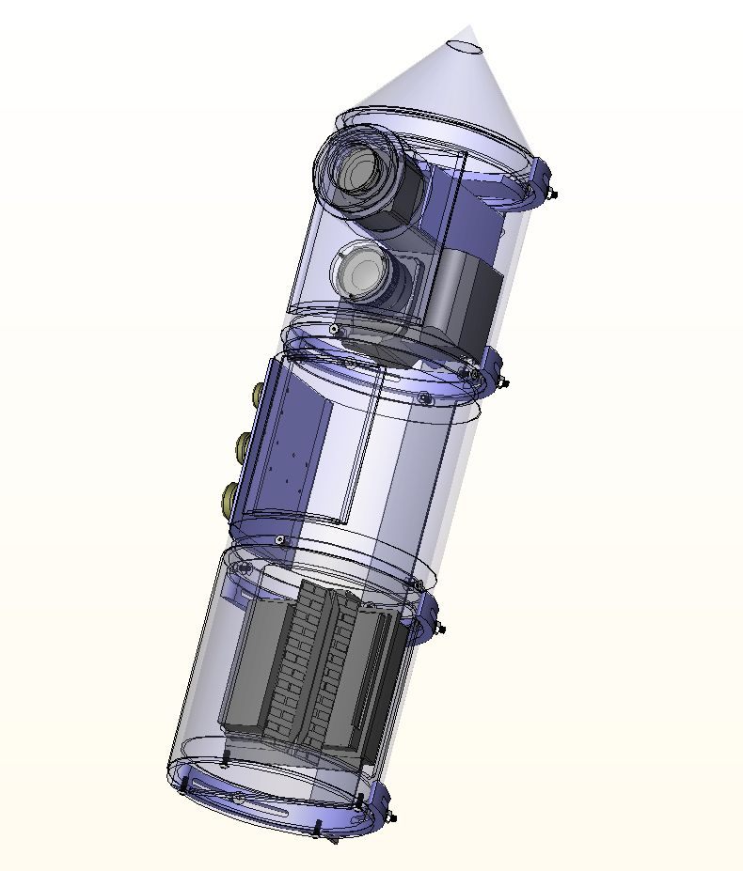
Payloads
Integrated Sensor System (’Tinman’) developed by our group at UAF includes:
RGB cameras (Nadir and Oblique)
FLIR cameras
X-band SAR
Hyperspectral camera
Multispectral cameras
Courtesy: Greg Shipman, UAF/GI

Slide 27
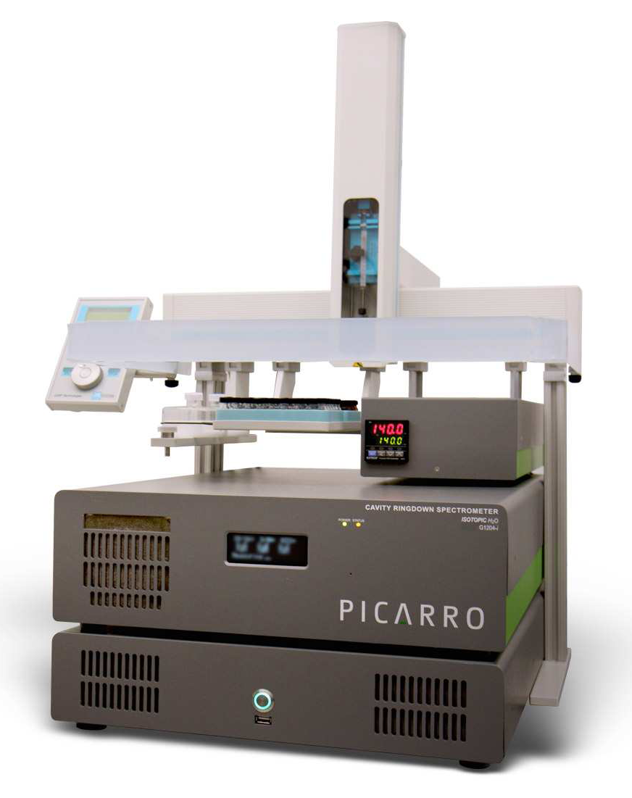
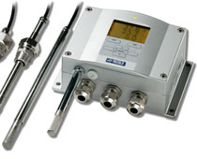
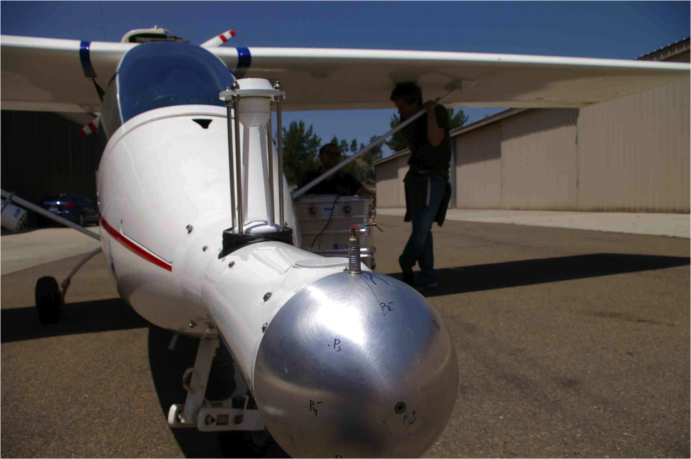
Payloads
A meteorological package (T, RH, P)
A cavity-ringdown laser spectrometer for water isotopes
SDSU Water Vapor, Carbon, Methane Flux
Photo: Vaisala
Photo: Phil Yoon
Photo: Picarro

Slide 28
Hydrologic Applications
Surface Water
Ground Water
Water Vapor
Hydrology and Biogeochemistry
Snow and Ice Modeling

Slide 29
Surface Waters: Wetlands
Photo: Jessica Cherry

Slide 30
Micro-climatology

Slide 31
Micro-climatology (Thermal IR)

Slide 32
Surface Waters: Lake Freeze Up
Photo: Jessica Cherry

Slide 33
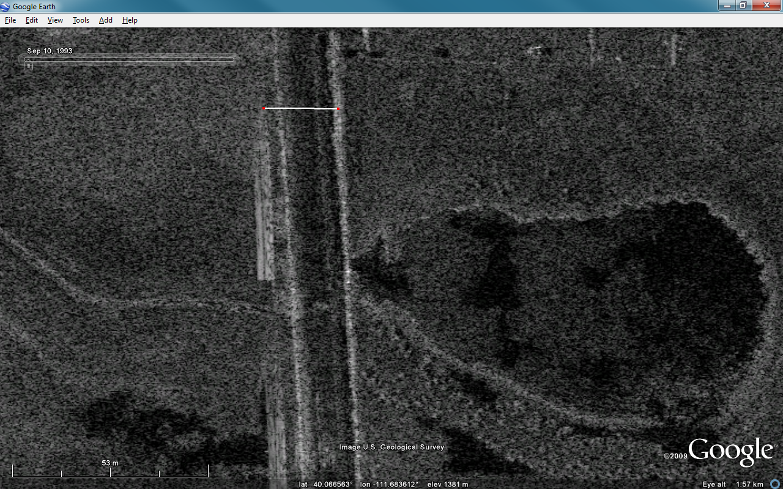
Surface Waters: Lake Freeze Up
20 m
Photo: ImSAR

Slide 34
Water Vapor: Isotopes
Data: Jessica Cherry

Slide 35
Hydrology: Snow & Ice Mapping
Photo: AKDEC

Slide 36
Future Directions
Continued Snow Depletion mapping technique development
Image and hydrology model integration
Lake and river bathymetry, river velocity
Migration to more physically-based hydrology models and improved data assimilation
Develop new products and data integration modules for water resource management tools

Slide 37
Brochure: educating stakeholders on how to use remote sensing imagery and where to get it
Your contributions are welcome!

Slide 38
Questions?
Contact: jcherry@iarc.uaf.edu

