Slide 1
GOES-R Proving Ground OCONUS Meeting
Update on Product Implementation and Challenges
Eric Lau
NWS Pacific Region
June 2013

Slide 2
Progress since the last OCONUS Meeting – Honolulu 2010
LX Band antenna installed at the Honolulu Community College with NPP data flowing to HFO and PRH.
MIMIC TPW implemented at HFO from LDM at UW CIMSS
Cloud Top Cooling (CTC) implemented at HFO from LDM at UW CIMSS.
Quantitative Precipitation Estimate (QPE) and Sea Surface Temperature (SST) implemented at HFO from LDM at NASA SPoRT.
Orographic Rainfall Index (ORI) implemented at HFO from LDM at CIRA.
Jordan Gerth developed World Wide Lightning Location Network (WWLLN) plugin for AWIPS II.
GOES-R Visiting Scientist Program underway for Pacific Region.

Slide 3
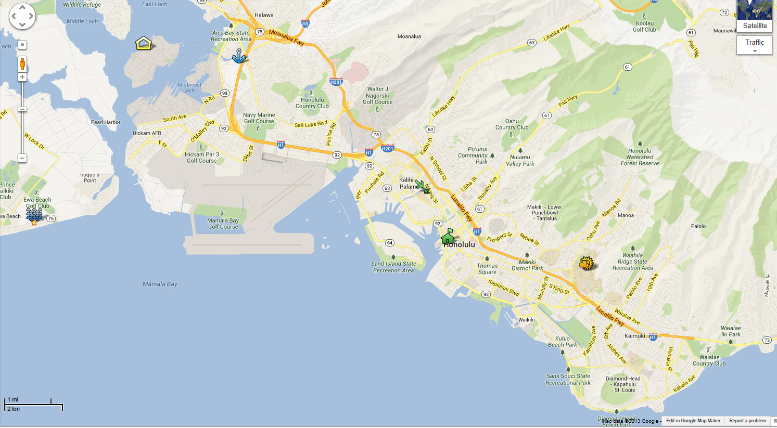
Island of Oahu – NWS and Partners
Ford Island
JTWC
HCC
UH, WFO Honolulu/CPHC
PTWC
NWS PRH
Waikiki

Slide 4
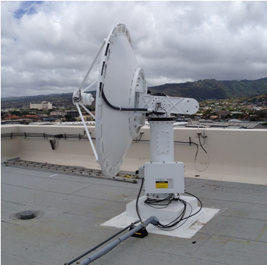
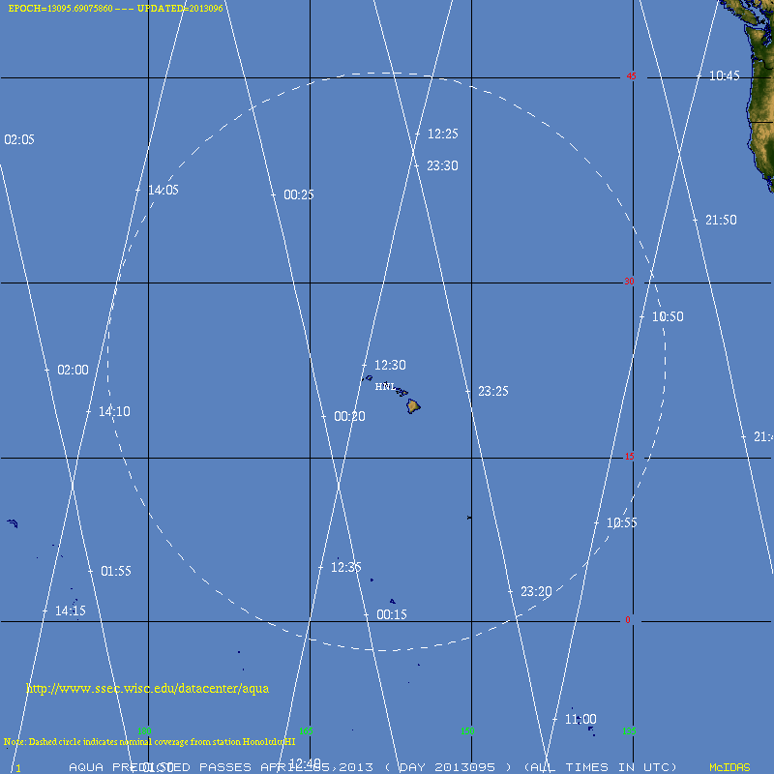
L/X Band Antenna, Range

Slide 5
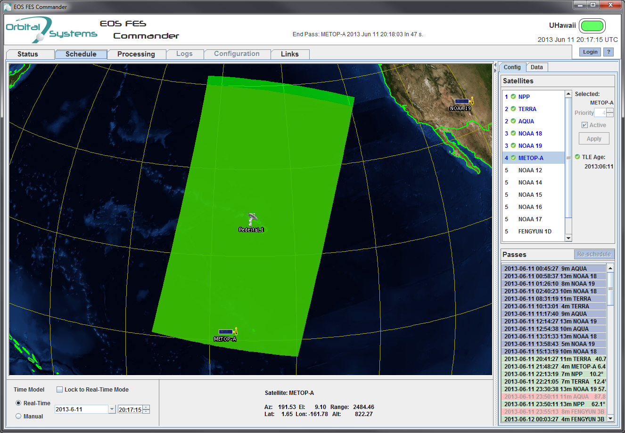
L/X Band Antenna, Range

Slide 6
Suomi-NPP VIIRS DNB Sunday, May 28, 2013 1201 UTC

Slide 7
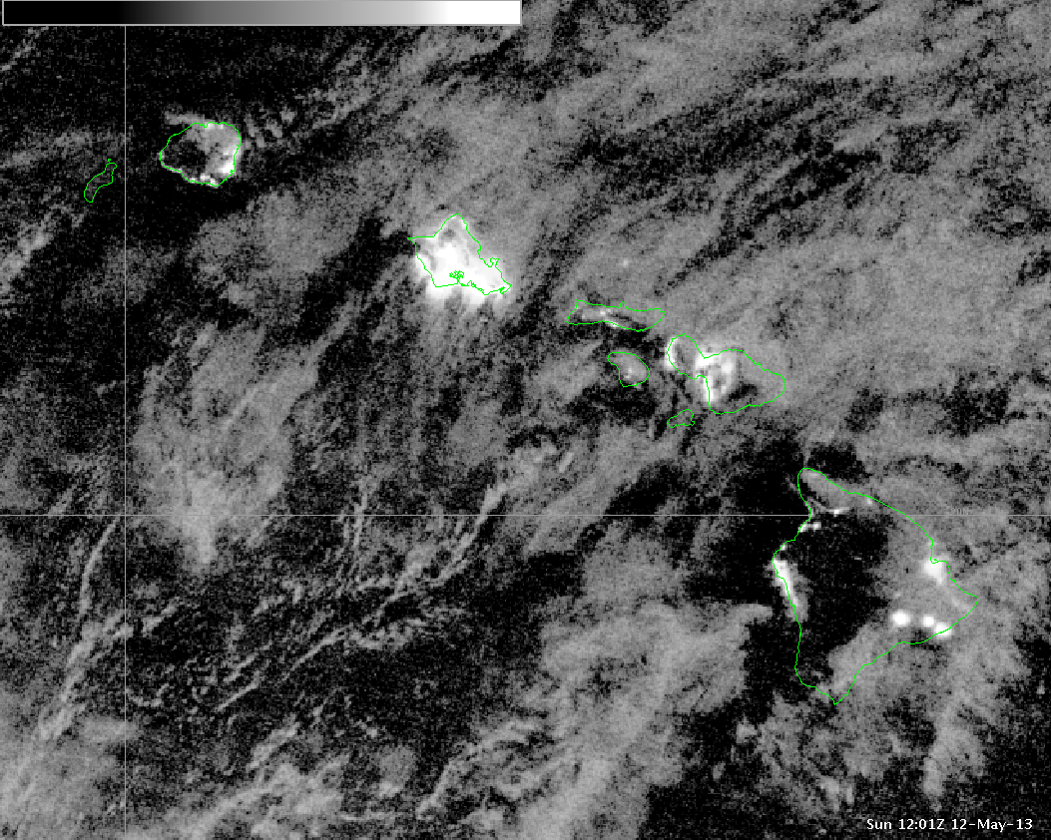
Suomi-NPP VIIRS DNB Sunday, May 12, 2013 1201 UTC

Slide 8
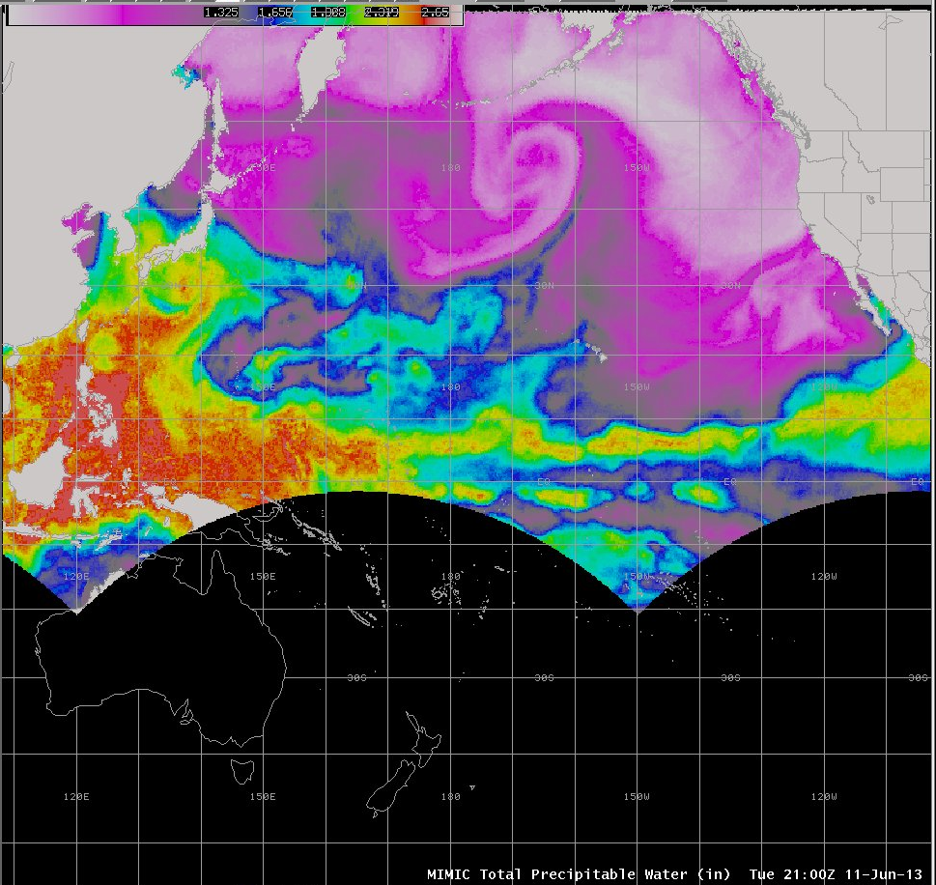
MIMIC – TPW in AWIPS I at HFO

Slide 9
Infrequent, but it does happen!

Slide 10
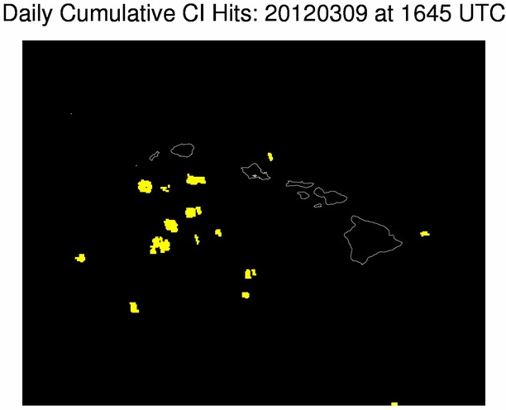
UW-CIMSS Cloud Top Cooling

Slide 11
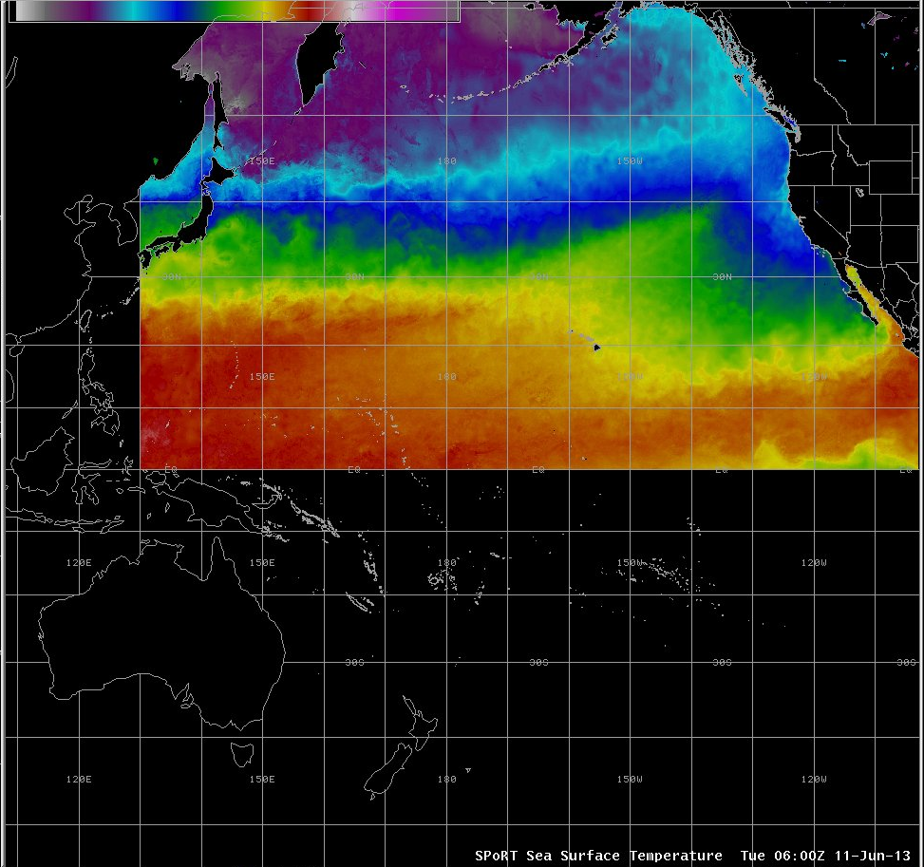
SST from SPoRT

Slide 12
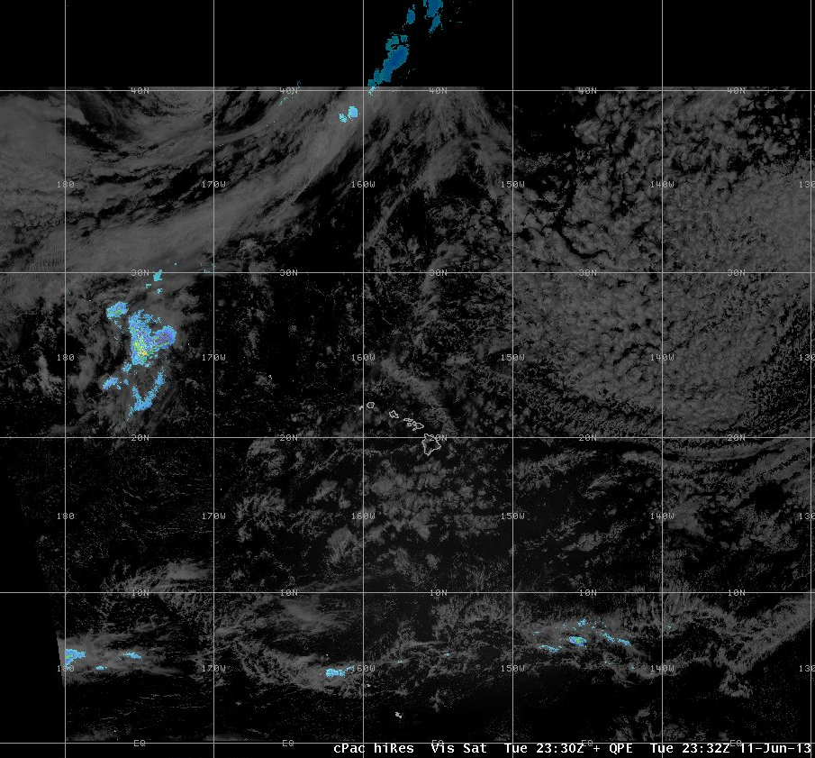
NESDIS QPE from SPoRT

Slide 13
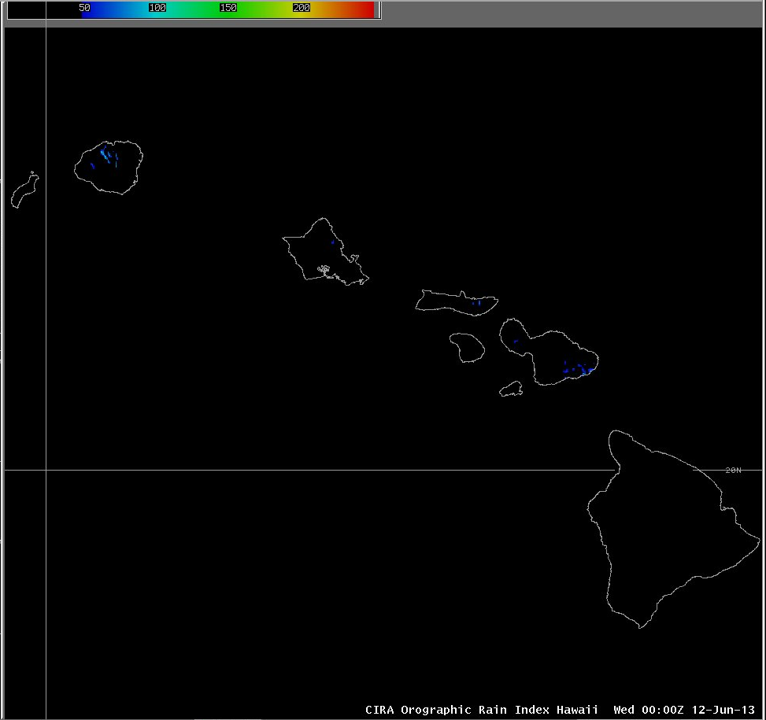
Orographic Rainfall Index (ORI)

Slide 14
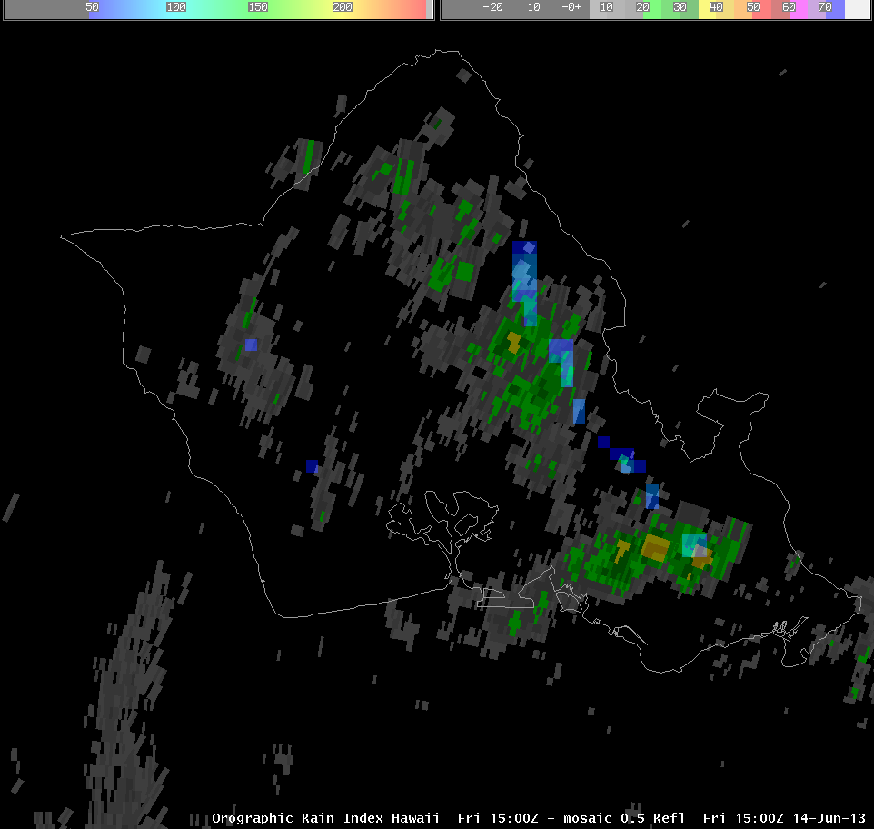
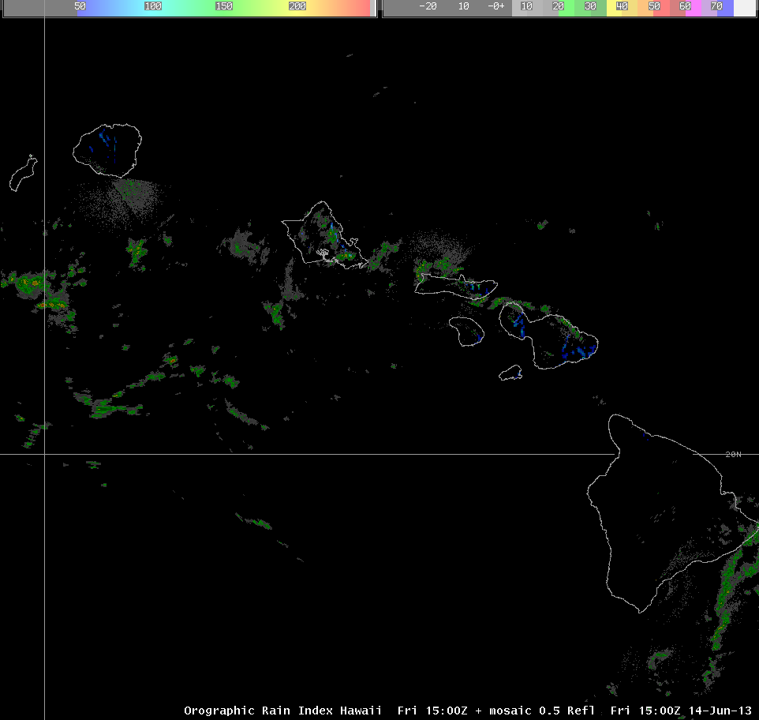
Orographic Rainfall Index (ORI)

Slide 15
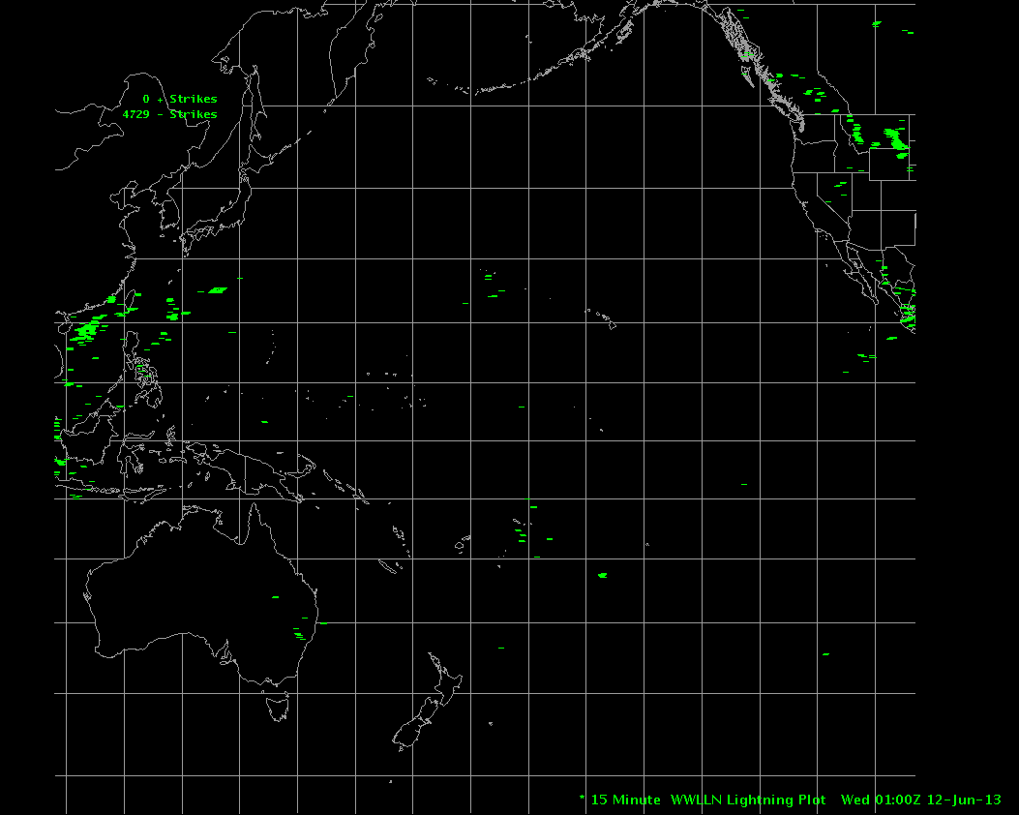
World Wide Lightning Location Network (WWLLN) AWIPS II Plugin

Slide 16
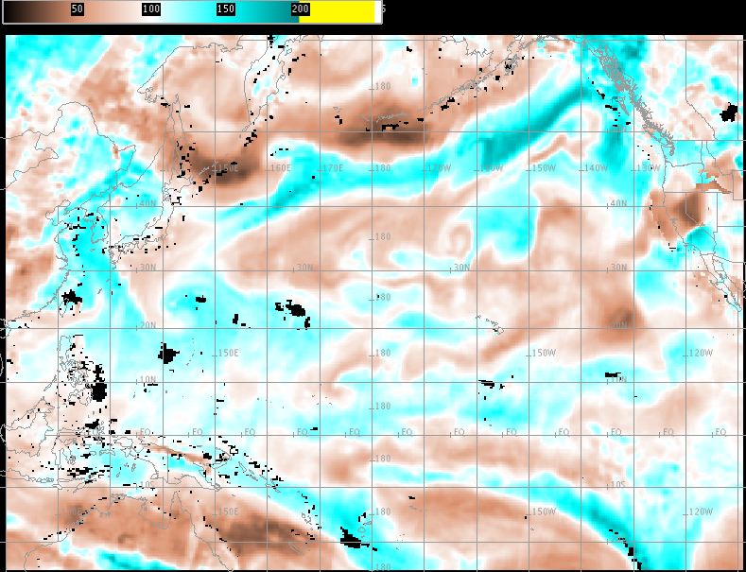
Mapping Issues with TPW in AWIPS I

Slide 17
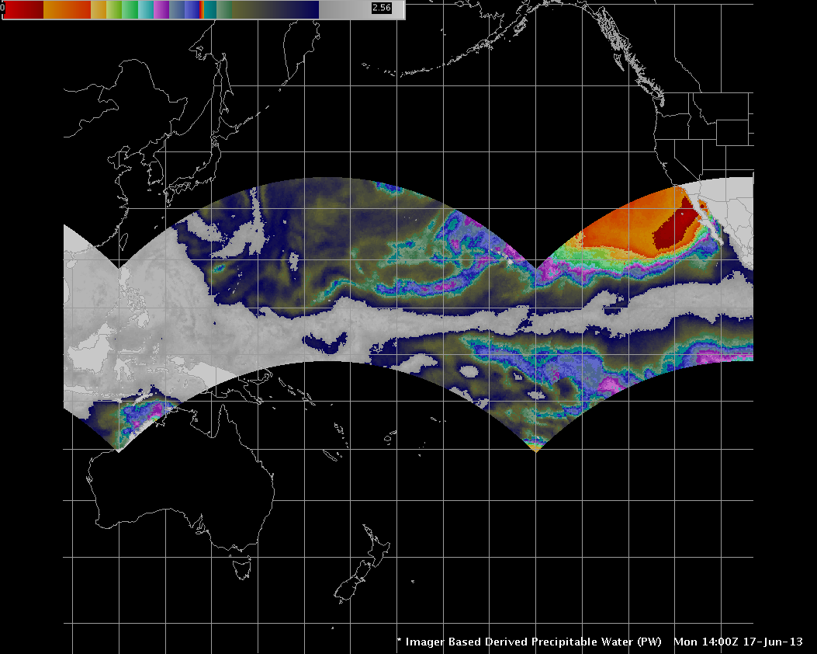
Mapping Issues with TPW in AWIPS II

Slide 18
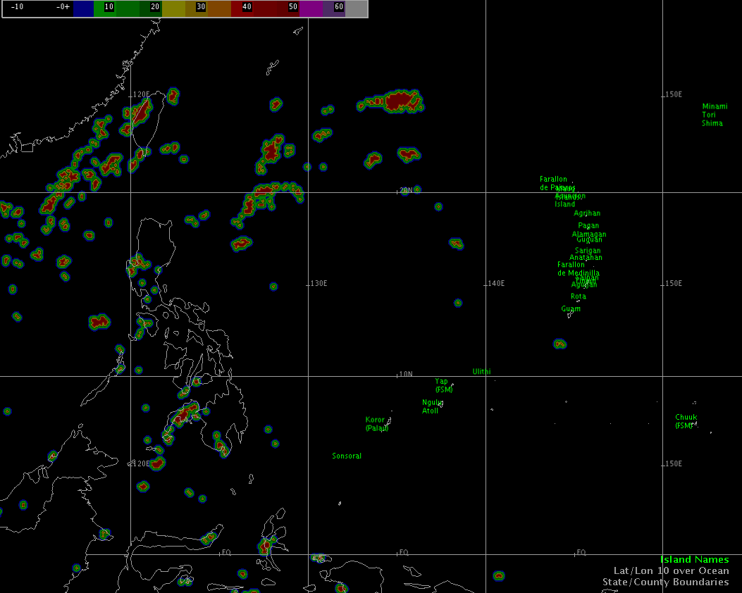
Future Products on deck
GOES Sounder DPI over Hawaii expected on the SBN in August 2013.
TIGI16 - Lifted Index
TIGI17 - Precipitable Water
TIGI18 - Surface Skin Temperature
TIGI27 - Cloud Top Height
TIGI28 - Cloud Amount
MODIS imagery and products from the HCC antenna.
More NASA SPoRT products, i.e. MODIS, MODIS-VIIRS Hybrids, RGB
UH Pseudo-Reflectivity
GLD360 Lightning Density
Tropopause Folding/Turbulence Products

Slide 19
Pacific Region Challenges
Equipment, bandwidth, travel-
Geography limits communication circuits and infrastructure.
Working with people over many time zones.
Travel to remote destinations. i.e., Guam and American Samoa.
Limited resources for operations maintenance and configuration.
AWIPS I and II support-
AWIPS I products converted to AWIPS II compatible products.
AWIPS Configuration and Localization within the region.
TPW mapping issues.
Recently broken RegionalSat plug-in prevents viewing external satellite data like VIIRS.
Training for these great products…going forward-
Multiple people with multiple roles in maintaining a GOES-R presence.
GOES-R Visiting Scientist Program will focus training on their expertise.
Mark DeMaria and Kathy Strabala in Hawaii from July 9-11.

Slide 20
Mahalo and Aloha!
Questions:
Bill Ward – bill.ward@noaa.gov
Eric Lau – eric.lau@noaa.gov

