Slide 1
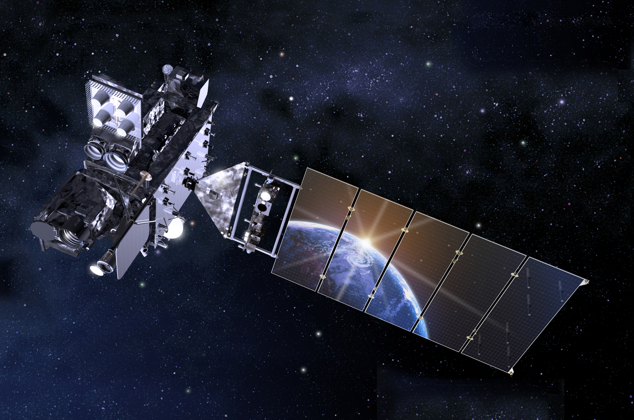
GOES-R Algorithm and Proving Ground Update
Steven J. Goodman
GOES-R Program Chief Scientist
NOAA/NESDIS USA
OCONUS Proving Ground Meeting
Anchorage, AK May 12-15, 2015

Slide 2
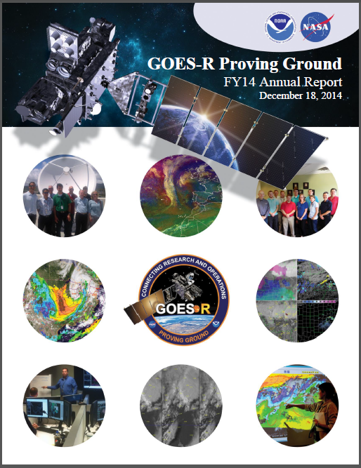
Outline
AWG Accomplishments
Science Priorities
2015 NOAA Testbed & Proving Ground Workshop
2015 Plans
Summary

Slide 3
AWG Notable Accomplishments
AWG teams continue execution of GOES-R algorithms on SEVIRI, MODIS, GOES, VIIRS, simulated ABI imagery in support of Level-2 algorithm testing and validation activities.
Baseline Level-2 Product Algorithm Enhancements (beyond 100% algorithm delivery)
Outcome of continuing product validation activities
Demonstrate and document algorithm enhancements
Carefully manage and document algorithm deltas (in anticipation of post-launch implementation).
AIT coordinates, documents, and places all software updates under CM.
AWG teams will extend this effort to Himawari-8/AHI imagery
Development of L2 Product Validation Tools
Refer to Science Week presentation “GOES-R Algorithm Status Update”
Jaime Daniels http://www.goes-r.gov/users/2015-NOAA-Sat-Science-Week.html
3
Notes:
AWG uses Clear Case CM product

Slide 4
NOAT Priorities for Future Capabilities/New Products
Fog and Low Stratus underway within the NESDIS SPSRB process
First implement with current GOES, then Enterprise Geo/Polar product
Currently funded by GOES-R Risk Reduction
SO2 Detection, ProbSevere, Convective Initiation
NOAT Recommended Top 5 Future Capabilities
Cloud Cover Layers
Aerosol Particle Size
Ice Concentration
Ice Age/Thickness
Ice Motion
NOAT-NWS Operational Advisory Team
Notes:
Fog and Low Stratus (formerly Option 2 Fog and Low Cloud product) underway funded by Tom Schott through SPSRB PSDI process- as part of his Geo Product System Development and Implementation (PSDI).
SO2 Detection, ProbSevere, Convective Initiation- on the initial NOAT recommendation list, but not ready for implementation as fused, non-stovepipe applications- will be ready in 2 years for transition to operations via SPSRB process.
The NOAT walked through the list of Option 2 products that were deemed mature enough for consideration. From that list the NOAT identified and prioritized 5 products we (the NOAT) are recommending for inclusion in the Harris ground system.
The NOAT held a 2 hour conference call where the NOAT came to consensus on the 5 FOC candidate recommendations for inclusion in the Harris Ground System.
That being said, the NOAT was conflicted with the task. It appeared (rightly or wrongly) that we were being asked to endorse a list of products that were not clearly consistent with spirit and charter of the NOAT. In other words: the list of candidate Option 2 products we had to choose from did not have clear, forward-thinking impacts to NWS operations. None of these products would have appeared on an unconstrained NOAT priority list.
What we understand from NOAT is-the products Greg offered are from those that are delivered ATBDs per the LIRD and mature enough (remaining Option 2 or in development algorithms-applications under Risk Reduction) that Harris can implement them in short order. None of the revamped and fused, non stovepipe GOES-R products we initiated at your request 2 years ago have completed their current funding cycle and, after consulting the PIs, are not yet ready to implement (SO2, CI, ProbSevere).
The NOAT has made the following recommendations (08/05/2014) for five FOC products for inclusion in he Harris Ground System:
1. SLI - Concentration
2. SLI - Motion
3. Ice Cover
These 3 products were deemed to have potential positive impact to Great Lakes forecast offices and the Anchorage Forecast Office.
4. Aerosol Particle Size
This product was believed to be potentially complementary to work going on with the Smoke Detection product in JPSS. It was also thought to address an emerging issue with pollution emanating from Asian sources.
5. Cloud Layers/Heights
This product could positively impact the need for cloud information across data sparse areas to support in-flight aviation.
Lower priority products that were discussed, but did not make the top 5:
6. Cloud Ice Water Path
7. Cloud Liquid Water
8. Enhanced “V”/OTD
9. Cloud Type
one more R2O transition from Risk Reduction is the HRRR Lightning Forecast Algorithm, something we started a while back. Its not a satellite algorithm, but a NWP forecast derived form our work with the Lightning Mapping Arrays.

Slide 5
Status of Future Product Capabilities
Future Capabilities
Advanced Baseline Imager (ABI)
Absorbed Shortwave Radiation: Surface Aerosol Particle Size Aircraft Icing Threat Cloud Ice Water Path Cloud Layers/Heights Cloud Liquid Water Cloud Type Convective Initiation Currents Currents: Offshore Downward Longwave Radiation: Surface Enhanced “V”/Overshooting Top Detection Flood/Standing Water Ice Cover Low Cloud and Fog (FLS) Ozone Total Probability of Rainfall Rainfall Potential Sea and Lake Ice: Age Sea and Lake Ice: Concentration Sea and Lake Ice: Motion Snow Depth (Over Plains) SO₂ Detection Surface Albedo Surface Emissivity Tropopause Folding Turbulence Prediction Upward Longwave Radiation: Surface Upward Longwave Radiation: TOA Vegetation Fraction: Green Vegetation Index Visibility
Added to Baseline
Surface Albedo (required for Snow Cover)
Prospective Post-Handover Implementation (NOAT Top 5)
Aerosol Particle Size
Cloud Layers/Heights
Sea and Lake Ice: Age
Sea and Lake Ice: Concentration
Sea and Lake Ice: Motion
** Fog and Low Stratus
** ASOS Cloud Product (clear, broken, scattered, cloudy for 3 layers – high, mid, and low)
Pathfinder Prototype Wrapped Algorithms
Convective Initiation (now fused with NWP)
Probability of Severe (ProbSevere)
** Walter Wolf R2O Proposal for FY16 PSDI
5

Slide 6
NOAA Testbed Proving Ground Annual Workshop
The TBPGCC met with guests Mike Farrar and Gary Matlock from the LOTM Council (that oversees the TBPGCC) and with John Cortinas of OAR for several hours on Thursday April 16 to discuss some of our common challenges and propose some options to address them. Here are the actions from our discussion: 1. Develop a plan for migrating affected testbeds from legacy NAWIPS to AWIPS2 platforms. (Mike Farrar) 2. Initiate a consolidated resources request for TBPG infrastructure upgrades to support increased/accelerated transition activities a) for consideration at R2X program development exercise b) for FY18 and beyond (Paula and MikeU)
Unanimous Endorsement for all NOAA TBPG Managers
Notes:
2. What does this mean- To ensure adequate infrastructure to conduct rigorous developmental/demonstration testing in relevant environments needed to address NOAA's crticialmission needs in transitioning R&D to operations/applications, requesting NOAA formalize support for its TBPG by instituting/sustaining base allocation for personnel for each NOAA TBPG, in the form of 1 FTE (TBPG manager), and 2 half-time equivalents (to support IT and technical aspects of testing). Implicit in our discussion was that the base support would be for NOAA FTE.

Slide 7
Initiate a consolidated resources request for TBPG infrastructure upgrades to support increased/accelerated transition activities
To ensure adequate infrastructure to conduct rigorous developmental/demonstration testing in relevant environments needed to address NOAA's crticialmission needs in transitioning R&D to operations/applications, requesting NOAA formalize support for its TBPG by instituting/sustaining base allocation for personnel for each NOAA TBPG, in the form of 1 FTE (TBPG manager), and 2 half-time equivalents (to support IT and technical aspects of testing). Implicit in our discussion was that the base support would be for NOAA FTE.

Slide 8
NOAA Testbed Proving Ground Annual Workshop
3. Provide statement of options for how to request testbed support within proposals for testing in FFOs/AOs (e.g. overhead, explicit inclusion in proposal, etc). Once adopted by the TBPGCC, this would be made available as standard language to include in future funding opportunities. (Paula and John Cortinas) 4. Proposed standardized approach for incorpating TBPB review/input into FFOs/AOs that incorporates appropriate expertise but avoids conflicts-of-interest. (Paula and Mike) 5. Begin plans for 2016 TBPG workshop. (Mike, Paula, Kim R, Chris L to launch)
Michael Folmer's presentation "Preparing for GOES-R at the Satellite Proving Ground for Marine, Precipitation, and Satellite Analysis“ was voted by the TBPGCC as winner of the best theme-paper award (=certificate).

Slide 9
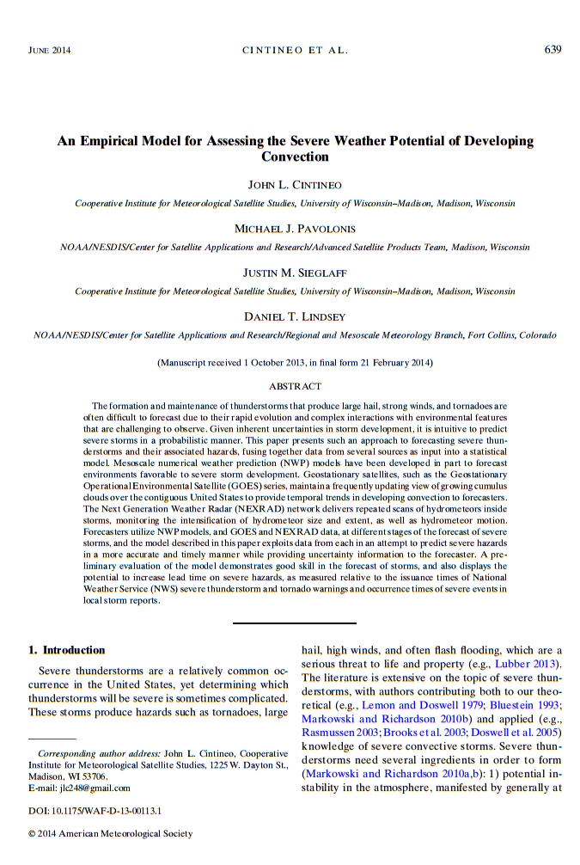
NOAA - David Johnson Award Outstanding Innovative Use of Earth Observation Satellite Data (VolAsh, ProbSevere) to Mike Pavolonis
Products being demonstrated in
the GOES-R Proving Ground

Slide 10
GOES-R Science Program
http://www.goes-r.gov/users/risk-reduce/index.html
Science Week, February 23-27, 2015: http://courses.comet.ucar.edu/course/view.php?id=149
29

Slide 11
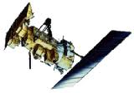
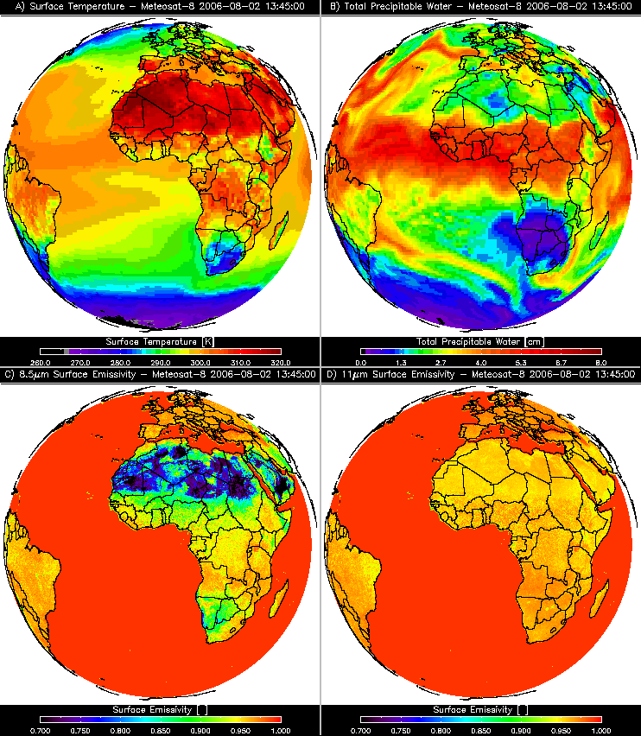
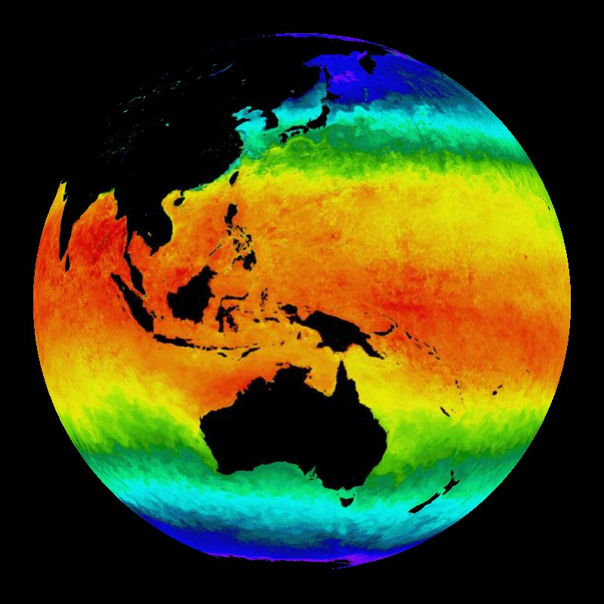
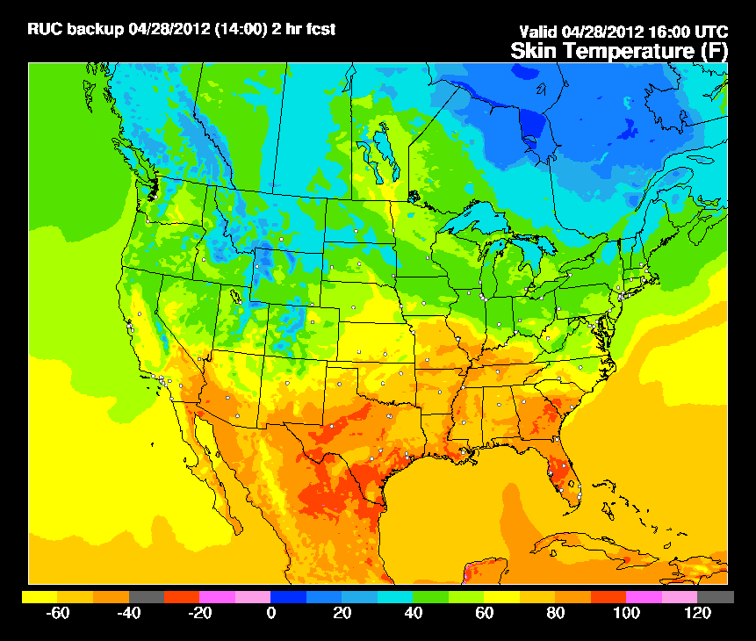
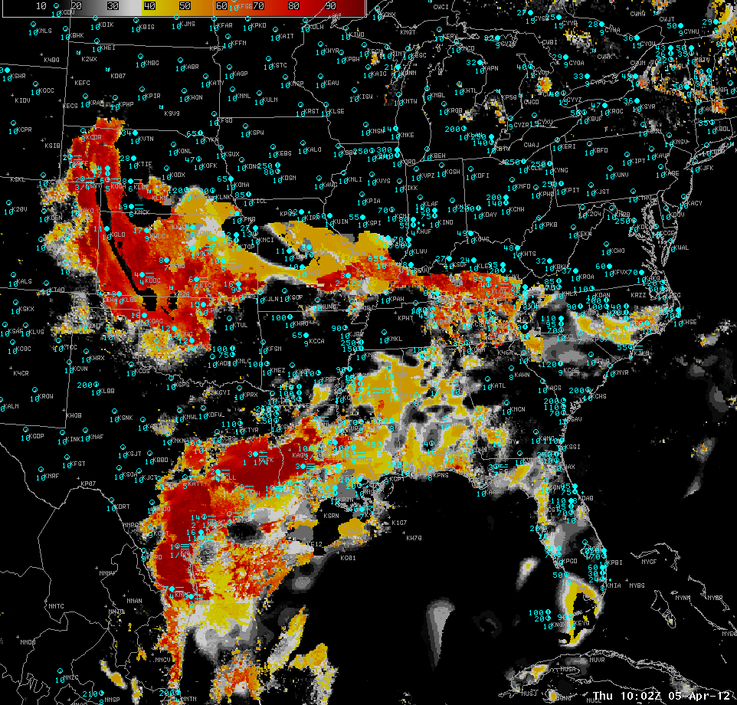
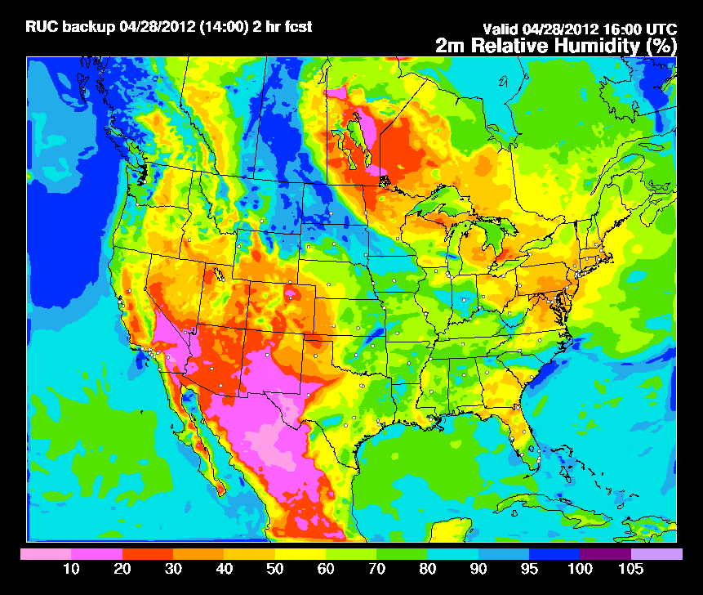
Fused Fog/Low Cloud Detection Approach
Satellite Data
Static Ancillary Data
Daily SST Data
NWP
+
+
+
-Minimum channel requirement: 0.65, 3.9, 6.7/7.3, 11, and 12/13.3 μm
-Previous image for temporal continuity (GEO only)
-Cloud Phase
-Surface Temperature
-Profiles of T and q
-RUC/RAP (2-3 hr forecast) or GFS (12 hr forecast)
-DEM
-Surface Type
-Surface Emissivity
0.25 degree OISST
Clear Sky RTM
IFR and LIFR Probability
NWP RH Profiles
Naïve Bayesian Model
Total run time: 2 - 3 minutes
-RUC/RAP (2-3 hr forecast) or GFS (12 hr forecast)
***IMPORTANT: Other sources of relevant data (e.g. sfc obs) influence results through the model fields

Slide 12
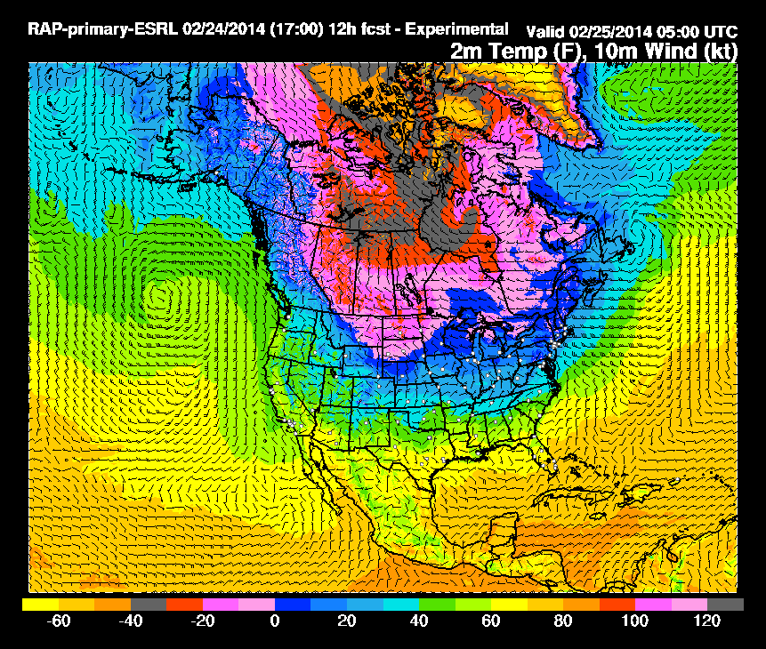
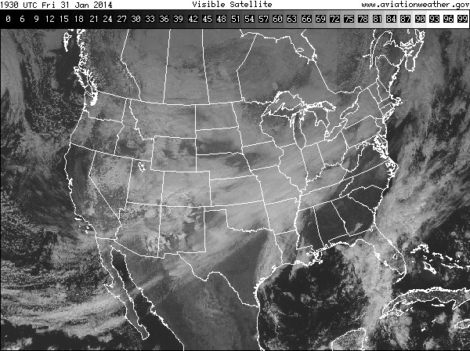
1. RAP grib2 (60 min)
2. GOES-East area files (5-30 min)
3. MRMS grib2 (2 min)
-1F00
F00
F01
Convert grib2 to netCDF (wgrib2, bash, python)
F02
F03
GEOCAT
6-h GFS
sfc. emissivity
sfc. albedo
Compute, remap, composite, and merge fields (bash, C, python)
RADAR PRODUCTS
(e.g., MergedReflectivity, MESH)
Remap (C + IDL)
SATELLITE PRODUCTS
(e.g., top-of-troposphere emissivity, cloud-top phase)
Identification and tracking (WDSS-II)
NWP PRODUCTS (e.g., MUCAPE, effective bulk shear)
Identification and tracking (WDSS-II + IDL)
Radar objects
Satellite objects
Uses latest satellite products and objects
EXECUTE ProbSevere (IDL)
-Executes when radar tracking is complete
-Reads history file (IDL save file)
-Creates ASCII output (IDL)
Uses latest NWP products
Mike Pavolonis- ProbSevere
Notes:
Three independent processing streams: 1. NWP, 2. Satellite, 3. Radar
Use the previous hour analysis (-1F00), current analysis (F00), current 1-, 2-, and 3-hour forecasts (F01, F02, F03). HRRR may be substituted here eventually.
GEOCAT is FORTRAN-90 and C. Remapping uses the mapx C library, which can interface with python or IDL
MRMS fields need to be converted to netCDF for WDSS-II identification and tracking. ProbSevere runs when
radar object tracking is complete
I'll try to answer some questions about the flowchart.
1. In the first Column, do we ingest the NWP product in the blue box or do we have to compute the NWP product using RAP grib 2 inputs using the software in the Green box?
The NWP products in the blue box are computed using the RAP grib2s. MUCAPE is readily available, so it just needs to be remapped, and then composited. Eff. bulk shear needs to be computed using the fields in each RAP grib2. More NWP fields may be used in the future, either pulling directly from the grib2s or computed.
2. In the second column, looks like you have to ingest Midas Area files in to GEOCAT (meaning you have to run GEOCAT) and create satellite objects. What about the IDL software in Green? Is it automated or is there a human in the loop?
Yes, GEOCAT creates level 2 products from McIDAS area files. The C+IDL remapping and the IDL portion of the tracking (a post-processing algorithm) are automated.
3. Same questions on the last column – is this one integrated software and is it automated or is there a human in the loop?
Yes, everything is integrated and automated. There is no human in the loop. There are inotify listeners, so when one product is created, another program will be executed. Column 2 also has a script running in an infinite loop listening for new McIDAS area files. It is not in the flowchart, but crontab is also employed to check for new RAP data (I can provide more details if you would like).
4. The main question is – is the IDL software in red titled EXECUTE ProbSevere ingesting there unique products to produce a final output or do you have to integrate each of the green boxes in each column?
The red box 'EXECUTE ProbSevere (IDL)' will run whenever a new set of radar file comes in (every ~2 min). It will automatically ingest the new radar products and objects (green boxes), as well as the latest satellite products and objects (orange boxes), and the latest NWP products (blue boxes). Each blue, orange, and green box is one or more netCDF files. IDL performs internal operations using these fields, and generates one ASCII file with the probability and geolocation information for each object. So, there is one unique ASCII file for each unique radar file. Each ASCII file is usually < 200 kB. The ASCII file is what gets sent to AWIPS2 for decoding and display. As ProbSevere evolves, things will change a little bit (e.g., when we add total lightning), but the structure of the flowchart will be pretty much the same -- i.e., completely automated, separate processing streams, with one main driving script (the red 'EXECUTE ProbSevere' box) that automatically ingests the outputs of those processing streams, and computes the final probabilities

Slide 13
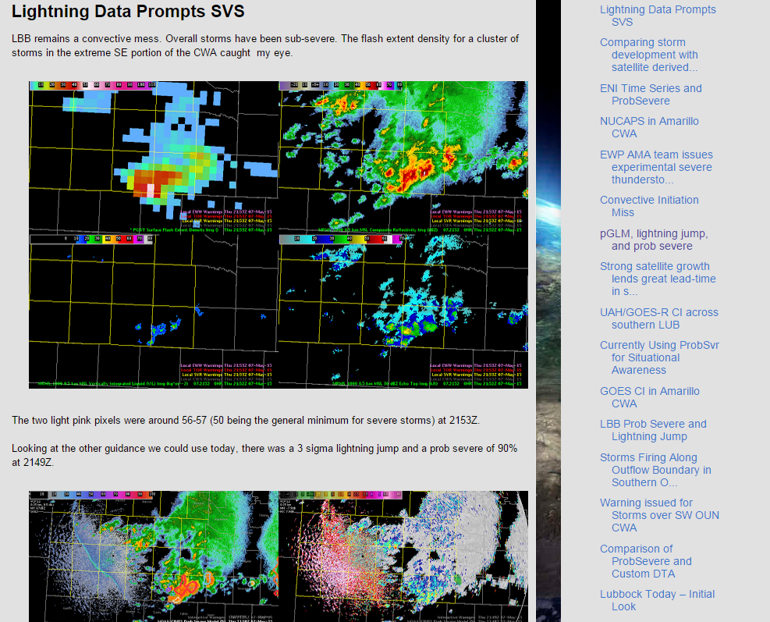
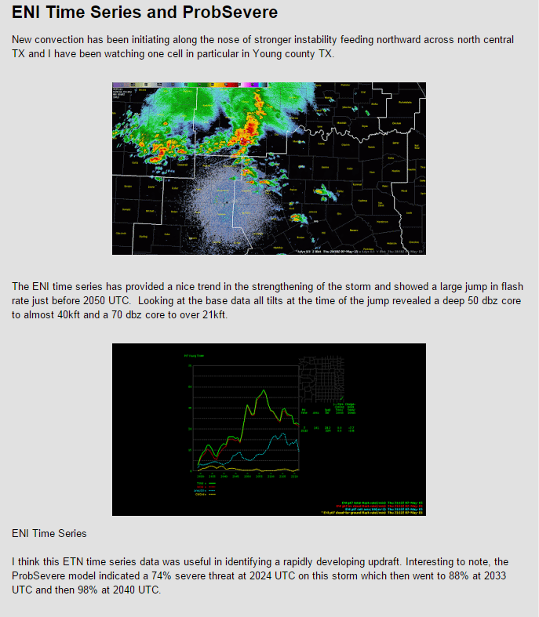
The 2015 GOES-R Proving Ground at the Hazardous Weather Testbed http://goesrhwt.blogspot.com/ http://hwt.nssl.noaa.gov/spring_experiment/
Notes:
Week 1 at HWT- May 7 blog.
Tales form the Test Bed- http://hwt.nssl.noaa.gov/spring_experiment/

Slide 14
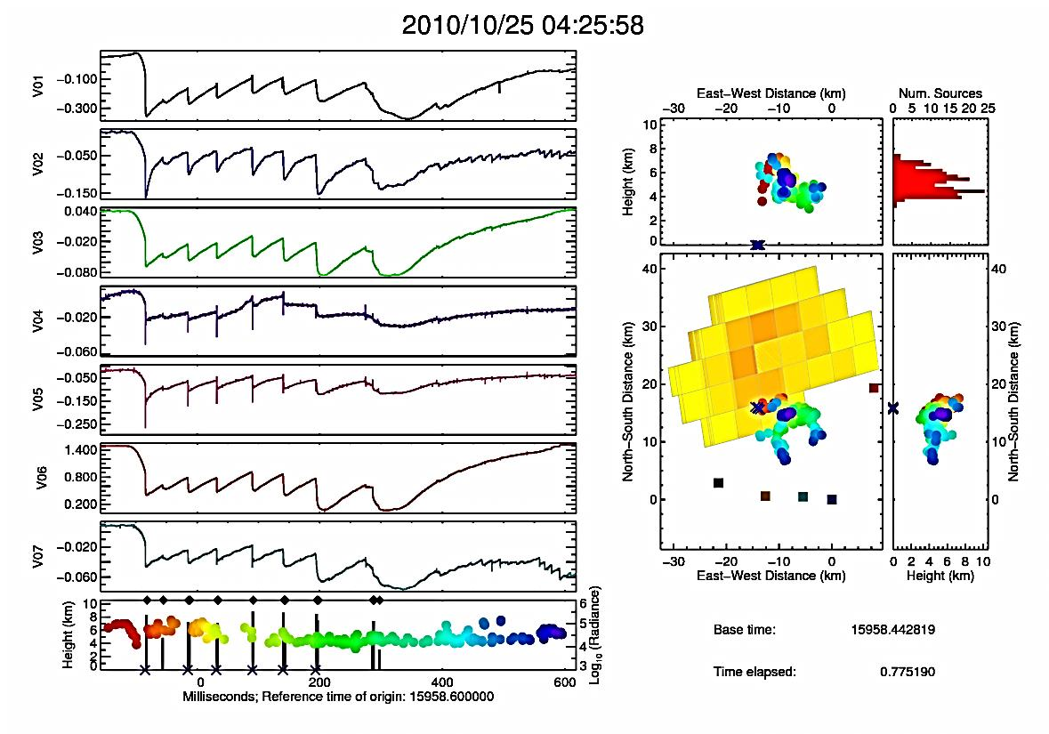
Toward an Operational Use of Stroke Level Lightning Data in Severe Weather Forecasting
Ongoing research using lightning data in the context of severe weather forecasting is promising.
However, only flash level data is used – but not all flashes are equal, energetically.
GLM will provide data that correspond to strokes (called groups in GLM nomenclature).
We will use existing LIS data and ground based electric field networks (e.g., HAMMA) to relate optical measurements to strokes, which are more closely related to the electrical energy output of a storm.
Ultimately, we seek to establish a new paradigm in which GLM data can be better used to relate electrical energy to storm dynamics.
Put one figure here
A single lightning flash observed by HAMMA (colored waveforms) and LIS (gray bars and yellow/red squares). The return strokes are detected by each system – this is the most energetic process in a flash.
Explore how to best use GLM data in relation to storm development
Phillip M. Bitzer and Larry Carey, University of Alabama in Huntsville

Slide 15
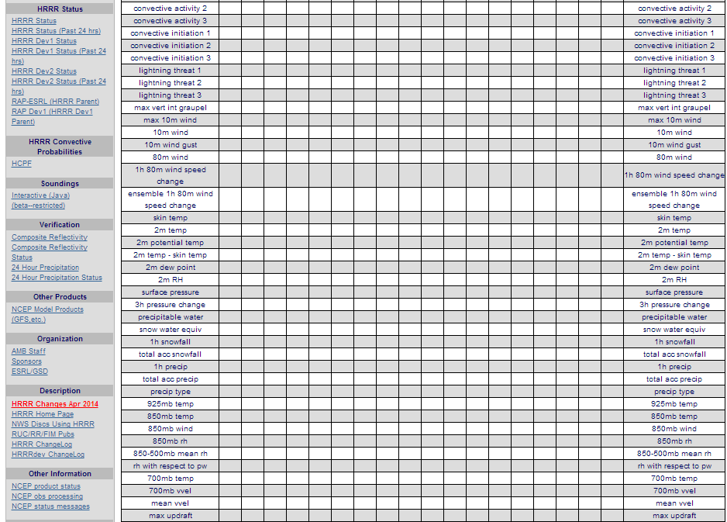
HRRR Forecast Fields
Lightning Threat 3 used for Prob LTG forecast out to 9 hours

Slide 16
HRRR Time-Lagged LTG Ensemble
Combined lightning risk
valid 19-20 z 11 Aug 2014
Combined lightning risk
valid 20-21 z 11 Aug 2014
HRRR From 16z
3-4 hr fcst
LTG3
4-5 hr fcst
HRRR From 15z
4-5 hr fcst
5-6 hr fcst
HRRR From 14z
5-6 hr fcst
6-7 hr fcst
six forecasts
combined
HRRR lightning
threat probability
Spatial filter applied
to each forecast

Slide 17
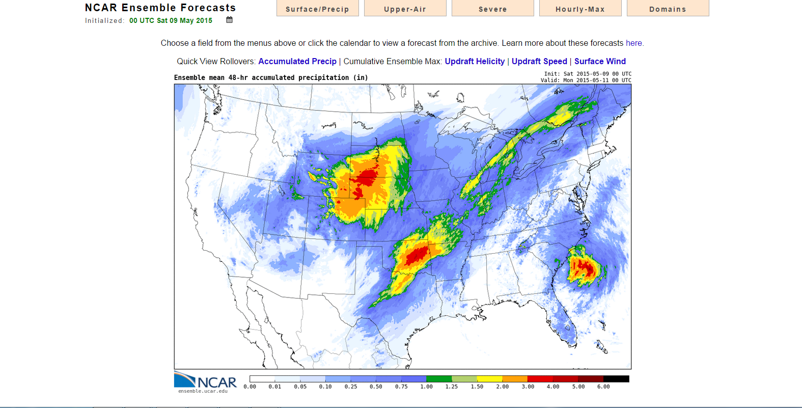
NCAR MMM 10-member Ensemble

Slide 18
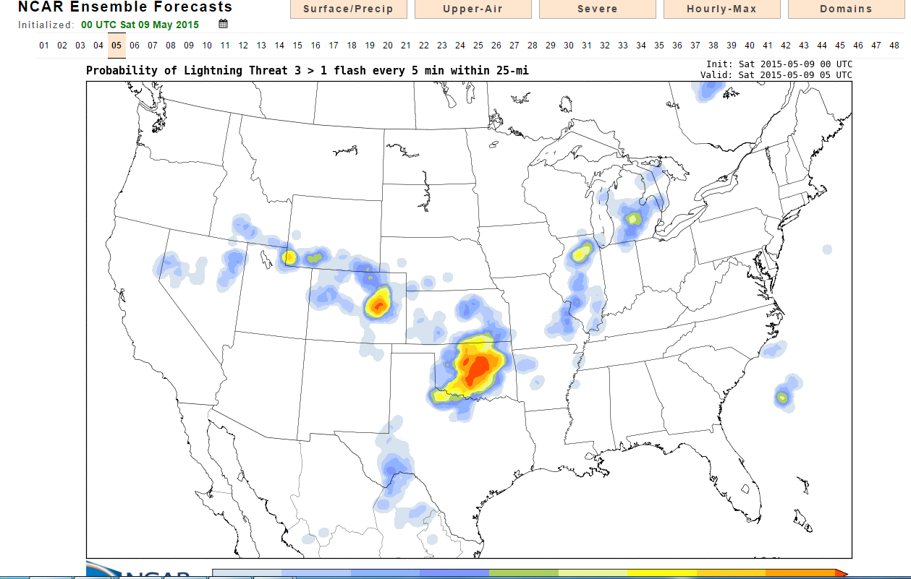
Lightning Threat Forecast

Slide 20
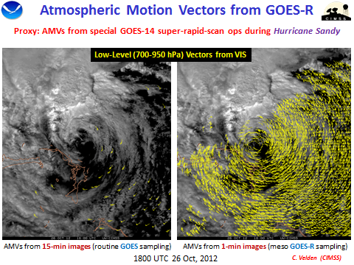
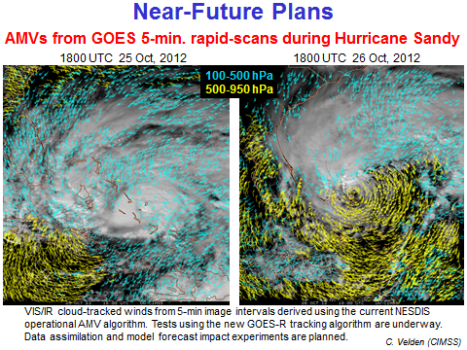
Development and Optimization of Mesoscale Atmospheric Motion Vectors (AMVs) using Novel GOES-R Processing Algorithms on 1-5 min. SRSO Proxy Data, and Demonstration of Readiness for GOES-R Applications via Impact Studies in Mesoscale NWP Systems
Super-rapid-scan operations (SRSO) imagery (available at 1-5 min. frequency) provided during special GOES tests can be used as proxy data for GOES-R readiness.
We can exploit this temporal upgrade towards the development and optimization of AMV production, particularly in situations where super-dense datasets are needed such as in hurricanes or mesoscale applications.
Case study AMV datasets will be processed and optimized, then provided to our mesoscale and hurricane NWP partners for data assimilation and model forecast impact testing.
Put one figure here
Figure caption
Example of AMVs achievable from GOES-14 rapid scan imagery (1-5 min.) available during Hurricane Sandy. The coverage and flow definition is greatly enhanced vs. that from current operational AMVs.
Optimization of AMVs from GOES-R for hurricane and mesoscale applications
C. Velden (UW/CIMSS), J. Daniels (STAR), S. Weygandt (ESRL)

Slide 25
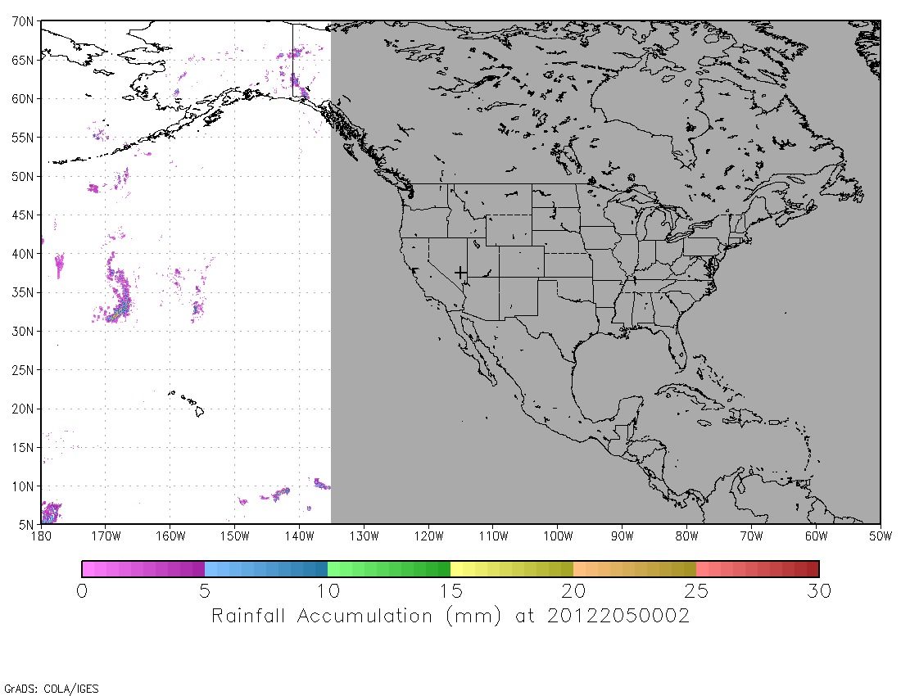
Improving Real-time GOES-R Rainfall Rate Estimates through Infusion of Ground Radar and Gauge Data and Evaluating the Impacts on NWS Flash and River Flood Prediction
Low-latency, high-resolution quantitative precipitation estimates (QPE) are critical for NWS river and flash flood forecast operations
Integrating satellite data into the operational QPE data stream will improve coverage, especially OCONUS
FY 14/15 GOES-R3 project will add radar data to the calibration of the GOES-R Rainfall Rate algorithm (which currently calibrates against microwave rain rates) and optimally merge the satellite QPE with radar and gauges
Output will be provided to the NWS via the Multi-Radar Multi-Sensor System (MRMS) becoming operational at NCEP Central Operations (NCO)
Current-GOES version of the GOES-R Rainfall Rate algorithm (no radar input; calibrated against MW only)
Low-latency multi-sensor QPE will be provided to NWS field offices for hydrologic forecasting
Y. Zhang (NWS/OHD), R. Kuligowski (NESDIS/STAR), and J. J. Gourley (OAR/NSSL)

Slide 26
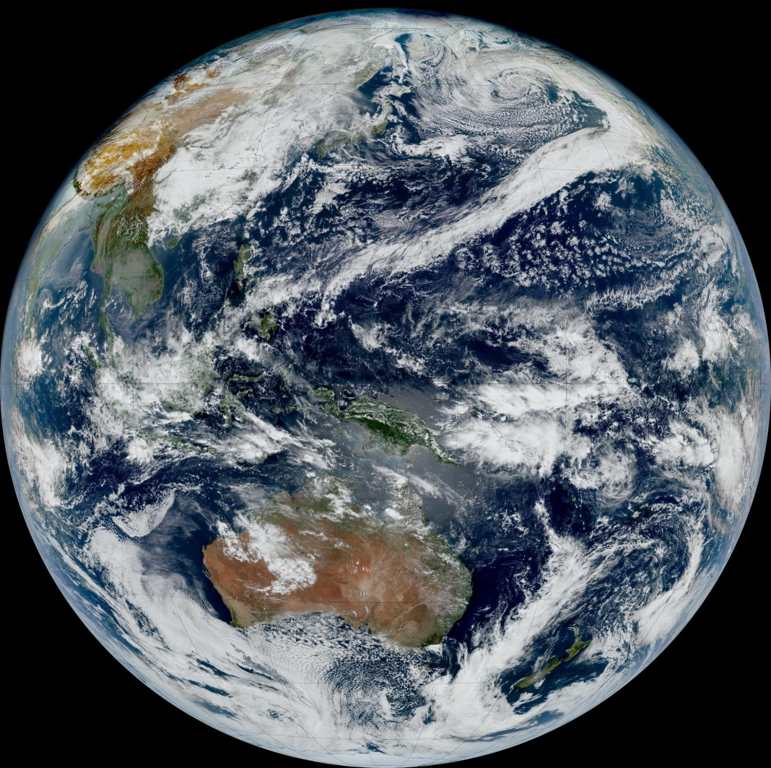
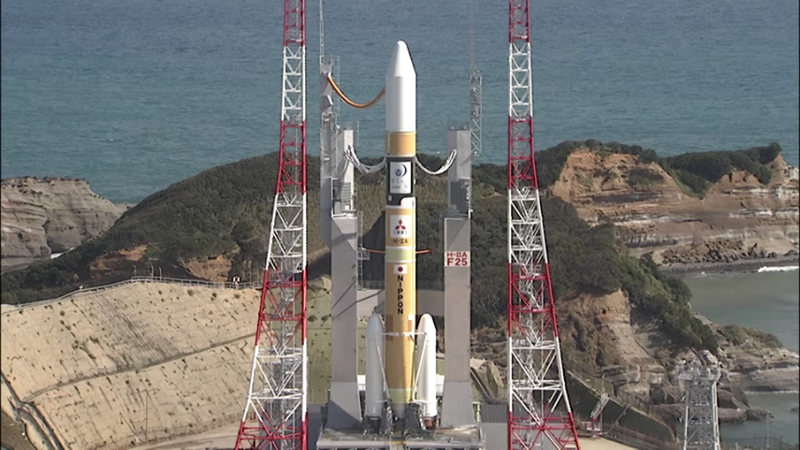
FY15 Plans- Himawari 8
Japan Meteorological Agency (JMA)
Information exchange and collaborative research on volcanic ash and cloud analysis science
Algorithm and Calibration Working Group and team member visits
Access to full resolution HIMAWARI imagery for AWG testing and Proving Ground demonstrations
Blue Marble, Himawari 8 True Color Composite
25-January-2015 02:30 UTC
S. Miller (CIRA) - GOES-R AWG Imagery Team
http://www.data.jma.go.jp/mscweb/en/himawari89/index.html
Notes:
Testing and checking of the Himawari-8 system, including related ground facilities, are going well. Himawari-8 is scheduled to start operation in mid-2015.
For more information: http://www.data.jma.go.jp/mscweb/en/himawari89/index.html
AHI – Advanced Himawari Imager very similar to ABI
The first Image will be taken in the end of AHI IOT
100-day Running Test for satellite mission will be commenced after AHI IOT (In-Orbit Test) – (~end of 2014)
An Experimental Operation will be commenced in April 2015
Full Operation will be commenced in mid-2015
The launch of Himawari-9 for in-orbit standby is scheduled in 2016
Himawari-8/9 will be in operation around 140 degrees East
Himawari-8/9 information is available from MSC Website http://www.jma-net.go.jp/msc/en/
Overview of satellite observations
Overview of Himawari-8/9 data distribution/dissemination
Plan for transition from MTSAT-2 to Himawari-8
Overview of the Himawari-8/9 ground segment and operations
Imaging channels
Observation area and periodicity
HimawariCast
Internet Cloud Service (HimawariCloud)
Sample data
AHI Simulated imagery is now available from Meteorological Satellite Center (MSC) of JMA at http://www.data.jma.go.jp/mscweb/en/himawari89/index.html
AHI “Real” sample image data in “Himawari Standard Data” format will be available from MSC Website soon after the “first” Image will be taken
Internet Cloud Service: JMA plans to start the HimawariCloud service in March 2015.
The HimawariCast service will start in Jan. 2015.
MTSAT-2 imagery will be disseminated through the HimawariCast until Himawari-8 becomes operational for the transition of MDUS users to HimawariCast.
Himawari-8 imagery will thereafter be disseminated via the HimawariCast service.
The technical information on the HimawariCast service is available on JMA’s website.
http://www.data.jma.go.jp/mscweb/en/himawari89/himawari_cast/himawari_cast.html

Slide 27
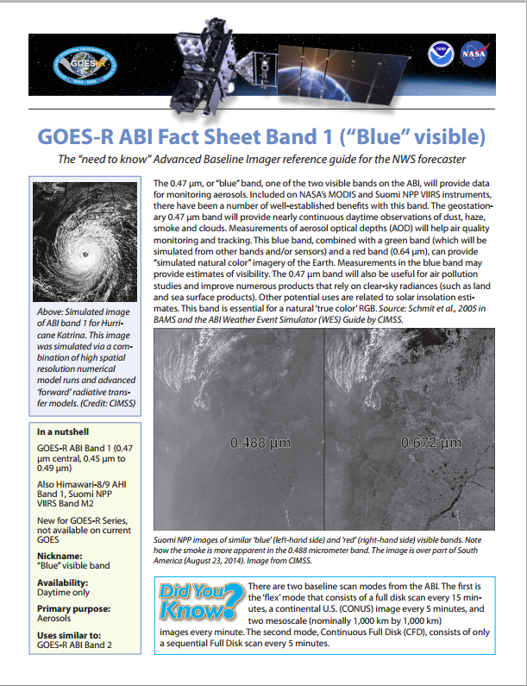
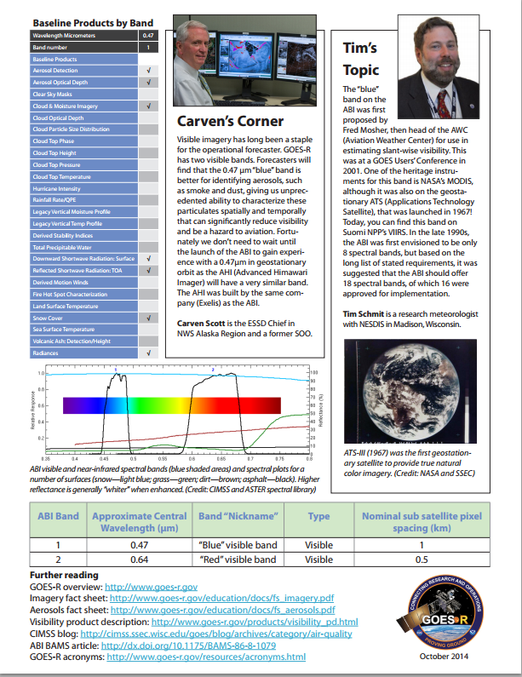
ABI Bands Quick Information Guides
Notes:
A new series of fact sheets detailing each of the Advanced Baseline Imager channels is now under development. These ABI Bands Quick Information Guides are designed as quick reference guides to provide National Weather Service forecasters with information on each of the GOES-R series Advanced Baseline Imager’s 16 spectral bands. Each fact sheet will cover what the band measures and how this is operationally relevant. Each sheet will also include links for more information. Currently, a Band 1 (“Blue” visible) fact sheet is available. http://www.goes-r.gov/education/ABI-bands-quick-info.html

Slide 28
Summary
GOES-R is coming - Launch early 2016
New sensors, products, and services will help improve forecasts and increase lead times for warnings and decision makers
Presents Challenges and Opportunities for model assimilation, data fusion and tools, Warn on Forecast/PHI, ensemble NWP
Product testing as soon as 2 months post-launch, also available to users for science assessment
User preparation is essential to take advantage of the advanced capabilities to support a Weather Ready Nation

Slide 29
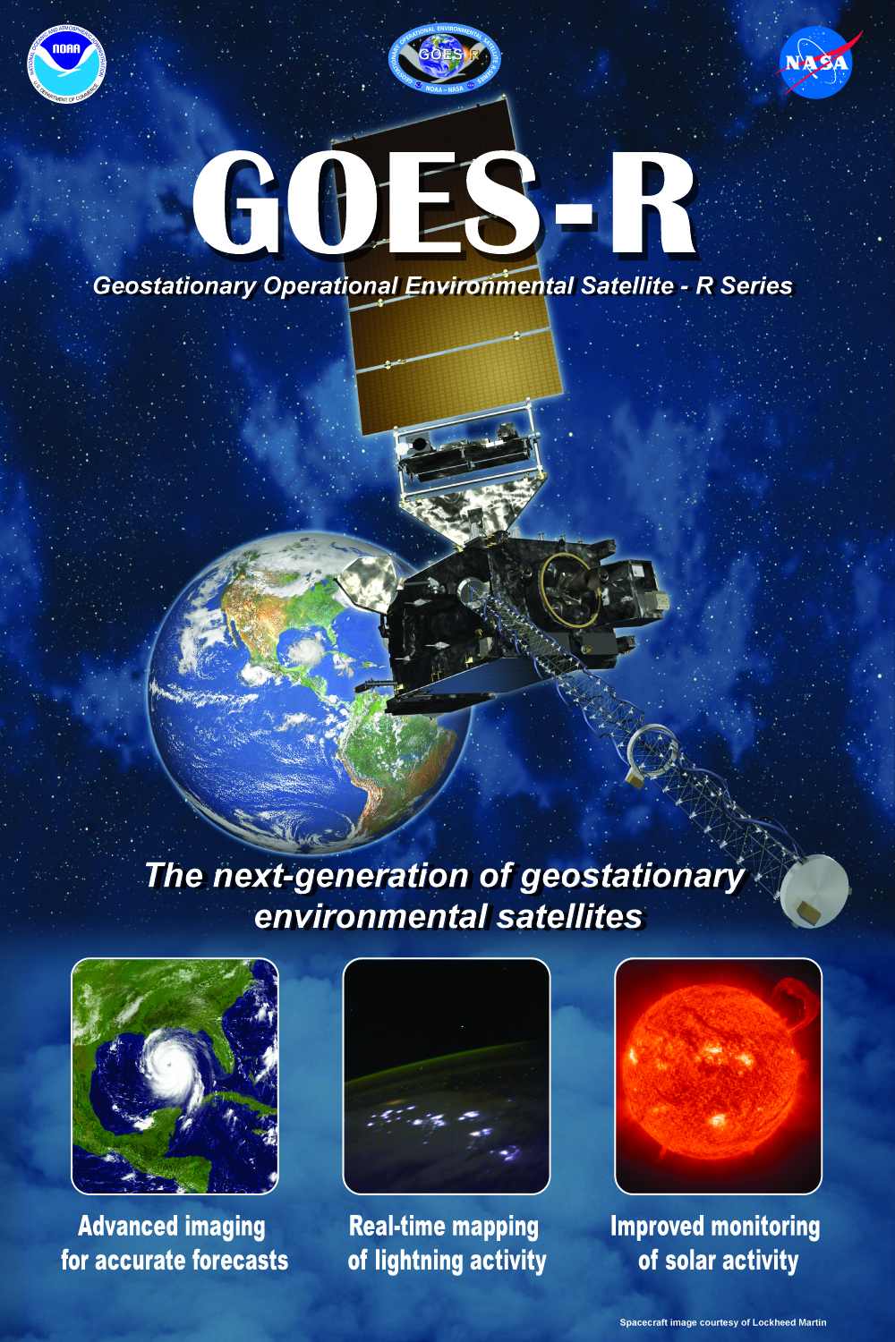
Thank you!
For more information visit www.goes-r.gov
www.facebook.com/ GOESRsatellite
https://www.youtube.com/user/ NOAASatellites
https://twitter.com/NOAASatellites
https://www.flickr.com/photos/ noaasatellites/

