Slide 1
Deriving Atmospheric Winds from GOES-R ABI Measurements
Jaime Daniels (Presented by Jeff Key)
Center for Satellite Applications and Research
National Environmental Satellite Data and Information Surface
National Oceanic and Atmospheric Administration
1

Slide 2
Outline
Background
Importance of satellite wind observations
GOES-R capabilities expected impacts on derived winds
Brief overview of the GOES-R nested tracking winds algorithm
Product examples and assessing product quality
User Readiness Activities for GOES-R Winds
2

Slide 3
Background
Importance of satellite wind observations
GOES-R capabilities expected impacts on derived winds
3

Slide 4
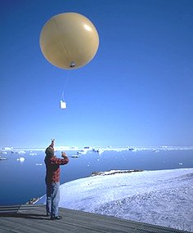
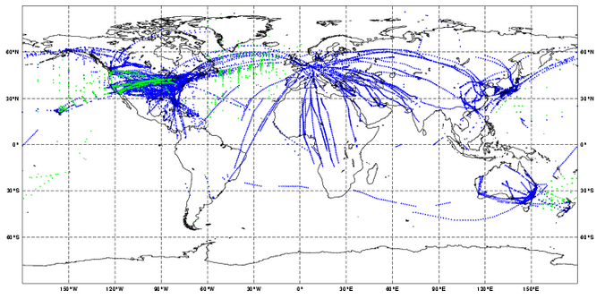
Importance of Satellite Wind Observations
Global Radiosonde Network
Satellite Derived Winds are a Key Component of the Global Observing System (GOS)
Provide vital tropospheric wind information over expansive regions of the earth that are devoid of in-situ wind observations that include oceans, polar regions, and Southern Hemisphere land masses.
Provide key wind observations to operational NWP data assimilation systems where their use has been demonstrated to improved numerical weather prediction forecasts including tropical cyclones
Provide key wind observations to NWS field forecasters at NWS WFOs and National Centers
Situational awareness of wind field
Verification of model output
Aircraft Winds
4

Slide 5
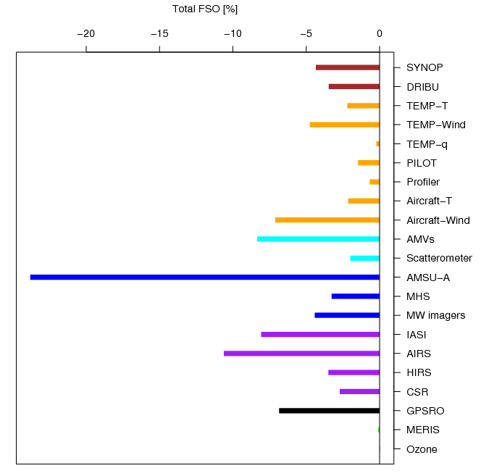
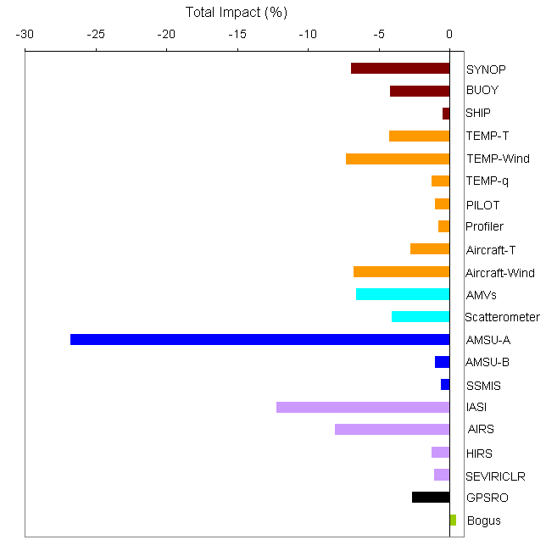
Coordinated Study of AMV Impact Highlights from IWWG Study...
Forecast Sensitivity to Observations (FSO)
Adjoint-based FSO method gives estimate of the contribution of each observation towards reducing the 24-hour forecast error
Satellite winds reduce 24 hour forecast error on the order of 7-11% (NRL was exception)
Places satellite winds among the top global observing system observations that contribute in a positive way to NWP global forecast impact
ECMWF
Met Office
NRL
5
Notes:
IWWG study done in 2012

Slide 6
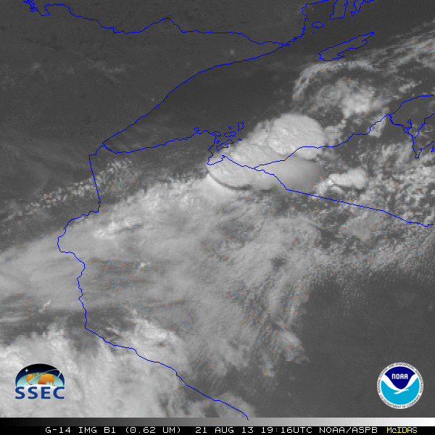
How will the GOES-R ABI improve our ability to retrieve better wind products?
Higher Spectral Resolution
Improved cloud detection and cloud retrievals
Higher Spatial Resolution
Able to retrieve motion at smaller scales
Higher Temporal Resolution
Improved feature tracking
Improved Radiometrics
Improved tracking
Improved AMV height assignments
Improved Navigation and Registration
Improved tracking
All of these things contribute to one being able to observe and retrieve phenomenon not previously observed before
GOES-14 provided very unique information and offers a glimpse into the possibilities that will be provided by the ABI on GOES-R.
6

Slide 7
ABI Bands Used to Derive Winds
ABI Band | Center Frequency (um) | Target Scene Size (Lines x Elements) | Horiz. Res (km) | Image Time Interval (mins) | Refresh Rate (mins)
2 | 0.64 | 15x15 | 7.5 | Full Disk: 5 or 15 CONUS: 5 Meso: 5 | Full Disk: 60 CONUS: 15 Meso: 5
7 | 3.90 | 15x15 | 30 | Full Disk: 5 or 15 CONUS: 5 Meso: 5 | Full Disk: 60 CONUS: 15 Meso: 5
8 (Cloudy targets) ------------------------ 8 (Clear-air targets) | 6.15 | 15x15 | 30 | Full Disk: 5 or 15 CONUS: 5 Meso: 5 ----------------------- Full Disk, CONUS, Meso: 30 | Full Disk: 60 CONUS: 15 Meso: 5
9 | 7.0 | 15x15 | 30 | Full Disk, CONUS, Meso: 30 | Full Disk: 60 CONUS: 15 Meso: 5
10 | 7.4 | 15x15 | 30 | Full Disk, CONUS, Meso: 30 | Full Disk: 60 CONUS: 15 Meso: 5
14 | 11.2 | 19x19 | 38 | Full Disk: 5 or 15 CONUS: 5 Meso: 5 | Full Disk: 60 CONUS: 15 Meso: 5
7

Slide 8
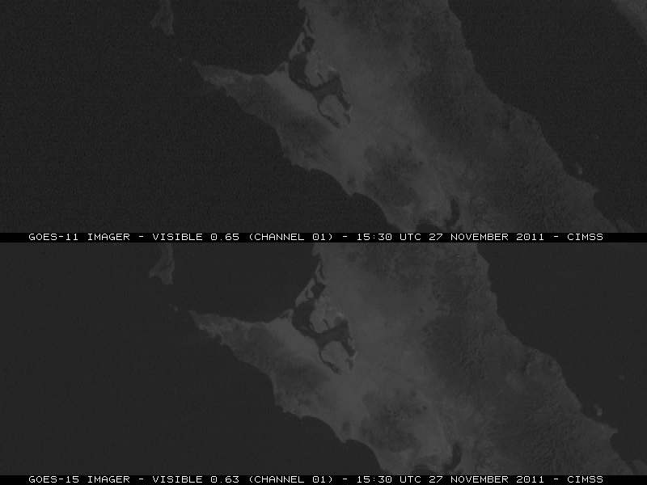
How will the GOES-R ABI improve our ability to retrieve better wind products?
Improved Navigation
and Registration
Will lead to a more
accurate wind product
GOES-15 provides a hint
of ABI’s INR quality…
8

Slide 9
How will the GOES-R ABI improve our ability to retrieve better wind products?
Improved Radiometric
Performance together
with Improved Spectral
and Spatial Resolution
Will lead to improved wind
height assignments and a
more accurate wind
product
100
200
300
400
Poor heights assigned to winds can produce large wind errors, especially in regions of large vertical wind shear
500
16 m/s error
Pressure (hPa)
600
700
800
900
u component (truth)
AMV height assignment
1000
-20
0
20
40
60
m/s
9
Notes:
Errors in heights assigned to winds are more problematic if large vertical wind shear exists
1 m/s = ~ 2.2 miles/hour
700mb: ~ 3km
400mb: ~ 7km
100mb: ~ 15km

Slide 10
Brief overview of the GOES-R nested tracking winds algorithm
10

Slide 11
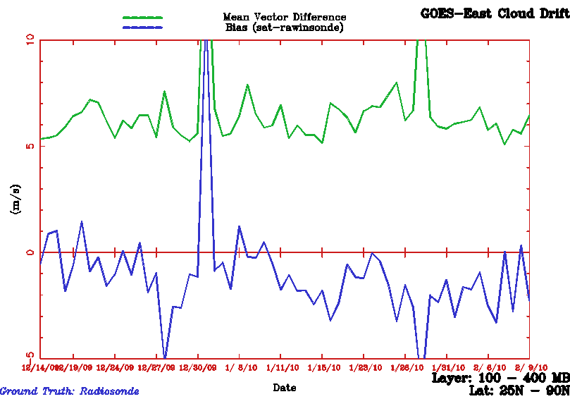
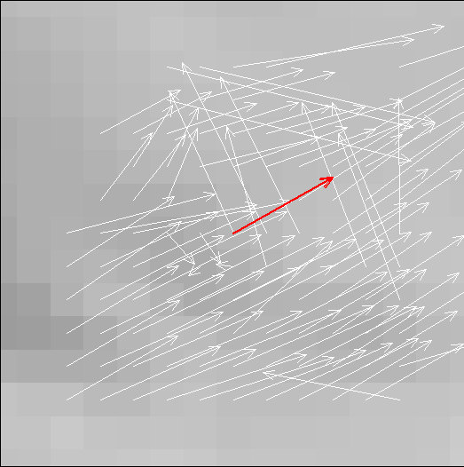
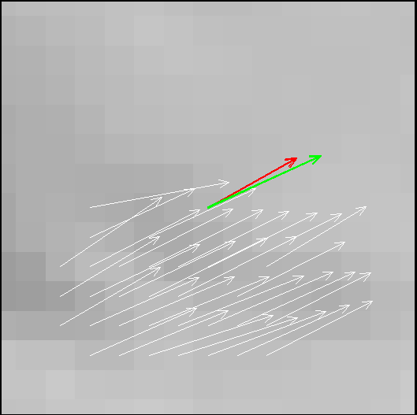
GOES-R Nested Tracking
Winds Algorithm
Designed to minimize observed slow speed bias of satellite winds; a long standing concern of the NWP community
Computes local motions (white arrows) within a larger target scene.
Clustering algorithm used to analyze local motion displacements. The average of the local motions from largest cluster is the final motion solution (green arrow)
Cloud heights at pixels belonging to the largest cluster are used to assign a representative height to the derived motion wind
GOES-12 Satwinds vs. Rawinsonde (100-400 hPa)
10
Mean Vector Difference
5
m/s
0
Speed Bias
-5
Date
Red arrow denotes motion of the entire NxN target scene
SPD: 22.3 m/s
Green arrow denotes average of the largest cluster
SPD: 27.6 m/s
N
Before clustering
After clustering
N
11

Slide 12
Product Examples and Assessing Product Quality
12

Slide 13
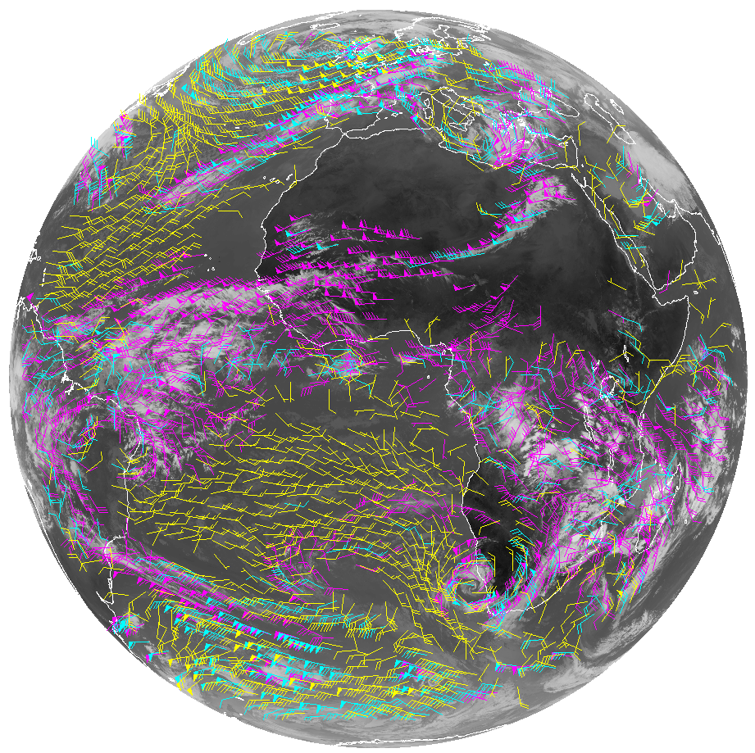
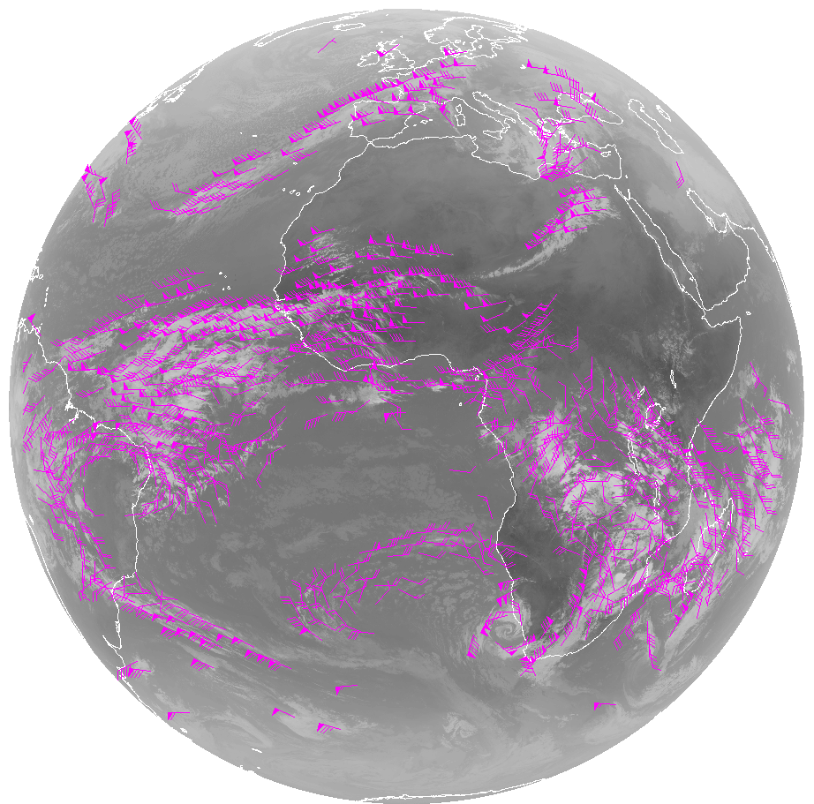
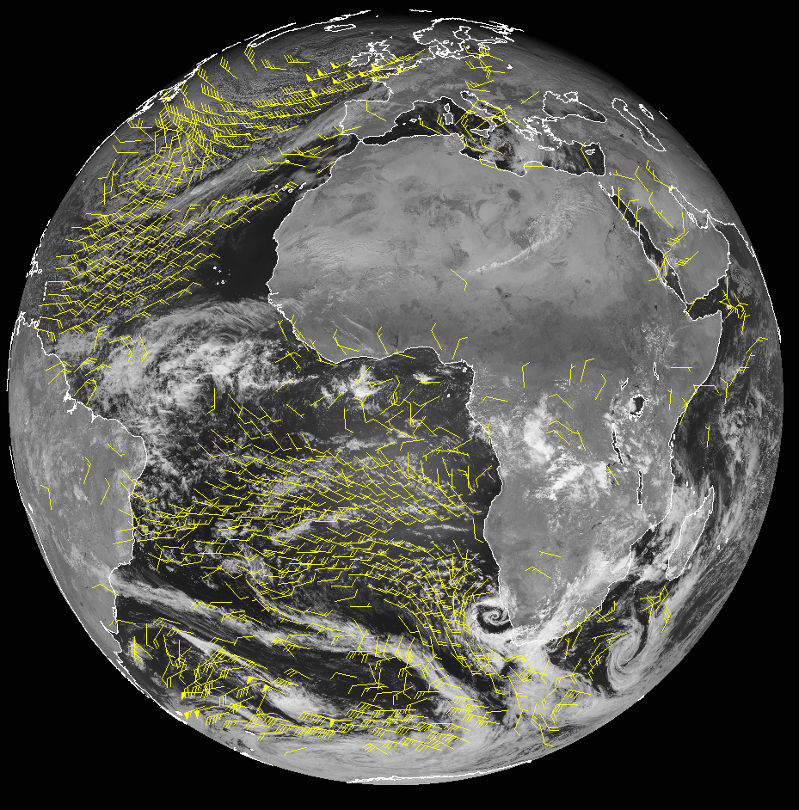
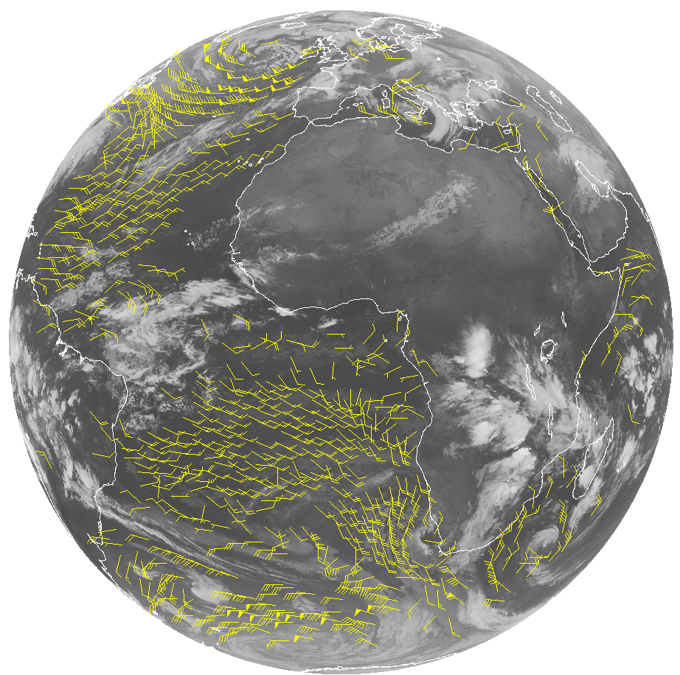
Meteosat-10/SEVIRI FD Winds
LWIR (10.8um)
January 6, 2013)
WVCT (6.2um)
VIS (0.60um)
High-Level 100-400 mb
Mid-Level 400-700 mb
Low-Level >700 mb
SWIR (3.9um)
13
Notes:
The Winds Team has been routinely generating experimental winds from GOES-13, GOES-15, Meteosat-9/10/SEVIRI , and NPP/VIIRS using the GOES-R winds algorithm.
Meteosat-10/SEVIRI FD Winds derived rom 0.60um, 3.9um, 6.2um (WVCT & CSWV), 7.3um (CSWV) and 10.8um bands the winds team is routinely generating
13

Slide 14
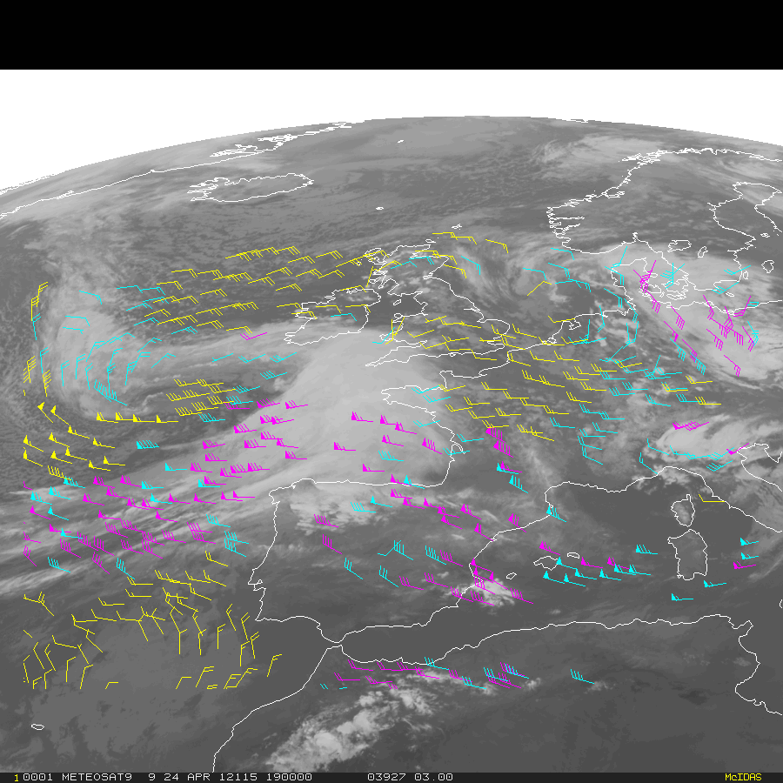
Using SEVIRI as a Proxy for the Future GOES-R ABI
Application of GOES-R Winds Algorithm
to Meteosat/SEVIRI
Loop of winds derived from hourly Full Disk Meteosat-9 SEVERI 10.8 µm imagery (22 UTC Apr 24 – 08 UTC Apr 25, 2012
High-Level 100-400 mb
Mid-Level 400-700 mb
Low-Level >700 mb
14

Slide 15
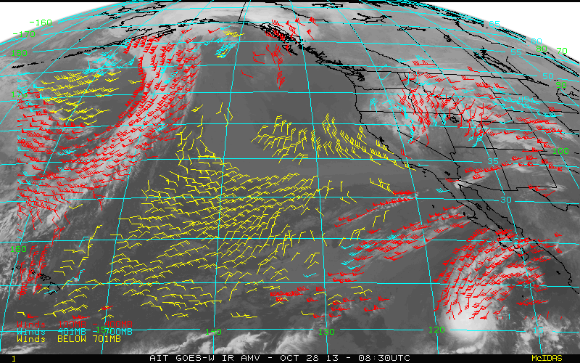
Application of GOES-R Winds Algorithm
to Current GOES
Cloud-drift winds derived from 15-min GOES-15 imagery over the East Pacific
High-Level 100-400 mb
Mid-Level 400-700 mb
Low-Level >700 mb
15

Slide 16
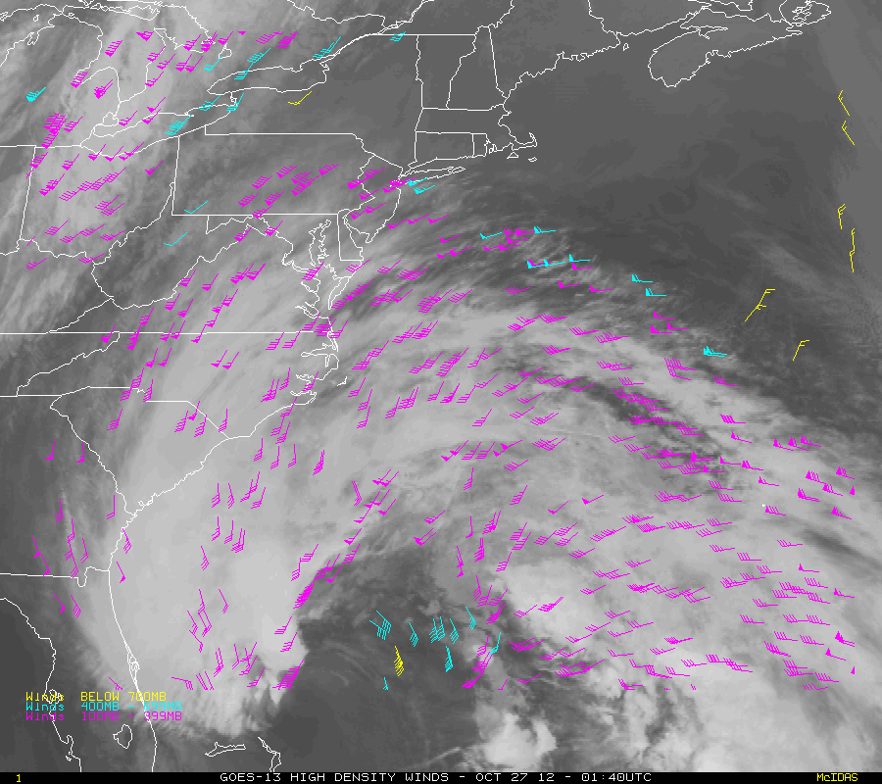
Application of GOES-R Winds Algorithm
to Current GOES
Cloud-drift winds derived from 15-min GOES-13 imagery over Hurricane Sandy (4-day loop)
High-Level 100-400 mb
Mid-Level 400-700 mb
Low-Level >700 mb
The GOES-R Winds Team continues to routinely generate and validate ABI proxy winds from GOES-13, GOES-15, Meteosat-10/SEVIRI, and NPP/VIIRS using the GOES-R winds algorithm.
16
Notes:
22 UTC April 24 – 08 UTC April 25, 2012

Slide 17
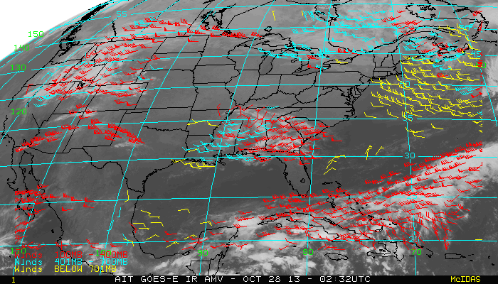
NESDIS Operations Plans to Implement an Upgraded GOES Product Processing System Framework
Implements Level-2 cloud and derived motion wind algorithm software, developed for the GOES-R ABI, into NESDIS operations for use with the current GOES-N/O/P series
Planned operational date: August 2015
Assures consistency between AMV products generated from GOES-N/O/P series and GOES-R, a likely operational scenario
Will run in parallel with current heritage GOES wind products for 9 months to give NWP users time for testing and switchover activities
GOES-13 LWIR Winds derived from 10.7µm band over the CONUS sector
High-Level 100-400 mb
Mid-Level 400-700 mb
Low-Level >700 mb
17

Slide 18
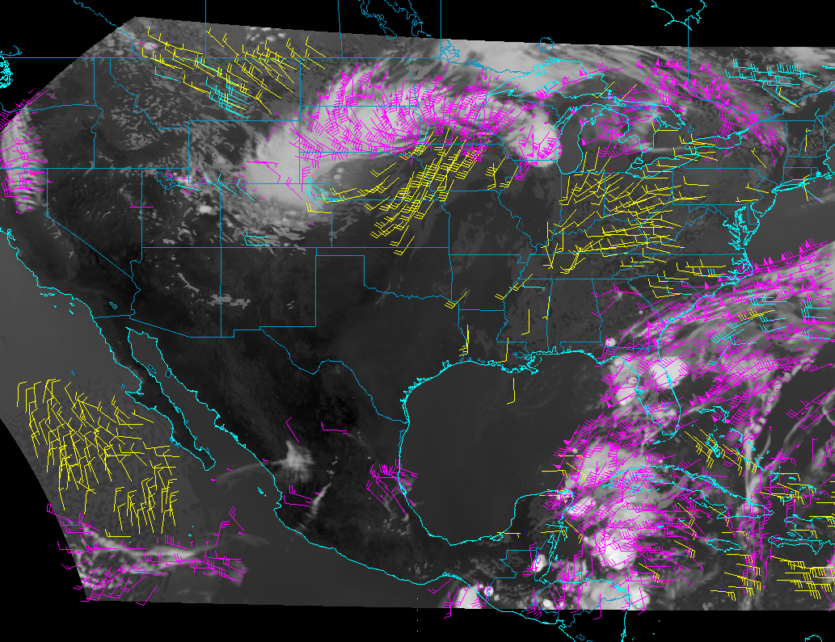
Application of GOES-R Winds Algorithm to
Simulated GOES-R ABI Imagery
High-Level 100-400 mb
Mid-Level 400-700 mb
Low-Level >700 mb
18
Notes:
WRF-CHEM Simulated ABI Imagery routinely produced every hour by the GOES-R ABI proxy team.
Initial Capability/Demonstration by AWG proxy team at CIMSS
WRF-Chem model met/aerosol forecasts (8km) over CONUS using the Community Radiative Transfer Model (CRTM) to simulated all 16 ABI bands.
NCEP/GFS model 3 hr forecast (T574L64, an effective grid point spacing of ~27 km) outputs used, together with CRTM (v2.1), to produce ABI simulated radiances (all bands) at 3hr intervals over FD
Generate simulated ABI radiances at 1hr intervals via interpolation of 3hr GFS forecast output and running CRTM every hour
Simulated data (all bands) are remapped from WRF-chem & GFS grids to the GOES-R ABI fixed grid at their expected resolutions and converted to GRB format

Slide 19
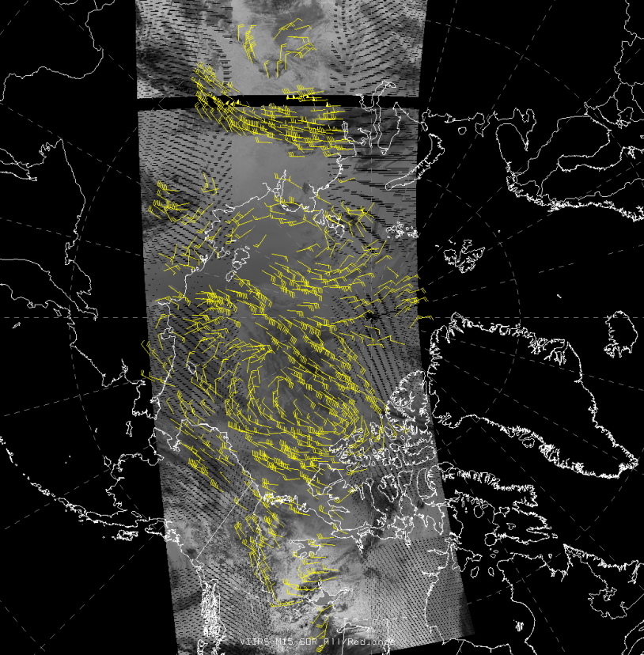
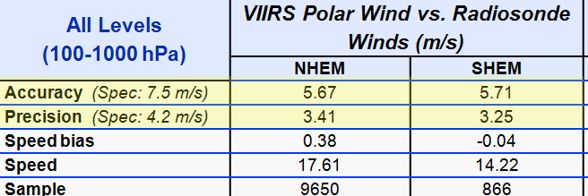
Winds from VIIRS Derived from the GOES-R Winds Algorithm
The VIIRS polar winds product achieved operational status on 8 May 2014.
VIIRS M15 (10.76um) band used
First operational use of GOES-R algorithms (clouds, winds)at NESDIS.
Data distribution via NESDIS’ NDE distribution server & EUMETCAST
September, 2013 – January, 2014
19

Slide 20
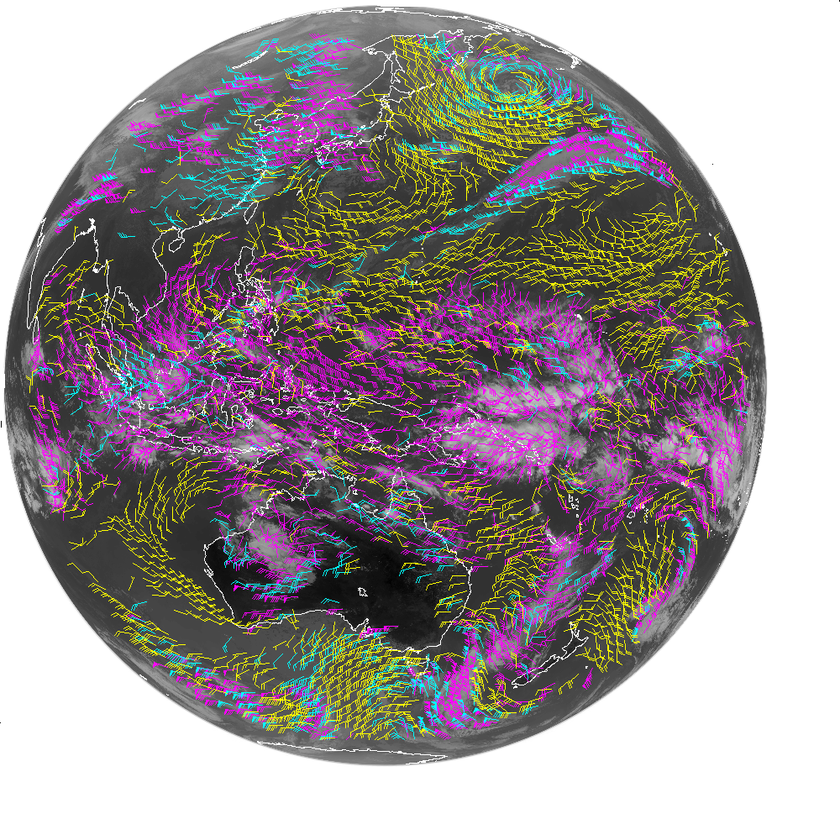
H-8/AHI Winds
HIMAWARI-8 AHI 1/24/2015 2120 UTC
Band 14 (11um) Winds
Over 50,000 AMVS were generated over the FD (~ 4x increase from current GOES)!!!
These winds were generated using 3 FD images separated by 10 minutes.
Image registration for these three images was quite good.
High-Level 100-400 mb
Mid-Level 400-700 mb
Low-Level >700 mb
20
Notes:
The Himawari-8 Advanced Himawari Imager (AHI) is in the relatively early stages of in-orbit checkout
Over 50,000 AMVS were generated over the FD (~ 4x increase from current GOES)
These winds were generated using 3 FD images separated by 10 minutes. Image registration for these three images was quite good.

Slide 21
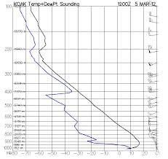
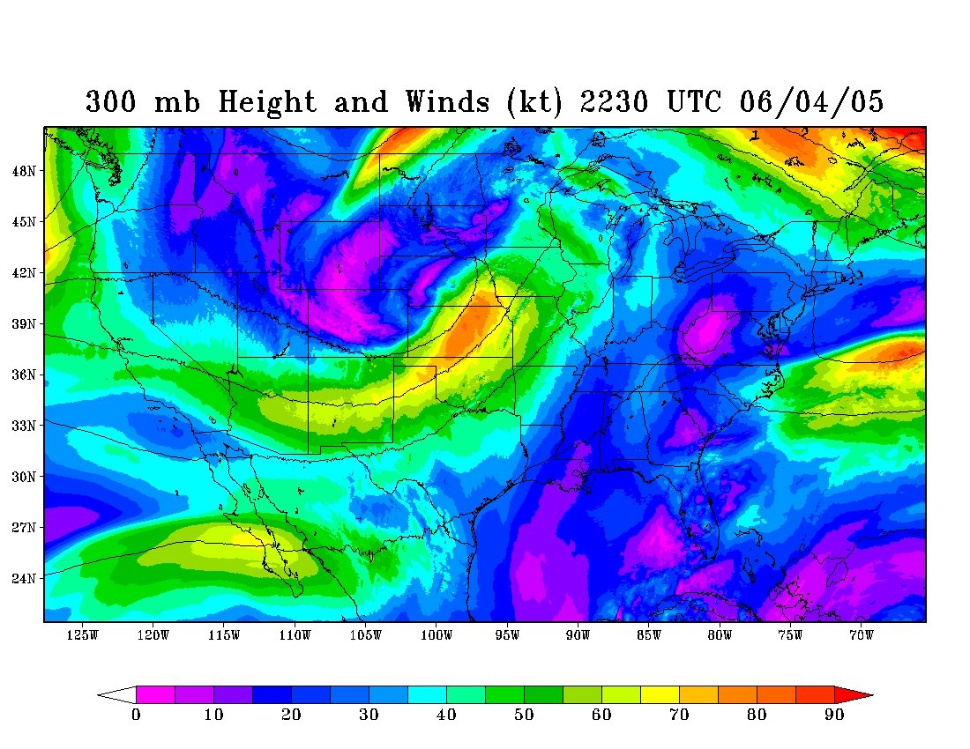
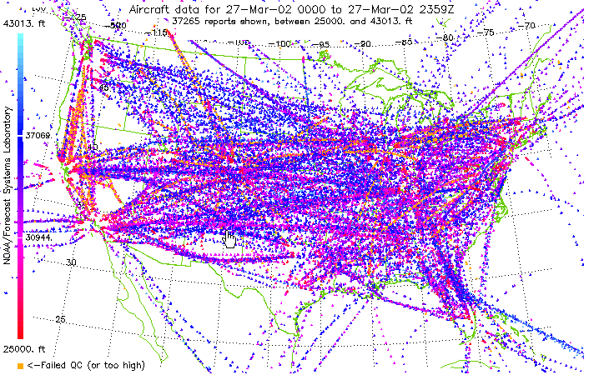
Assessing the Quality of Satellite Derived Winds
Radiosonde Wind Observations
Used by all operational satellite processing centers that generate satellite derived motion winds
NCEP GFS Analyses Winds
Useful over ocean
Aircraft Communications and Addressing System (ACARS) Wind Observations
21
Notes:
Satellite-derived winds and these reference wind observations are collocated in space and time

Slide 22
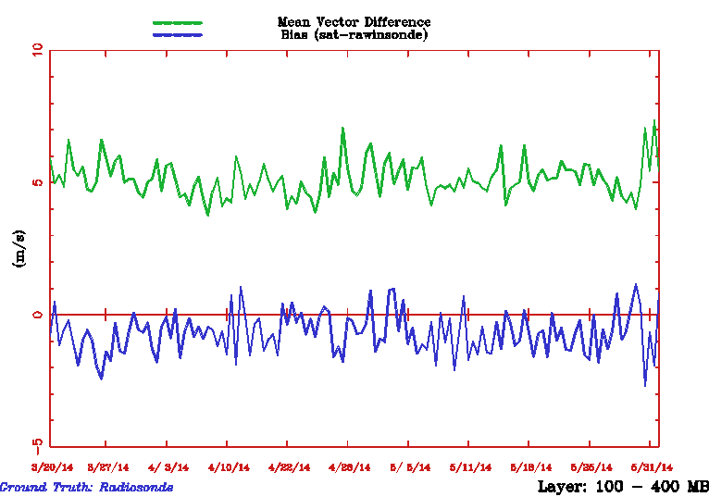
Assessing the Quality of Satellite Derived Winds (vs radiosondes)
100-400 mb
Meteosat-10/SEVIRI Winds (10.8um)
Mean Vector Difference
Overall Metrics for the Period:
MVD = 4.84 m/s
NRMS = 0.37
Speed Bias = -0.72 m/s
Avg Speed = 16.12 m/s
N = 23,400
Speed Bias
22
Notes:
Satellite-derived winds and these reference wind observations (radiosondes in this case) are collocated in space and time.
We can do the same comparison for aircraft wind observations…

Slide 23
User Readiness Activities for GOES-R Winds
23

Slide 24
User Readiness Activities for
GOES-R Winds
Coordination with GOES-R PG Liaisons to acquire GOES-13/15 winds (generated via GOES-R Winds Algorithm) from STAR and bring them into OPC, AWC, and NHC
Nearing completion of the GOES-R3 Project aimed at readying NCEP for Assimilation of GOES-R AMVs in NCEP’s GFS/GSI
Project Title: “Development of Advanced Data Assimilation Techniques for Improved Use of Satellite-Derived Atmospheric Motion Vectors”
Participants: Sharon Nebuda (CIMSS), Jim Jung (CIMSS), Jaime Daniels (NESDIS/STAR), and Wayne Bresky (IMSG)
Work being done in close collaboration with NCEP personnel
Successful development and testing of GOES-R AMV quality control procedures that are being adopted at NCEP
Prepare NCEP for ingest of GOES-R wind products
Application of GOES-R wind algorithm to Himawari-8/AHI
Completed modifications to winds software for H-8/AHI; successfully generated H-8 winds
Working to establish routine H-8 winds processing at STAR
Will provide NWS with H-8 AMV datasets for NWS testing of AWIPS-2 plug-in
24

Slide 25
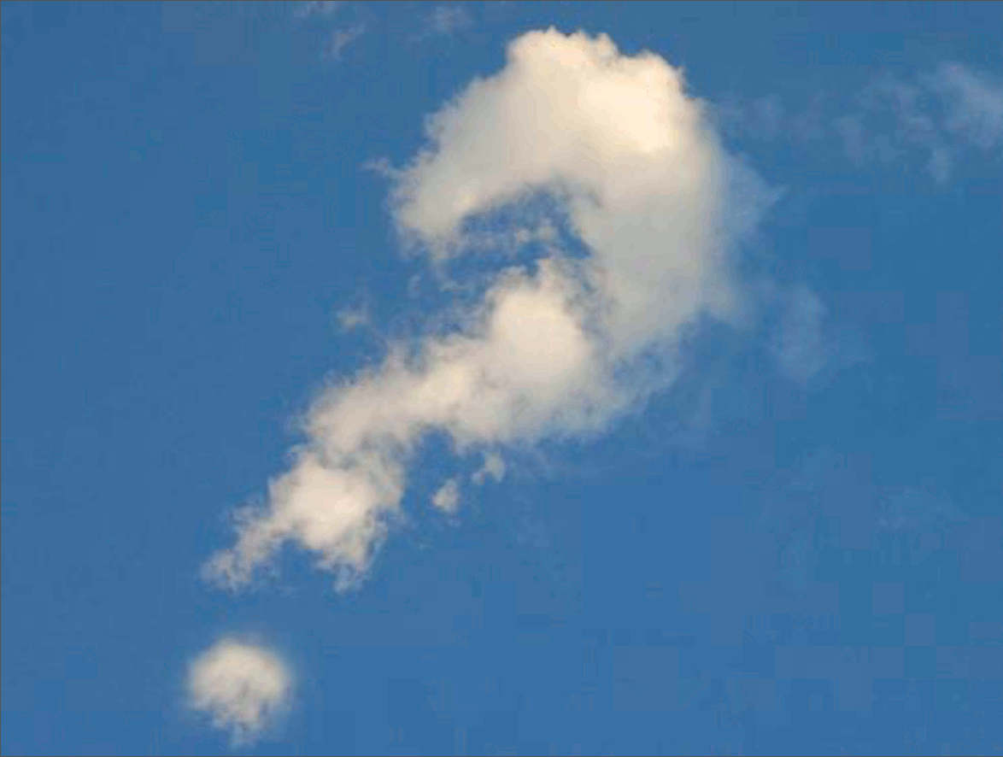
Questions
25

