Slide 1
FACETs: Evolving a New Warning Paradigm
Seeking Clarity & Coalescence
in the Primordial Soup
Lans P. Rothfusz
Deputy Chief
Warning R & D Division
NSSL
Notes:
Self introduction and introduction of topic.

Slide 2
We’ve always sung from the same sheet of music…
Future MIC

Slide 3
FACETs

Slide 4
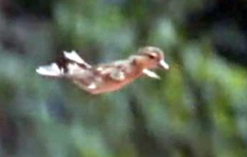
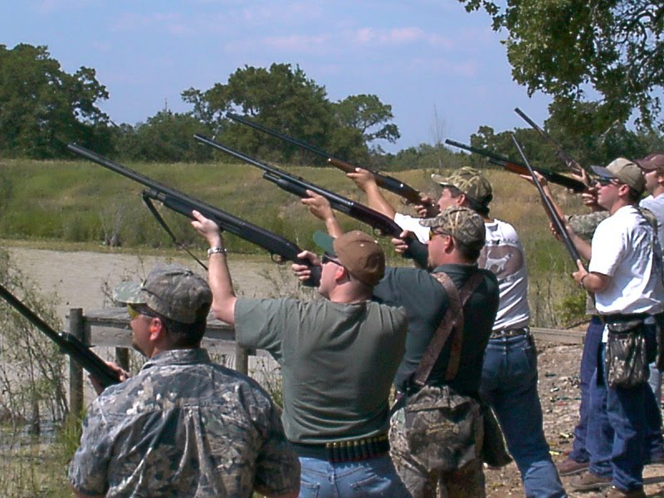
WoF Workshop

Slide 5
Informed By…
Weather Ready Nation
Norman 2011
Birmingham 2012
NWS Scientific Services Div. Chiefs
“Science & Technology Roadmap Capstone” (10/1/12)
NWS Roadmap
National Research Council
“Weather Services for the Nation: Becoming Second to None” (2012)
1000+ years of NWS field experience.
For WoF, Dave Stensrud!

Slide 6
Credits
A whole host of unofficial contributors…
Greg Stumpf
John Ferree
Eli Jacks
SSD Chiefs
NSSL Leadership
Alan Gerard
Pete Wolf
Steve Piltz
Travis Smith
Steve Lyons
Bill Bunting
David Andra
Jami Boettcher
Kim Klockow
Harold Brooks
Lou Wicker
Ken Howard
Jon Zeitler
My wife
And many others…

Slide 7
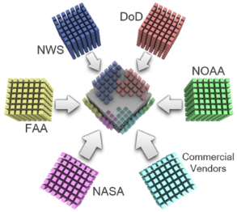
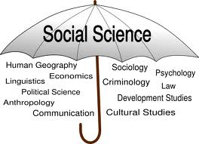
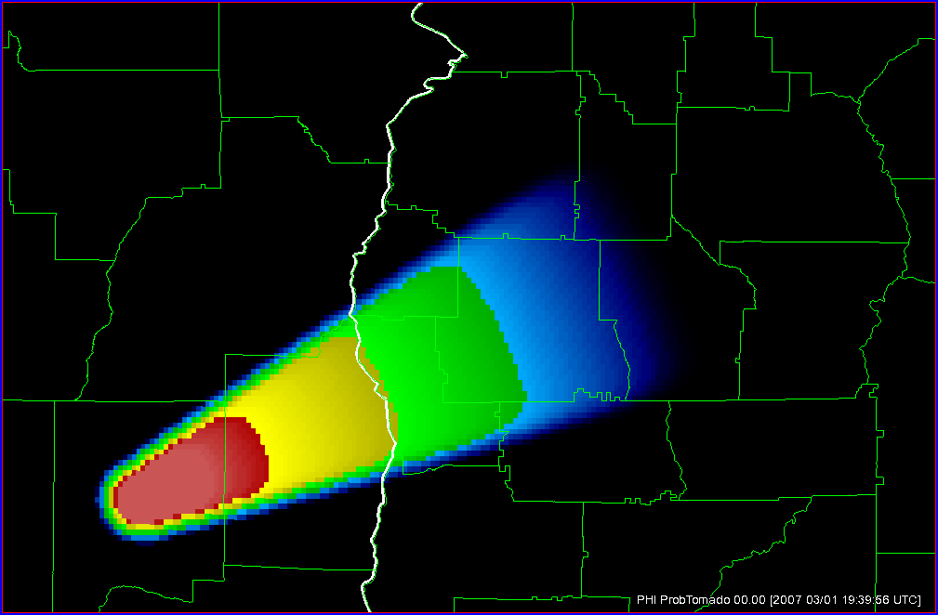
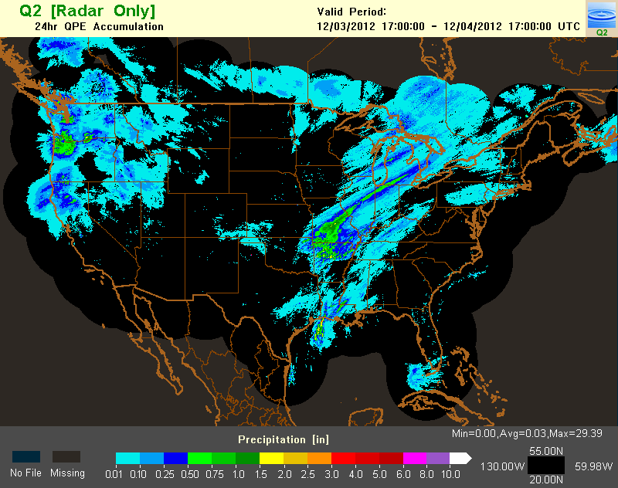
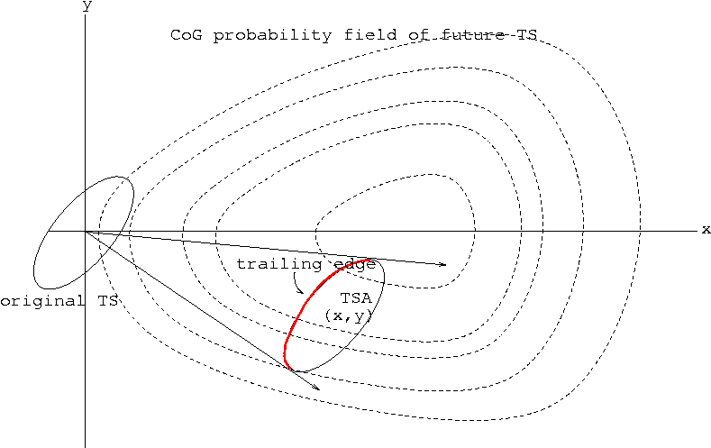
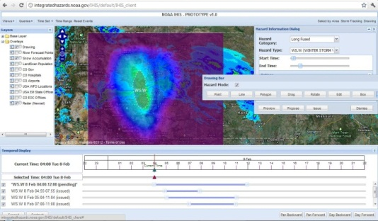
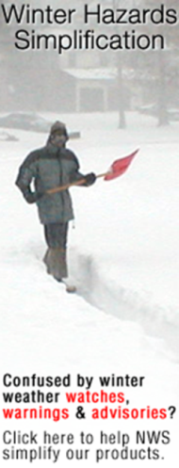
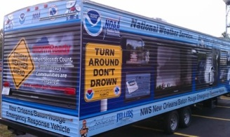
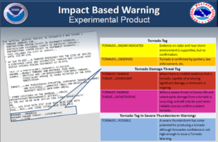
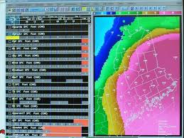
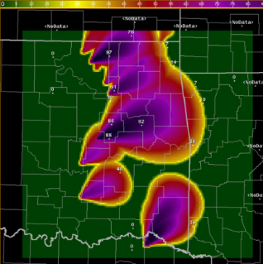
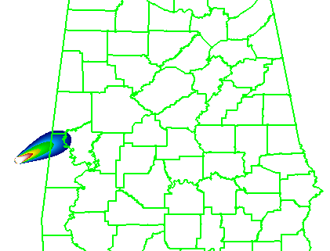
The Primordial Soup
Weather Ready Nation
The Grid
Probabilistic Hazard Information (PHI)
MRMS
WoF
THESPA
Hazard Services
Mid-South Warning
Improvement Project
Pilot Projects
Impact-Based Warnings
FDP
UberGrids
Threats in Motion
Threat Petals

Slide 8
The Primordial Soup
“Ingredients” of the primordial soup are advancing, but each on their own trajectory.
Poorly-coordinated = No assurance they will “arrive” in the same place as others.
Impractical in today’s fiscal climate.
For “Warning R&D,” this sucks!
All connected by a common desire to improve public safety!
Mid-South Warning
Improvement Project

Slide 9
The Opportunity
There is a need (and opportunity) to coalesce the disparate activities into a single vision for a threat forecasting* paradigm that is…
Modern
Effective
Scientifically robust
Holistic
Unifying
*beyond watches & warnings

Slide 10
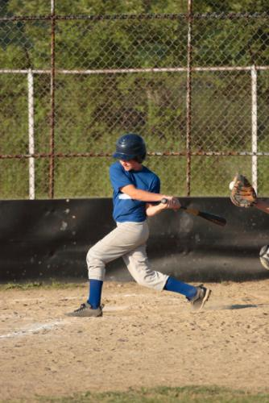
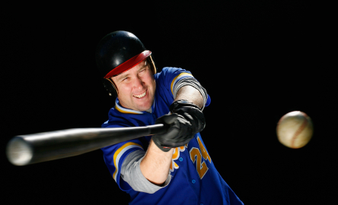
A Swing at a Coalescing Vision
This is a possible vision based on the state and trajectory of warning improvement activities.
It may also be the last time you ever listen to me.
Ball

Slide 11
Forecasting a Continuum of Environmental Threats
of Environmental Threats
Forecasting a Continuum
FACETs

Slide 12
Informing a Paradigm Change
Refine, revise and/or reinvent (e.g., WRN).
Future Warning Paradigm
Good things we do now.
Challenges we have now.
Trajectories of science, tools and society.
First, do no harm!
Where we’re headed.

Slide 13
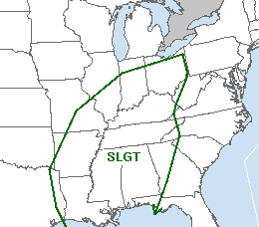
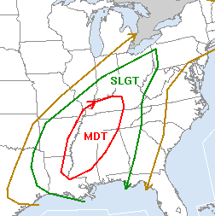
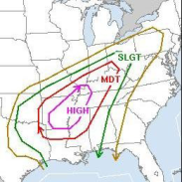
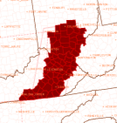
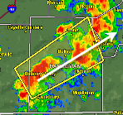
Decision Support Information
Information Void(s)
Outlooks
Watches
Warnings
Time
Days
Hours
Minutes
Event
Space
Regional
State
Local
Product-centric and binary.
More information needed.
More information available.
Adapted from Dr. Heather Lazrus (SSWIM)
Notes:
13

Slide 14
A Continuum of Decision Support Information
Outlooks
Watches
Warnings
Time
Days
Hours
Minutes
Event
Space
Regional
State
Local
Information Continuum
Adapted from Dr. Heather Lazrus (SSWIM)
Notes:
14

Slide 15
FACETs Paradigm
Six Pillars of the Paradigm
Grid-Based Probabilistic Threats
Storm-Scale Obs & Guidance
Threat Grid Tools
Useful Output
Effective Response
Verification
Temporal Continuum
of the
Threat
Forecasting
Process

Slide 16
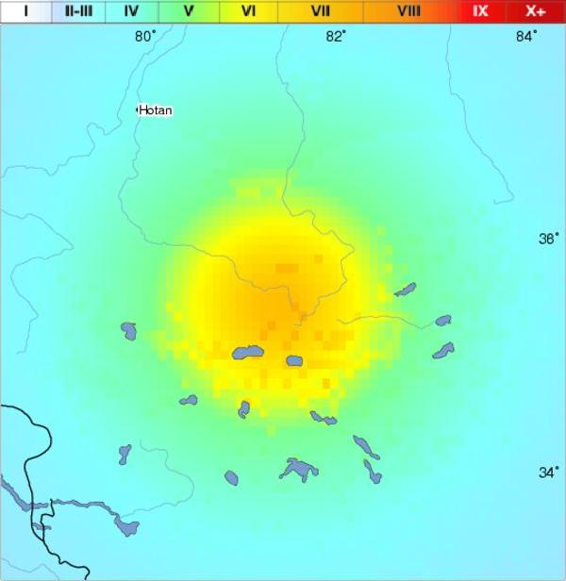
Pillar #1: Grid-Based Probabilistic Threats
Grid-Based Probabilistic Hazard Information (PHI)
Forecasters convey threat probability on grids.
NOT (explicitly) watches or warnings…
Tornado threat index
Valid 10:00 pm-10:15 pm XDT
Last updated: 6 minutes ago
Whatever Co.
Anytown
Courtesy K. Scharfenberg

Slide 17
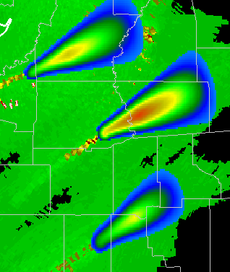
Pillar #1: Grid-Based Probabilistic Threats
Sub-Warning
Alert for High Wind
Eliminate binary warn/don’t warn decision for forecasters!
Forecast the threat probability.
Legacy products result from pre-determined thresholds.
User-specified thresholds.
Hospitals, etc.
Better information flow!
“Byproduct”
Tornado Warning
Courtesy G. Stumpf

Slide 18
Pillar #1: Grid-Based Probabilistic Threats
Sub-Warning
Alert for High Wind
Weather enterprise should be receptive.
Huge value-adding opportunities.
A major paradigm shift for ops!!
Training
New data manipulation tools.
“Byproduct”
Tornado Warning
Courtesy G. Stumpf

Slide 19
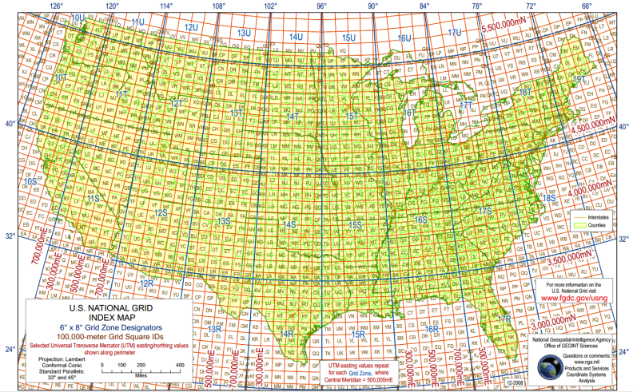
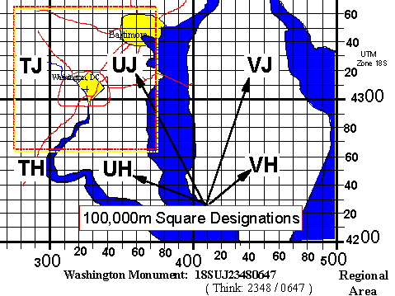
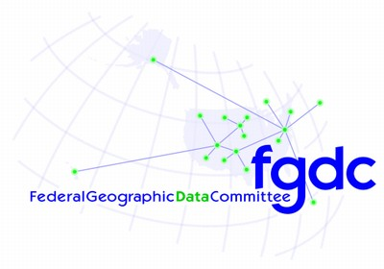
Pillar #1: Grid-Based Probabilistic Threats
“Severe on The Grid”
Transition from storm-based (polygon) warnings to threats conveyed on a pre-defined, sub-dividable, universal grid.
U.S. National Grid?
Down to house level.
Existing and in use (e.g., FEMA)
Others?

Slide 20
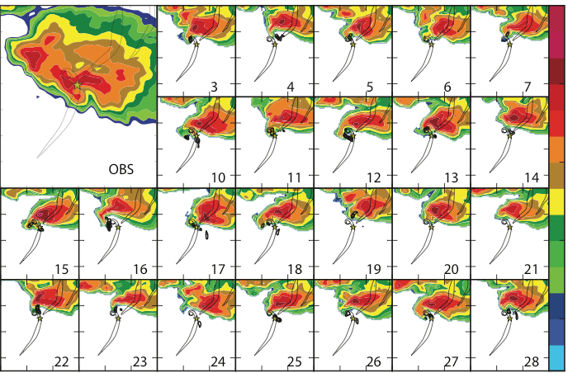
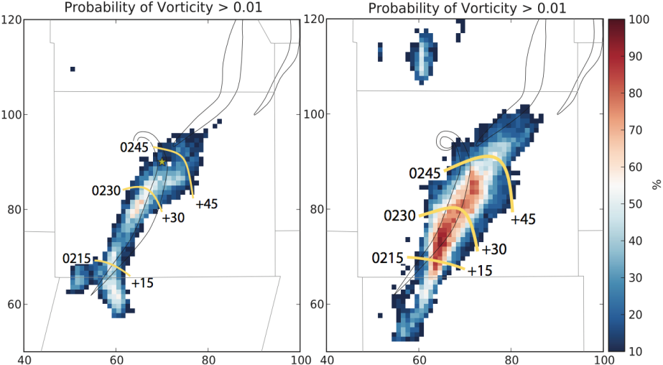
Pillar #2: Obs & Guidance
Warn on Forecast
NWP for storm-scale processes.
Probabilistic output that enables FACETs.

Slide 21
Pillar #2: Obs & Guidance
Multi-Year Reanalysis of Remotely-Sensed Storms (MYRORSS).
Statistical output of climatological storm-scale “behavior.”

Slide 22
Pillar #2: Obs & Guidance
Synoptic Scale
Storm Scale
GFS, NAM, RAP, etc.
MOS
Forecaster makes decision.
Warn on Forecast
Multi-Year Reanalysis of Remotely-Sensed Storms (MYRORSS).
Forecaster makes decision.
Key Point: Forecaster still over the grids!!
Aided by “Recommenders.”

Slide 23
Pillar #2: Obs & Guidance
EMC Models
3DVAR, WRF
SPC
WoF
Update Grids
Radar
Verification
WoF
3DVAR, WRF
WFO
Radar
Update Grids
MYRORSS
Verification
Next-Generation Integrated
Hazardous Weather Ops
Output

Slide 24
Pillar #3: Threat Grid Tools
WarnGen for threat grids.
GSD’s “Hazard Services” app is headed in this direction.
Need to strengthen connections between tool development and warning science R&D.
Are there tools for storm-specific threats (e.g., supercell widget to simultaneously populate/adjust hail, wind and tornado threat grids)?

Slide 25
Pillar #4: Useful Output
Watches & warnings, yes.
Other means of (grid-derived) impacts which include specific…
Location(s)
Time(s)
Phenomena
Urgency
Confidence, etc.
All support DSS.
Hail Damage
Trees Down
>EF3 Tornado
Lightning

Slide 26
Pillar #4: Useful Output
Grid-Based threat forecasting permits massive opportunities…
For example, impacts can be pre-decided.
Forecast the weather threat and then a GIS-based, “impact translator tool” can communicate the site-specific impact.
Forecast: “Wind gusts to 70 mph”
Impact: “Numerous trees and branches will fall. Roofing material will be peeled back. Mobile homes can be rolled.”
Gives more useful, actionable, recipient-specific information.

Slide 27
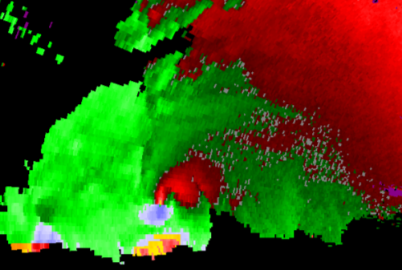
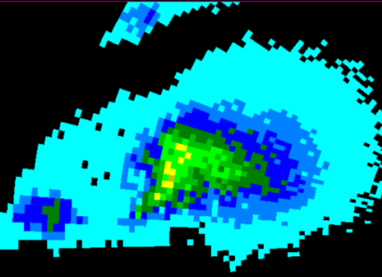
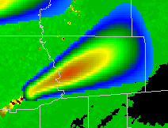
Pillar #4: Useful Output
GIS layers
Hail Damage
Trees Down
>EF3 Tornado
Lightning
Wind Grid
Hail Grid
Tornado Grid
Impact Grid

Slide 28
Pillar #4: Useful Output
Until
6:45 p.m.
Last Update
6:15 p.m.
Until
5:30 p.m.
Last Update
5:00 p.m.
High
Act Now!
Act Now!
Med
Low
Phone App Example

Slide 29
Pillars #4: Useful Output
Must-Haves…
Relevance to the recipient.
Am I impacted?
How does it compare to other events I've witnessed?
Urgency
When will I be affected?
Severity
How bad will it be?
Certainty
How sure are you?
Specificity
Is it really me?
Direction
What should I do?
Social Science
Needed Here!!

Slide 30
Pillar #5: Effective Response
Social Science Integration
“Look at the desired response and work our way backwards from there.” - Russ Schneider
The Impact
Preparation
Awareness
Response
Education
Response
Public
Method
Decision
Tools
Output
Output
Forecaster

Slide 31
Preparation
Awareness
Response
Education
Response
Public
The Impact
Method
Decision
Tools
Output
Output
Forecaster
Notes:
The warning process needs to be viewed in a holistic sense, with (at least) two distinct tracks: The public track and the meteorologists’ track (although there are other tracks for EMs, media, private sector, etc.). There are key basic steps in each track that must be employed for effective public response. It all starts with the Impact or Trigger (or Causation). With this more complete view of the warning system, where does/should social science fit in?

Slide 32
Pillar #5: Effective Response
Matching threat to vulnerability
Weather Vulnerability Score
Analogous to Credit Score and Carbon Footprint.
Statistically-derived index based on lifestyle, socioeconomics, residence, preparedness, awareness, etc.)
Craft hazard message to match WVS.
“If your WVS Flood Score is below 600, this flood will affect you.”
Dynamically-tailored threat information (D-THIN) apps.

Slide 33
Pillar #6: Verification
“Treat forecasts and observations on the same coordinate system: A geospatial grid.” (Brooks, Stumpf)
New metrics possible…
False alarm time.
False alarm area.
Site-specific lead time.
Site-specific end time.
FALSE
HIT
MISS
CORRECT
NULL
Resolution: 1 km² × 1 min

Slide 34
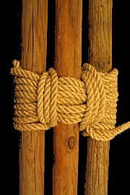
FACETs Paradigm
Six Pillars of the Paradigm
Grid-Based Probabilistic Threats
Storm-Scale Guidance
Threat Grid Tools
Useful Output
Effective Response
Verification
Strengthen the pillars by integrating physical & social sciences throughout.

Slide 35
The Simple View
Response
Public
Mutual
Frustration
Output
Social
Scientist
Forecaster
Notes:
The focus of warning effectiveness is usually on the interface between a forecaster’s output (warning) and the public response (or lack thereof). To resolve this, social scientists are asked after the fact to help diagnose and fix “the problem.” The result of this afterthought approach is mutual frustration between physical and social scientists.

Slide 36
Preparation
Awareness
Response
Education
Response
Public
The Impact
Q: Where do/should social sciences apply?
Method
Decision
Tools
Output
Output
Forecaster
Notes:
The warning process needs to be viewed in a holistic sense, with (at least) two distinct tracks: The public track and the meteorologists’ track (although there are other tracks for EMs, media, private sector, etc.). There are key basic steps in each track that must be employed for effective public response. It all starts with the Impact or Trigger (or Causation). With this more complete view of the warning system, where does/should social science fit in?

Slide 37
A: Everywhere…
Preparation
Awareness
Response
Education
Public
The Impact
= Opportunities for Investigation
Detect/Predict
Decision
Tools
Output
Forecaster
Notes:
Everywhere. There are abundant opportunities for research questions at each step of the system and the interface between each step.

Slide 38
Psychology
Sociology
Psychology
Sociology
Economics
Anthropology
Law
Preparation
Awareness
Response
Education
Public
Economics
Economics
Psychology
Communication
Anthropology
Political
Science
Cultural
Studies
Public
Policy
The Impact
Human
Geography
Cultural
Studies
Linguistics
= Opportunities for Investigation
Communication
Anthropology
Psychology
Human
Factors
Human
Factors
Psychology
Human
Factors
Human
Factors
Political
Science
Linguistics
Method
Decision
Tools
Output
Forecaster
Notes:
And it’s not just “social sciences” that are applied, it must be specific and situation-dependent social science. The types of social sciences shown are just examples. We (at the NWC) have begun exploring the most appropriate science(s) for each step and interface. By defining these opportunities, we’ll avoid the common trap for meteorologists…

Slide 39
Freaked Out Yet?
The future lies in the primordial soup.
FACETs is intended to organize and guide the evolution of this diverse pool of activities and opportunities.
WRN seeking this.
Paths for success: HWT, PG, Pilot Projects.
FACETs cannot work without NWS, OAR, social science and partners (EMs, private sector, media) in lock step.

Slide 40
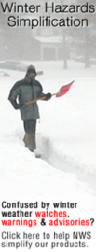
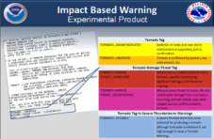
FACETs Going Forward…
Grid-Based Probabilistic Threats
Obs & Guidance
Threat Grid Tools
Useful Output
Effective Response
Verification
Education
Preparedness
Awareness
Threat & Vulnerability Matching
Grid-based, improved metrics.
Hazardous Weather Testbed “Development & Polishing”
Integrated Social Science
Mid-South Warning
Improvement Project

Slide 41
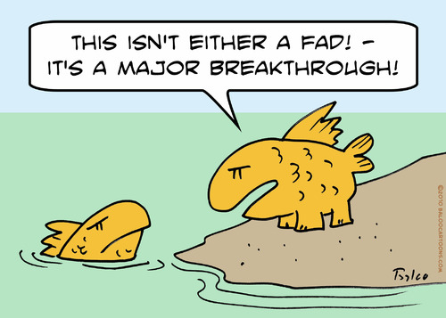
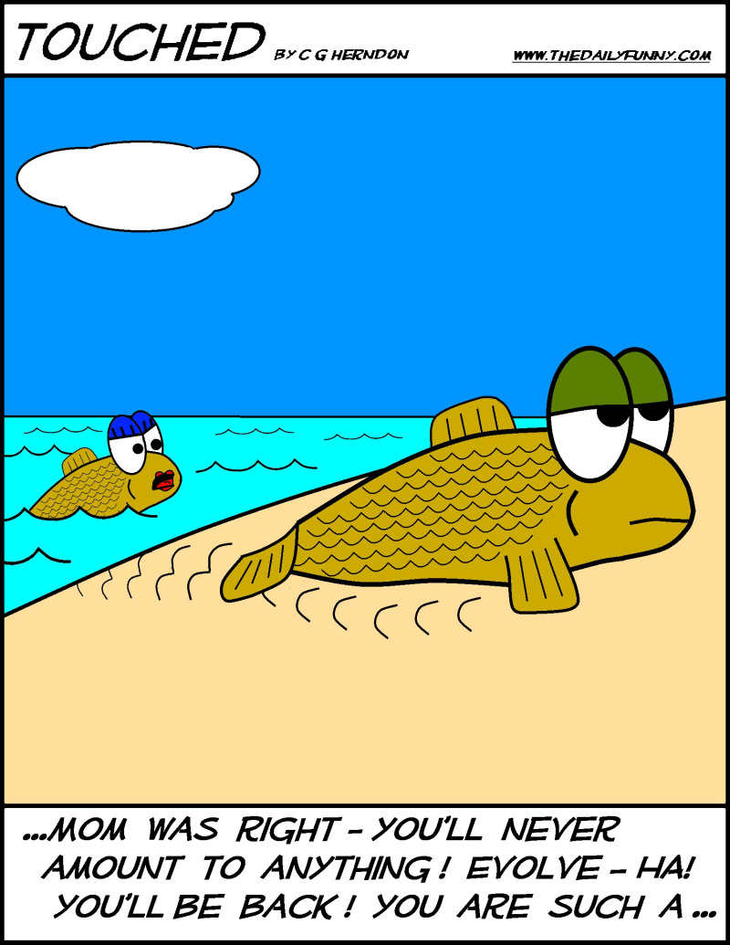
Your Questions?
Lans P. Rothfusz
lans.rothfusz@noaa.gov
678-665-7049

