Slide 1
Satellite Air Quality Proving Ground
S. Kondragunta, NESDIS/STAR
R. Hoff, UMBC
A. Huff, PSU

Slide 2
Summary of Recent Activities
Presentation at the OCONUS PG meeting in Alaska
Demonstrated VIIRS capabilities to capture fires and smoke plumes
VIIRS OCONUS aerosol imagery from DB data deployed (http://www.star.nesdis.noaa.gov/smcd/spb/aq/)
Porting the WRF-CMAQ model to STAR computers to prepare for the September 2013 experiment
First draft of GOES-R AQPG manuscript completed and being reviewed by co-authors

Slide 3
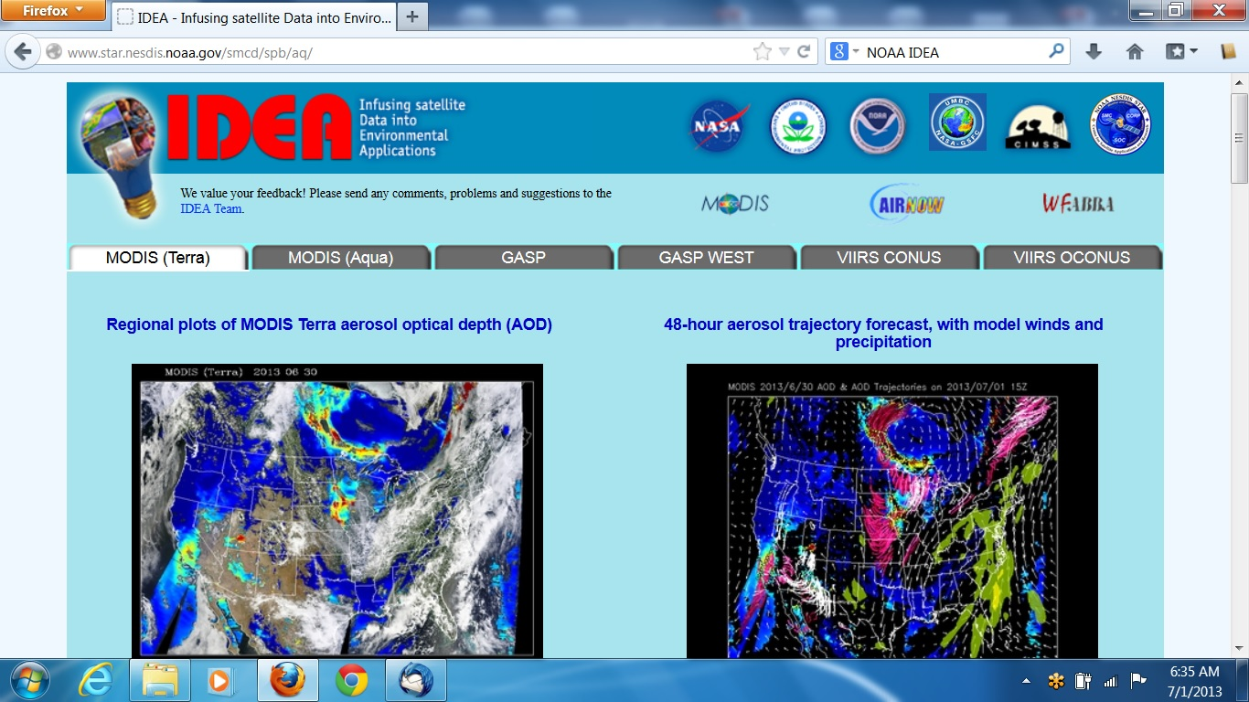

Slide 4
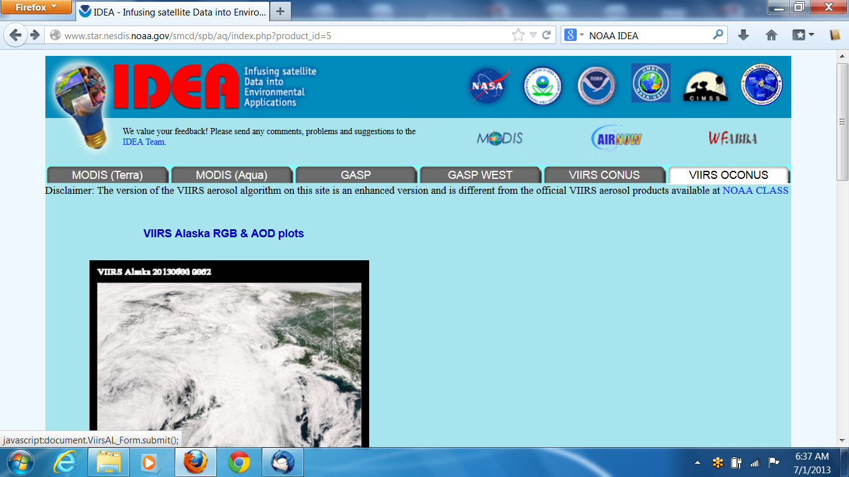
Click on this image

Slide 5
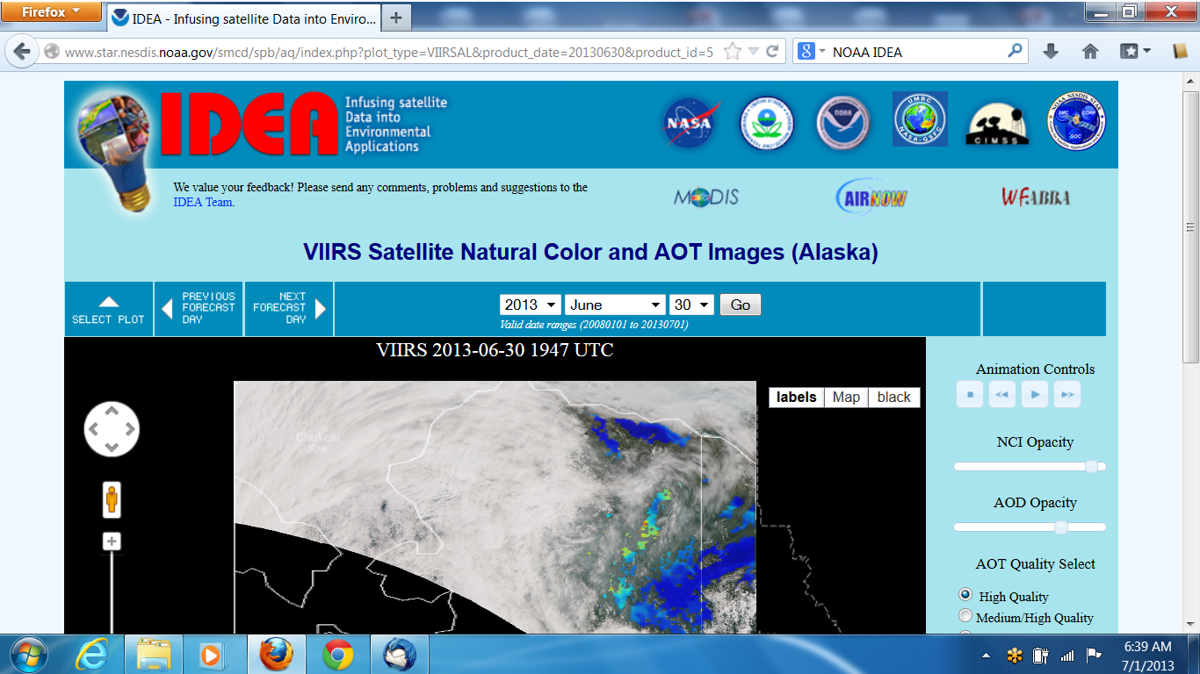
Control tabs for different QFs, toggle fire hot spots, toggle county lines

Slide 6
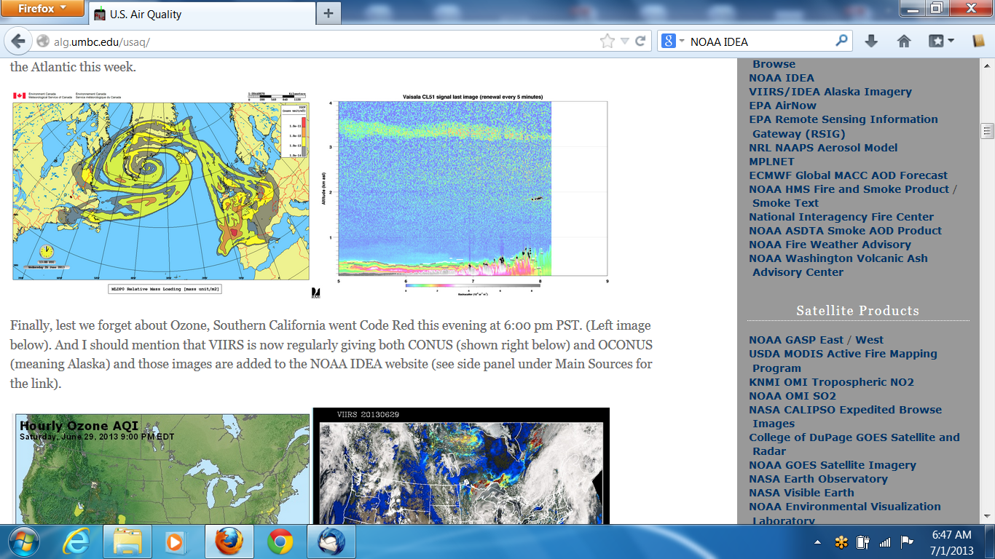
http://alg.umbc.edu/usaq
Over million hits per year !!!

